Slide 1
Column Writing
Sports Writing

Slide 2
What is a Sports Column?
By definition, a sports column is a story based upon the writer’s opinion.
  This makes sports columns distinctly different from any other type of story.
Good columns will pick a side:
  For or Against
  Good or Bad
  Right or Wrong
  Strong or Weak

Slide 3
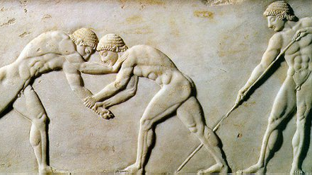
Sports Columns
Typically, the best-read article in a newspaper or magazine.
Usually the highest-paid writers on staff.
The oldest style of sports writing.
Columns are entertaining in nature.

Slide 4






Famous Columnists

Slide 5
Sports Columnists
Sports columnists essentially fall into three basic groups when it comes to their styles or approaches to column writing:
  The homer
  The critic
  The teacher

Slide 6

The Homer
Always thinks their team is the best.
They overlook flaws or mistakes, make excuses for losses or problems (which are usually provided by the coach), and over-glorify every victory.
Very few columnists would admit to being a homer.
  Pretty much every columnist is guilty of this at some point of their career.
A good columnist makes sure sure there is a good reason to salute someone or some team.
Most ”homers” are found in community papers, writing about high school sports.

Slide 7

The Critic
A sports critic’s primary purpose is to judge an event, player, team or issue.
Critics are like movie reviewers: they give thumbs-up or thumbs-down opinions on current events or issues in the sports world.
Most successful critics are adept at using humor.
Critics most often target athletes, coaches, owners, league officials or other aspects of the world they interpret as unjust.

Slide 8
The Teacher
The best sports columnists float between the extremes of the homer and the critic.
  These are the teachers.
They utilize a wide array of tools, ranging from the harshest sarcasm to the sweetest praise, as a means of teaching a lesson through their interpretations of the sporting events they witness.
The teaching columnist’s objective is to make a point and to show readers why the columnist's opinions about the meaning of an event are justified.

Slide 9
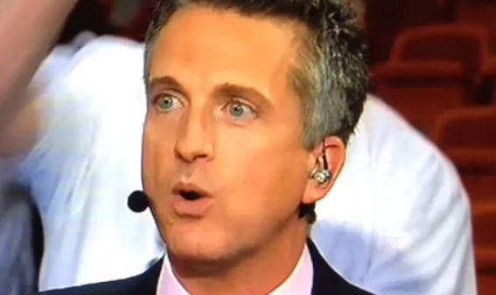
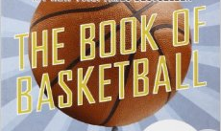
The Teacher
“Flipping channels in the wee hours last week, I stumbled across MSG's replay of a Jazz-Knicks game just in time to hear the announcer say, "And our score at the half: Jazz 31, Knicks 25." I kept watching long enough to see Jerry Sloan sitting on the bench, staring vacantly onto the court as Carlos Arroyo and Jarron Collins ran a pick-and-no-roll. Either he was day-dreaming about Stockton and Malone, or he was making plans to hang himself in the locker room after the game. Maybe it was a little of both.”

Slide 10
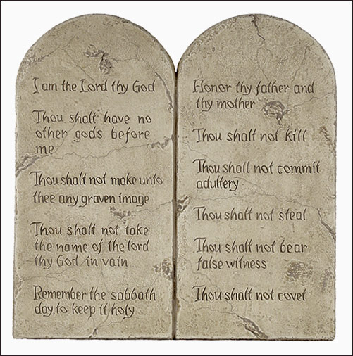
Eight Commandments of Sports Columns
Have a Juicy Topic
Have a Point
Be about Something of Interest to the Readers
Be Written at the Right Time
Address Issues
Have a Human Element
Always Be Well Reported
Clearly Take a Stand on the Issue

Slide 11
1. Have a Juicy Topic
Always be on the lookout for a juicy topic.
What are the ideas that interest you as the writer?
What are the questions that come to your mind after a game or interview?
“Do I have a strong opinion about this person/team/issue?”

Slide 12
2. Have a Point
Figure out what your point will be.
There’s nothing harder in sports writing than trying to write a column when you really don’t know what it is you’re trying to say.
Talk about the issue/person/team with colleagues first.
  Can you state your point in conversation?
  Do people understand your point/perspective, even if they disagree?
  If they offer a different opinion, does that change how you feel about the issue?

Slide 13
3. Be about Something of Interest to the Readers
Choose a topic that concerns your readers
Columns should be relevant to your audience.
  Demographics, audience interest
  Cover events, talk with fans
Keep columns within the range of what you routinely report on whenever possible.
  You absolutely need to know what you are talking about.

Slide 14
4. Be Written at the Right Time
Timeliness-
  Certain issues have greater importance during particular seasons of the year.
  Columns have the greatest impact when they are connected to a recent or soon-to-happen event.
Often packaged with other stories.

Slide 15
5. Address Issues
Make your column’s topic issue-oriented
  An issue that is important to your readers.
Can be a broad topic
  “The importance of choosing right from wrong in sports.”
Can be a very specific topic
  “The local high school needs a new gym.”
Be wary of turning your columns into a feature story.

Slide 16
6. Have a Human Element
Placing a face and a name with your readers will make your story easier to understand and more relatable.

Slide 17
7. Always Be Well Reported
Reporting backs up your opinion.
For your opinion to be credible, your audience must view you as a trustworthy, accurate, informed journalist.
Good reporting is the basis of a good column.
  Interview people who have first-hand knowledge of the column’s topic.
  Talk with people who agree and disagree with you.
    Why do they feel this way?
    What has led them to form this opinion?
  By talking with people on both sides of the issue, you will learn more about the issue.

Slide 18
8. Clearly Take a Stand on the Issue
Take a stand!
Make it clear what you believe.
  Never make readers guess at the point of a sports column.
It is better to make people mad than to leave no impression at all.

Slide 19
Bob Ryan on Column Writing
“A columnist really has to have something extra to bring to the table. You’ve got to have historical perspective, a frame of reference. You’ve got to have at least one sport, maybe two, where you really are an encyclopedia. I’ve got two. I don’t make any claims about hockey and football, but I certainly will roll up my intellectual sleeves and say, ’Let’s go, baby, I’ll duke it out with you on baseball and basketball right here and now.’ ”

Slide 20
Examples of Great Sports Columns
The Life of Reilly – Rick Reilly
Steve Rushin
Bill Simmons

