Slide 1
Intro to Editing

Slide 2
Copy Editing
Working with writers
Editing for context
Voices and sources
Editing for structure
Proofing
Corrections

Slide 3
Working with writers
Editing is individual,
but it’s not subjective.
Editing is not personal. You are editing the copy, not the person.
Writers may have an easier time saying out loud what they mean.
Engage the writer in the editing process.
It’s usually easier to do a SECOND READ with the reporter at hand.

Slide 4
Editing for context
Context vs. Content
Why this story, and why now?
Who or what benefits?
Who or what is harmed?
Is it factual but still misleading?
Are there any holes?
Does it answer: who, what, where, when, how, how much, why and why care?
Is there enough background?
Does this story say anything? Can you write a headline without re-reading three times?

Slide 5
Voices and sources
Same people quoted issue after issue?
Misleading “people on the street” polls or opinion:
  Is community or student population represented?
  Are these convenient and friendly voices?
More voices needed for dimension and/or fairness?
Is topic placed in context by including information from an outside or unbiased observer? Third-person source.

Slide 6
Voices and sources
Is there “another side” to the story or to the contentions of the main sources?
Is that other side, or sides, presented and is it given appropriate weight?
When an explicit or implicit accusation is raised, does the target have an opportunity to respond?

Slide 7
Voices and sources
Are racial, sexual, religious or ethnic references relevant? Are they applied equally?
Are there too many quotes? Should they be paraphrased?
Is the sexy quote really relevant?
Do the quotes have their own agenda? Are they making fun of subjects, or unnecessarily putting them in a bad light?
Are quotes from email? Do they read that way?

Slide 8
Editing for structure
Lead
Rest of the story
Tone and style
Details

Slide 9
Lead
Is the beginning inviting?
It’s not news that meetings or events were held.
Does inviting intro fit point of story?
If lead is anecdotal, et al., is there a follow-up graph?
Is first paragraph easy to understand? If a hard-news story, could you write a headline based on lead?
Too much information in the first sentence or graph?
Doubts about the lead? Hunt for a “buried” one.

Slide 10
The rest of the story
Is information where readers want to find it, or are important details left to the end?
Too long? If you were a fellow student, teacher or administrator, how much would you read?
Does every paragraph contribute? Is too much information being included, either out of fear or enthusiasm?
Does the ending fit the beginning?

Slide 11
Tone and style
Be short, familiar and specific.
An attempt to sound intellectual by being wordy or using big words?
Too much jargon or insider terms?
Does the tone fit the subject matter? Is the tone consistent?

Slide 12
Details
Grammar is crucial; style can be adapted.
Too many adjectives because the nouns and verbs aren’t more more specific?
Is background information inserted in the right sentences?

Slide 13
Proof-reading
Double-check proper names and claims of distinction (first, best, oldest, tallest).
Does the math work? Is it “millions” or “billions”? Percentages figured correctly?
Look for typos early and often: misspellings, missing or duplicated words.
If you see something, mark it immediately. You may not remember it later.

Slide 14
Online Corrections
Correct online errors immediately.
“An earlier version of this article misspelled the surname of Lamar’s vice principal.”
If an editor inserted the error, try this: “Because of an editing error, an earlier version of this article misspelled the surname of Lamar’s vice principal.”
Online corrections don’t need to repeat the error.
Notes:
How many of you have correction policies?

Slide 15

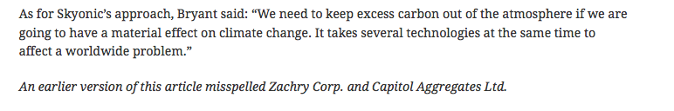

Slide 16
Print Corrections
Printed errors should be corrected by next publication, with the mistake repeated.
“In the last issue, the page 4 article about temporary classrooms misspelled the surname of Lamar’s vice principal. His name is Bobby Reynolds, not Reynoso.”
Only correct typos that cause factual errors.

Slide 17
Editing Your Own Work
First review headlines, cut lines, teasers and any numbers that stand out.
Step away from your work, then come back to it.
Try to read your piece objectively.
  Read it aloud.
    This forces you to process it differently from the way you processed it in your head.
  Change the font.
  Blow up the font.
    This helps you physically slow down when you read it.
Get someone, anyone, to read your article.

Slide 18
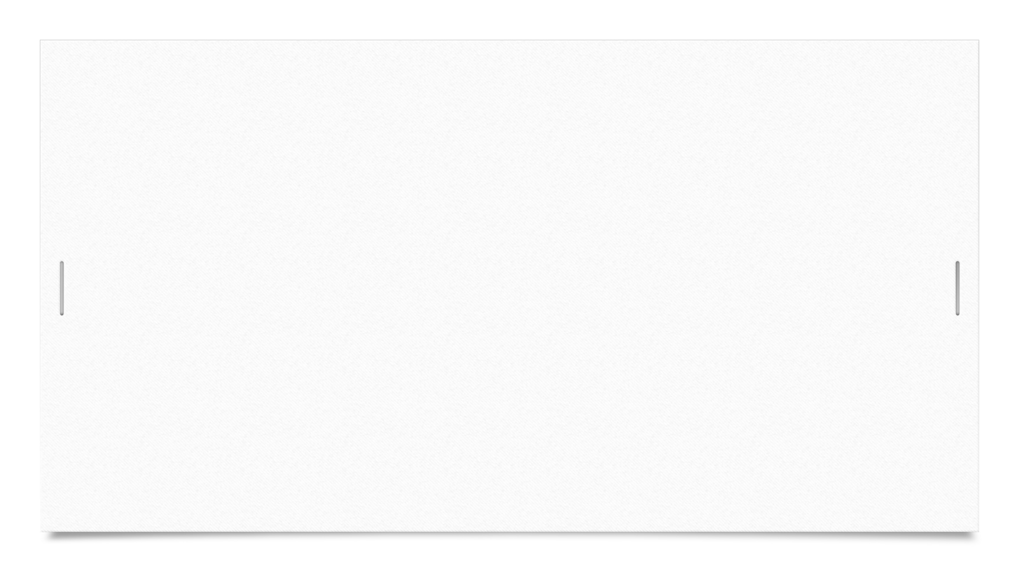
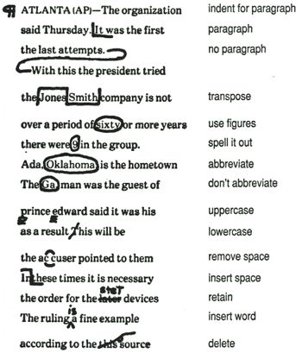

Copy Editing Marks
AP Style Editing
See back of AP Stylebook or handout

Slide 19
What to look for
Easy to tell that he story was an interview.
  Focus more on the story inside the interview.
AP style punctuation
Keep paragraphs short
  This isn’t an English paper
Typos
AP style numbers
  Dates and ages

Slide 20
Editing Review
Remember, you are editing the piece, not the person.
  Don’t be shy or scared to offer suggestions and make corrections.
There is something wrong with every article.
  Do not just say, “This looks great!”
Talk to each other during the editing process.
  Ask clarifying questions.
  Engage the writer in the process.

Slide 21
Editing Review
4. Edit for AP Style
  Edit grammar, punctuation, spelling.
  Make sure you are using AP style rules.
  AP style ages (three-year-old vs. 3-year old, etc.)
  Oxford comma
Edit Content
  Passive voice vs. Active voice
  Does the story flow?
  Are the paragraphs too long?
  Are quotes standing on their own or hidden in a paragraph?

