Slide 1

Résumés
Purdue OWL staff
Brought to you in cooperation with the Purdue Online Writing Lab
Notes:
Rationale: Welcome to “Résumés.” This presentation is designed to help students with their résumés (also spelled “resumes”).
Directions: Each slide is activated by a single mouse click, unless otherwise noted in bold at the bottom of each notes page.
Writers and Designers: Stacy Lolkus and Allen Brizee, 2007.
Design Contributor and Revising Author: Veronika Maliborska, 2014
Developed with resources courtesy of the Purdue University Writing Lab.

Slide 2
Agenda
Résumé Description
General Guidelines
Preliminary Research
Sections
Extra Tips
Notes:
This slide shows the contents of this PowerPoint presentation.

Slide 3
What is a Résumé?
A résumé is a personal summary of your professional history and qualifications
A résumé (also spelled “resume”) includes anything a person wants to express about:
    Career goals
    Education
    Experience
    Activities
    Honors
Notes:
Definition of a resume

Slide 4
General Guidelines
Length: Limit résumé to one typed page
***NEVER GO OVER ONE PAGE***
Font: Arial, Times New Roman, Calibri
  Between 10-12 point font
Paper: Use 8 1/2” x 11” 20 lb paper
  White, light cream, or gray
Notes:
-An employer only has about 10-15 seconds to look at your resume! Sometimes a good exercise is to have someone else study your resume for 10 seconds and then repeat back what he or she remembers.
-Be as concise as possible in stating information in each section of your resume. If you have had a couple jobs or are a grad student, then your resume can be two pages, but until then, keep it at one
-No funky colors

Slide 5
Preliminary Research
Find out:
  General job information
  Desired qualifications and skills
  Key values and words
Look on:
  Company website
  Job advertisement
  Any publications about the company (magazine articles, etc.)
Notes:
Key Concept: Doing preliminary research helps a writer to tailor their resume for the job they are applying for, and writers should do as much preliminary research as possible about the companies to which they are writing and the jobs for which they are applying. Applicants should conduct research whenever possible, especially for top choices.
Job applicants should look at the vocabulary of job ads, especially the vocabulary of the ad to which they are responding. There are many job bank sites on the World Wide Web and browsing through some of the postings at these sites will help applicants understand how to discuss their experiences and skills on their resume.

Slide 6
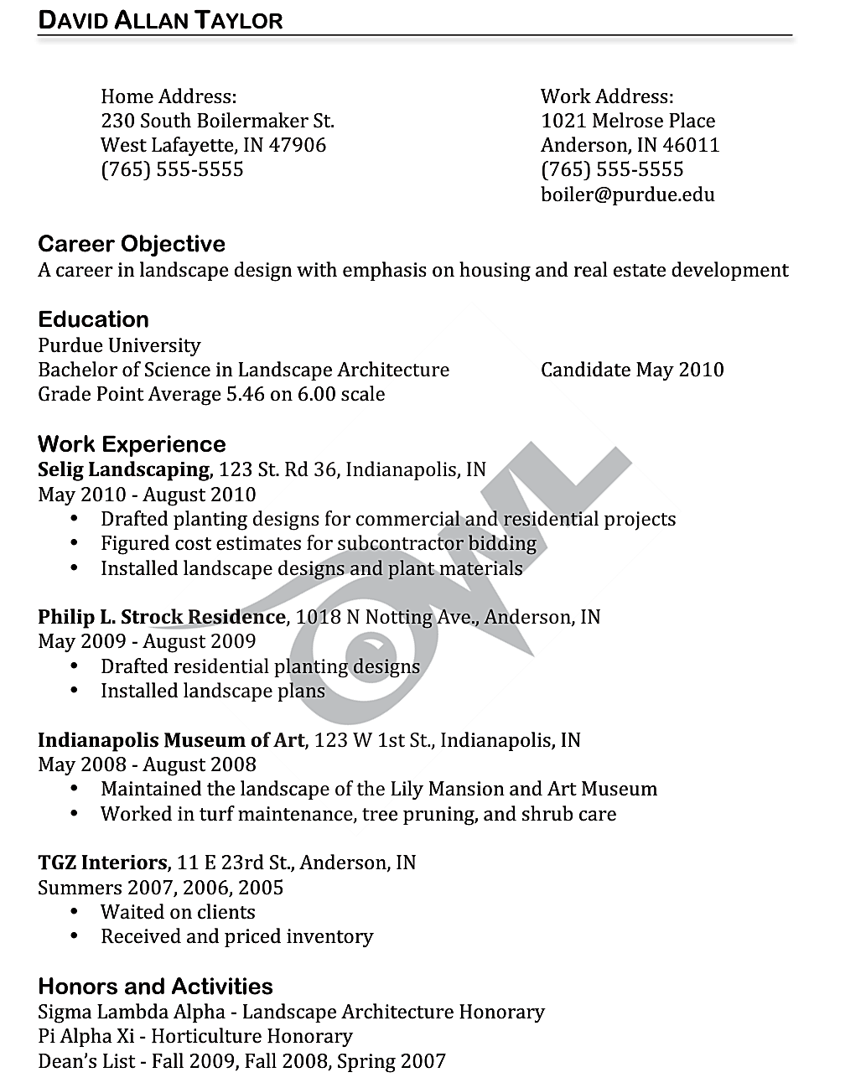
Sections
Contact Information
Objective
Education
Experience
Honors and Activities
Notes:
The sample resume can be found here: https://owl.english.purdue.edu/owl/resource/927/03/

Slide 7
Contact Information
Include:
Name
Permanent and/or campus addresses
Permanent and/or campus phone numbers
Email address
Notes:
Key Concept: It is very important that employers be able to reach the applicant at the address(es) and phone number(s) listed in the heading. If applicants are going through a time of transition and will be moving, they should make it clear on the resume where they will be on any given day. During transitional times, it is a good idea to include a permanent address where someone will always know the applicant’s whereabouts and can locate them.
-Not always necessary to have both addresses, especially if you won’t be getting the mail there for a long time or have no way of finding out if you have received anything
-Don’t use a nickname
-Email is especially important because many employers contact students through email
-Remember that any number you give out has the possibility of being called, change voice mails to be more professional or warn roommates of possible calls

Slide 8
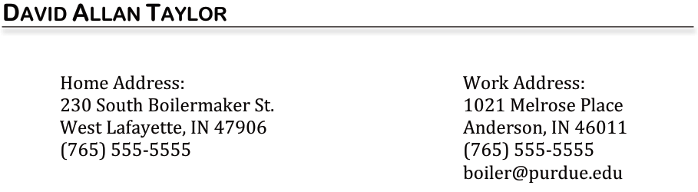
Contact Information
Notes:
Key Concept: This is just one example of a contact information section that is very common for Management students. The contact information section can be different depending what the student wants to put on it.
The example above has both a campus address and a permanent address. The student must decide if he or she wants to include both or just one address.

Slide 9

Objective Statements
There are two approaches to objective statements:
Brief and to the point
Detailed description of desired position and qualifications
You must decide which approach is best for you
An example of a “brief and to the point” approach”:
Notes:
Key Concept: The facilitator should emphasize that the objective statement is sometimes considered the hardest part of the resume. Different people have different ideas about what objective statement approach is appropriate to use. Some recruiters say that objective statements are useless and if the student has an objective statement at all, it should be brief and to the point.
Other recruiters argue that they just scan the objective statement when they are initially considering applicants. If it doesn’t stand out, a student could be rejected even before the activities and work experience are taken into account. If this is the case, objective statements should be longer and more descriptive.
You must decide which one is most appropriate!

Slide 10

Objective Statements
Notes:
Key Concept: The facilitator should emphasize that the objective statement is sometimes considered the hardest part of the resume. Different people have different ideas about what objective statement approach is appropriate to use. Some recruiters say that objective statements are useless and if the student has an objective statement at all, it should be brief and to the point.
Other recruiters argue that they just scan the objective statement when they are initially considering applicants. If it doesn’t stand out, a student could be rejected even before the activities and work experience are taken into account. If this is the case, objective statements should be longer and more descriptive.
You must decide which one is most appropriate!

Slide 11

Objective Statements
There are two approaches to objective statements:
Brief and to the point
Detailed description of desired position and qualifications
You must decide which approach is best for you
An example of a “brief and to the point” approach”:
Notes:
Key Concept: The facilitator should emphasize that the objective statement is sometimes considered the hardest part of the resume. Different people have different ideas about what objective statement approach is appropriate to use. Some recruiters say that objective statements are useless and if the student has an objective statement at all, it should be brief and to the point.
Other recruiters argue that they just scan the objective statement when they are initially considering applicants. If it doesn’t stand out, a student could be rejected even before the activities and work experience are taken into account. If this is the case, objective statements should be longer and more descriptive.
You must decide which one is most appropriate!

Slide 12
Education
Begin with the highest level of educational achievement, include:
University attended
Major/Minors
GPA (if 3.0 or above)
Date of program completion information
Notes:
Key Concept: The education section should be first on the resume after the objective statement, because usually employers are most concerned with this section. It should contain the university the student attends along with the student’s major, minors, expected date of graduation, and relevant educational classes the student has taken to make him or her valuable to the position.
This section can also contain computer skills, language skills, courses or projects taken. If the student decides to add computer skills, Microsoft Office is not needed since most college students know how to use Microsoft Office.
The facilitator should emphasize that the tutor make sure the student has which campus the student attends, and also the scale of the GPA. A 3.0 out of 5.0 looks a lot worse than a 3.0 on a 4.0 scale!
A lot of students have questions on how low is too low for GPAs. Usually if a student has below a 3.0, it shouldn’t be included. If the student’s major GPA is higher than the overall GPA, that can be used instead. The student can carry out the GPA to two decimal points (3.55), but that is the maximum.

Slide 13

Education

Slide 14
Work Experience
Include positions you have held which are related, in some way, to the job you are seeking
NOTE: Can be both paid and volunteer positions
Be creative with this section of your résumé by describing and emphasizing your experiences in the most relevant way possible.
Notes:
The jobs that are included in the students’ resumes should support the jobs they are looking for. If a student is applying to a teaching job, he or she doesn’t need to include a serving job unless the student wants to emphasize certain skills that are valuable to teaching in the serving job.
If the student worked for a significant company or organization and would rather highlight the company than the position, the student can bold the company or put it before the job title.
Jobs should be listed in either reverse chronological order or in order of importance. Anytime anything quantitative can be included, the student should include the information so employers have a better way of measuring the student’s skills.

Slide 15

Work Experience
Notes:
Key Concept: This is an example of a very standard work experience section. The tutor should make sure that the student is including the position,location, dates, and a brief description of each job. Each description should be parallel, and each job should be set up the same as the previous job.

Slide 16
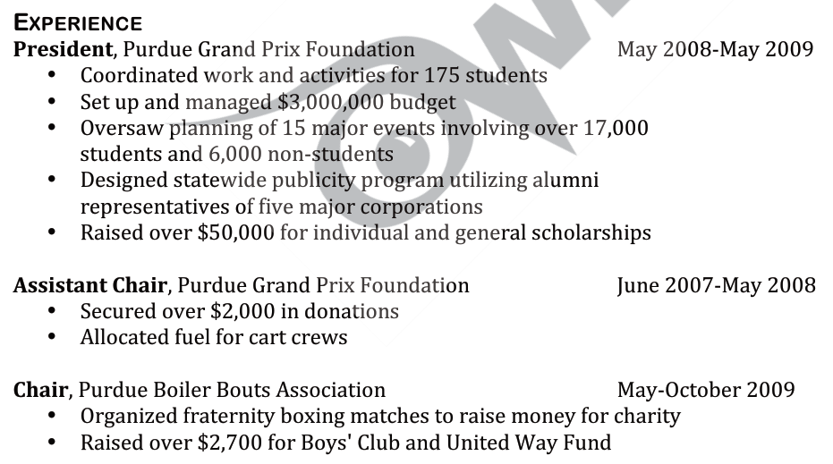
Experience
Notes:
Sample resume available here: https://owl.english.purdue.edu/owl/resource/927/04/
Key Concept: Although a lot of students usually just list their actual paid jobs in the work experience section, the tutor can also stress to the student that if he or she was involved in a significant club or activity, this can be included in the experience section. Instead of calling the section the traditional “Work Experience”, the student could call the section “Experience” and put the club or activity in so that it stands out more. For this example, the student is interested in a public relations position. He has done a lot of work with athletic promotions at Purdue, so he put this before the rest of his paying jobs. Notice that this student has also focused more on the actual places he worked for, rather than the positions.

Slide 17
Other Elements
Computer skills
Classify your skills in categories such as hardware, software, languages, and operating systems. List any professional certifications you have earned.
Military experience
If you are a veteran, describe your military service as if it were a job, citing dates, locations, positions, ranks, and tasks. List positive job-performance evaluations.
Language ability
List your proficiency, using terms such as beginner, intermediate, and advanced.
  Some applicants distinguish among reading, writing, and speaking abilities.
Don’t overstate your abilities.
Willingness to relocate
If you are willing to relocate, say so. Many organizations will find this flexibility attractive.

Slide 18
Action Verb List
Action phrases will help you avoid being too brief and understating your qualifications.
Example:
  ✗ Planned activities
  ✓ Planned arts and crafts activities for preschool aged children
Handout:
http://owl.english.purdue.edu/owl/resource/543/02/
Notes:
Key Concept: The facilitator should remind the tutors that if the students are having trouble thinking of words, there is an action verb list on OWL they can use to look up different verbs for the job descriptions.
http://owl.english.purdue.edu/owl/resource/543/02/
Key Concept: Using action phrases helps writers avoid being too brief and from understating their qualifications. Writers should try to look at their qualifications as a professional would and use concrete words to describe their experiences.
Example: Consider the example above. Is it more impressive to say “swept the floor and cleaned tables” or “created a positive and healthy atmosphere in the restaurant?”
Activity: The facilitator might relate several passively written or understated phrases and ask for ways to make the phrases stronger. Some examples of phrases that need to be rewritten are:
Before: Answered the phone and related messages
After: Took orders and verified their correctness with customers
Before: Planned activities
After: Planned arts and crafts activities for preschool aged children
Before: Made change
After: Handled large sums of money, balanced the cash drawer
Before: Talked to customers
After: Giving quality customer service while promoting the sale of products

Slide 19
Quantify Your Data
Always use specific and exact numbers when you can.
Example:
During my time as manager, the company experienced unprecedented growth.
During my time as manager, the company experience a 27% spike in sales.
Notes:
Key Concept: The facilitator should remind the tutors that if the students are having trouble thinking of words, there is an action verb list on OWL they can use to look up different verbs for the job descriptions.
http://owl.english.purdue.edu/owl/resource/543/02/
Key Concept: Using action phrases helps writers avoid being too brief and from understating their qualifications. Writers should try to look at their qualifications as a professional would and use concrete words to describe their experiences.
Example: Consider the example above. Is it more impressive to say “swept the floor and cleaned tables” or “created a positive and healthy atmosphere in the restaurant?”
Activity: The facilitator might relate several passively written or understated phrases and ask for ways to make the phrases stronger. Some examples of phrases that need to be rewritten are:
Before: Answered the phone and related messages
After: Took orders and verified their correctness with customers
Before: Planned activities
After: Planned arts and crafts activities for preschool aged children
Before: Made change
After: Handled large sums of money, balanced the cash drawer
Before: Talked to customers
After: Giving quality customer service while promoting the sale of products

Slide 20
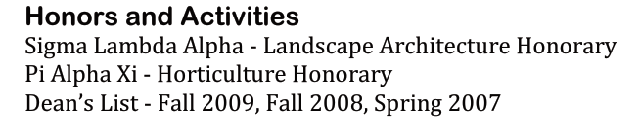
Activities, Honors, Volunteer Experience
Include relevant activities, honors, and volunteer experiences
Notes:
The rest of your resume should be set up however the you wants. Additional activities, clubs, awards, volunteer experience, can also be helpful if there is extra white space. The additional sections can be set up as shown or also more like the work experience section.
These extras should be something that you could either discuss with your prospective employer or have given you valuable experience or skills.

Slide 21
Extra Tips
Ultimate goal is to get an interview;
Use white space effectively;
Employer will only take about 30 seconds to glance at a résumé.
Structure the résumé according to the job.
Notes:
Key Concepts: The facilitator should be sure to stress to the student that the ultimate goal of a resume is to get an interview. A lot of times, students will try to cram too much on a resume. If the student wants to elaborate, he or she can do so in the interview. One way to get the student to understand the importance of keeping to the point is to remind the student that having too much information will take away from the rest of the resume.
Another way to get different sections of the resume to stand out is to allow enough white space between each section. If the resume is too crammed together, many employers won’t take the time to read it.
Activity: The facilitator can pass around example resumes or the students can trade their own resumes. The facilitator should not allow the students to look at the resumes until instructed. When the facilitator says, the students can look at the resume for just 10 seconds. After looking at the resume, they should write down what they remember and share with the rest of the group.

