Slide 1
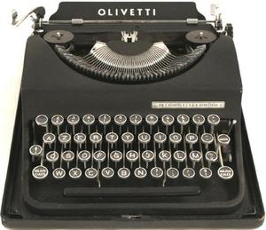
AP style and grammar
Essential tools for journalists

Slide 2
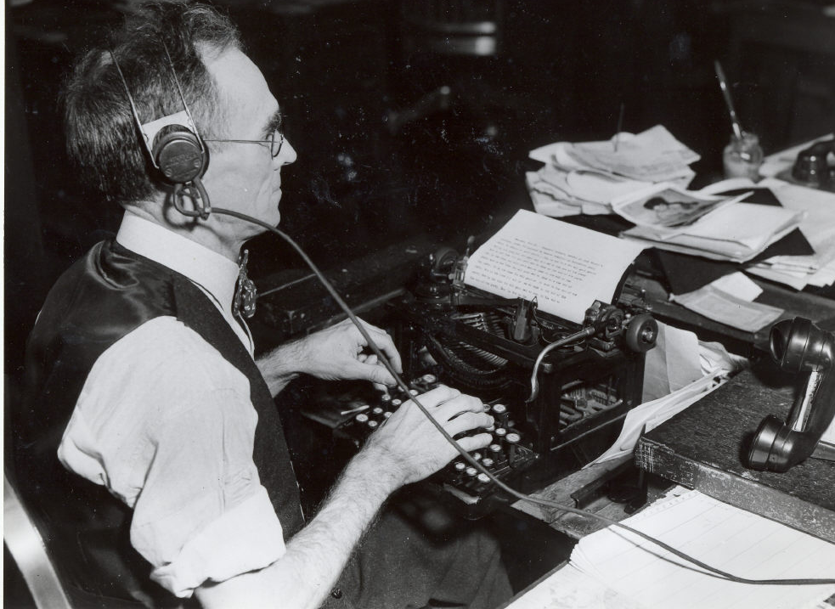

A lot has changed…

Slide 3
…but some things haven’t.
The essentials:
Writing and editing
Accuracy and fairness
Grammar and style

Slide 4
Grammar has always been around
(even if we don’t always “get” it)
… but what about style?

Slide 5
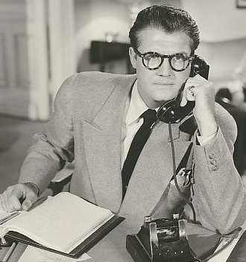
In 1953, journalists finally got some style.

Slide 6
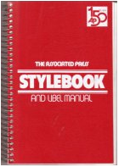
Meet the
Associated Press Stylebook.

Slide 7
What is AP style?
The “rulebook” for newswriting.
As AP says, its “part dictionary, part textbook, part encyclopedia.”

Slide 8
Can’t I just use google?
No.
And here’s why:
The AP Stylebook was created to give an accurate, consistent presentation of the printed word.

Slide 9
How many opportunities for inconsistent presentation can you find below?
At an E.U. summit yesterday, President George W. Bush spoke to twenty-seven leaders about United States policies in the Mideast.

Slide 10
Did you count six?
At an E.U. summit yesterday, President George W. Bush spoke to the twenty-seven leaders about United States policies in the Mideast.

Slide 11
Same paragraph, adjusted for AP style:
At a European Union summit Sunday, President Bush spoke to the 27 member states about U.S. policies in the Middle East.

Slide 12
Even if spelling variations are correct, they’re confusing:
Al-Qaida
Al-Qaeda
al-Qaida
Al qaida
al-Qaeda
Al Qaida

Slide 13
Avoid confusion by following a consistent style.
Al-Qaida
Al-Qaeda
al-Qaida (AP style)
Al qaida
al-Qaeda
Al Qaida

Slide 14
Why students need
AP Style:
Position: Internship
Company: Chicago Tribune
Requirements: “…you’ll also need to have a solid knowledge of AP style…”

Slide 15
Why students need
AP Style:
Position: Sports Reporter
Company: The Arizona Daily Sun
Job Status: Full-time
Requirements: “…the ideal candidate has a firm grasp of AP style…”

Slide 16
Why students need
AP Style:
Position: Web News Editor
Location: Detroit, Michigan
Job Status: Full-time
Requirements: “…must have knowledge of editing and AP Stylebook standards. A writing/editing test will be given…”

Slide 17
Students need to know:
What to look up.
How to find it.
Let’s take a tour…

Slide 18
What to look up: The basics
Proper nouns
Numbers
Time references
Directions and regions
Abbreviations/acronyms

Slide 19
Proper nouns
The stylebook tells you when and why to capitalize nouns.
The Democratic Party sponsored a rally outside Gov. O’Neill’s office.
But…
The party sponsored a rally outside the governor’s office.

Slide 20
Proper nouns
Some basic AP rules:
Capitalize nouns that constitute the unique identification for a specific person, place or thing. Examples:
John, Mary, America, Boston, England

Slide 21
Proper nouns
Some basic AP rules:
Capitalize common nouns such as party, river, street and west when they are an integral part of the full name for a person, place or thing. Examples:
Republican Party, Mississippi River, Fleet Street, West Virginia

Slide 22
Proper nouns
BUT:
Lowercase those common nouns when they stand alone in subsequent references:
the party, the river, the street, go west

Slide 23
Proper nouns
Other rules (and exceptions) are found throughout the stylebook, under entries such as:
  Brand names
  Historical periods
  Governmental bodies
  Nationalities and races
  Organizations
  Trademarks

Slide 24
What to look up: The Basics
Proper nouns
Numbers
Time references
Directions and regions
Abbreviations/acronyms

Slide 25
Numbers
The stylebook tells you when and why to use numerals or spell them out.
He invited two of his friends.
But…
He has a 2-year-old daughter.

Slide 26
Numbers
Some basic AP rules:
Spell out whole numbers below 10, and use figures for 10 and above. Example:
I’ll bring six cans of soda and
12 paper plates to the picnic.

Slide 27
Numbers
BUT:
With ages, always use figures for people and animals (but not inanimate objects). Examples:
The 5-year-old boy.
The 10-year-old girl.
The boy, 5, has a sister, 10.
My parents are in their 70s.

Slide 28
Numbers
Other rules (and exceptions) about numbers are found under entries such as:
  addresses
  dates
  dimensions
  percentages
  speeds
  times
  statistics

Slide 29
What to look up: The Basics
Proper nouns
Numbers
Time references
Directions and regions
Abbreviations/acronyms

Slide 30
Time references
The stylebook tells you how to present the time of day, the day of week, a calendar date, year or decade.
The New Year’s countdown begins at 11:59 p.m.
or
Crime rates spiked in the 1980s.

Slide 31
Time references
Some basic AP rules:
Use figures except for noon and midnight. Only use a colon to separate hours from minutes:
11 a.m. (not 11:00 a.m.)
But…
11:03 a.m.

Slide 32
Time references
Some basic AP rules:
Avoid such redundancies as:
7 a.m. Thursday morning
(AP style is 7 a.m. Thursday)

Slide 33
Time references
Some basic AP rules:
Do not abbreviate days of the week.
Use the day of the week (Monday, Tuesday, etc.) rather than using today, tomorrow or yesterday.

Slide 34
Time references
Some basic AP rules:
For a month with a specific date, abbreviate all but March, April, May, June, July. Example: Dec. 25, 1999.
For a month with a year, do not separate with commas: January 1972
For a month, day and year, set off the year with commas: Jan. 2, 1972.

Slide 35
Time references
Some basic AP rules:
When referring to a decade, show a plural by adding the letter s: the 1920s. (Note: no apostrophe before the s)
But …
Use an apostrophe to indicate numerals that are left out: the roaring ‘20s.

Slide 36
What to look up: The Basics
Proper nouns
Numbers
Time references
Directions and regions
Abbreviations/acronyms

Slide 37
Directions and regions
The stylebook tells you when to capitalize/lowercase or when to abbreviate/spell out the names of compass directions, regional designations and states.

Slide 38
Directions and regions
Some basic AP rules:
In general, lowercase north, south, northeast, etc., for compass direction.
Example: The storm headed east.
But …
Capitalize when they designate regions.
Example: The storm hit the Midwest and headed for the East Coast.

Slide 39
Directions and regions
Some basic AP rules:
Lowercase compass points when they describe a section of a state or city (eastern Idaho, northern Arizona)
But …
Capitalize when part of a proper name (West Virginia, North Korea)

Slide 40
Directions and regions
Some basic AP rules:
State names should be spelled out when they stand alone. (Montana)
But …
Abbreviate them in conjunction with a city, county or town. (Missoula, Mont.)
(Note: Do not use two-letter Postal Service abbreviations unless full mailing address)

Slide 41
Directions and regions
Exception to the rule:
Eight states are not abbreviated in text: Alaska, Hawaii, Idaho, Iowa, Maine, Ohio, Texas and Utah.
A tip for remembering the eight:
Two are the states not part of contiguous U.S.
The rest are states with five letters or fewer.

Slide 42
Directions and regions
State Abbreviations
Ala. | Neb.
Ariz. | Nev.
Ark. | N.H.
Calif. | N.J.
Colo. | N.M.
Conn. | N.Y.
Del. | N.C.
Fla. | N.D.
Ga. | Okla.
Ill. | Ore.
Ind. | Pa.
Kan. | R.I.
Ky. | S.C.
La. | S.D.
Md. | Tenn.
Mass. | Vt.
Mich. | Va.
Minn. | Wash.
Miss. | W.Va.
Mo. | Wis.
Mont. | Wyo.
You should always spell out Alaska, Hawaii,
Idaho, Iowa, Maine, Ohio, Texas, and Utah.
Abbreviate all other states.

Slide 43
What to look up: The Basics
Proper nouns
Numbers
Time references
Directions and regions
Abbreviations/acronyms

Slide 44
Abbreviations & acronyms
The stylebook tells you when it’s appropriate to abbreviate or use acronyms and how to do so correctly.
NASA (not N.A.S.A or written out)
No. 1 (not Number One or number 1)
John F. Kennedy Jr. (not Junior)

Slide 45
Abbreviations & acronyms
Some basic AP rules:
BEFORE a name: Abbreviate formal titles.
Dr. Joyce Brothers
Gov. Schwarzenegger
Rep. Newt Gingrich
the Rev. Al Sharpton
Sen. Harry Reid

Slide 46
Abbreviations & acronyms
Some basic AP rules:
AFTER a name: Abbreviate junior or senior. Abbreviate company, corporation, incorporated and limited. Examples:
Hank Williams Jr.
(Note: no comma before Jr.)
PepsiCo Inc.
Exxon Mobil Corp.

Slide 47
Abbreviations & acronyms
Some basic AP rules:
Don’t follow an organization’s full name with an acronym in parentheses. (NOTE: If the acronym wouldn’t be commonly known on second reference, don’t use it.)
National Rifle Association (NRA)
National Rifle Association
(use NRA on second reference in story).

Slide 48
Abbreviations & acronyms
Other rules are found throughout the stylebook, under entries such as:
  Company names
  Courtesy titles
  Military titles
  Religious titles
  Academic titles / Academic degrees
  Organizations and institutions
  Judge / Court names

Slide 49
The secret to mastering style
Don’t panic. Nobody is expected to memorize the whole stylebook.
(After all, it’s almost 500 pages long!)

Slide 50
The secret to mastering style
2. Master the basics. The most common rules and topical entries (like the ones in this presentation) will become familiar very quickly.

Slide 51
The secret to mastering style
3. Get in the habit. Train yourself to stop and look up any word(s) that could be presented in varying ways.
P.S. A lot of words fall under this category.

Slide 52
4 grammar topics to teach (and re-teach) journalism students
  Parts of speech
  Subject-verb agreement
  Pronoun case
  Plurals v. possessives

Slide 53
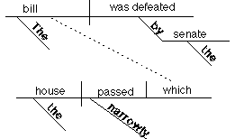
Parts of speech
Bring back memories?
(or nightmares?)

Slide 54
Parts of speech
Sentence-diagramming threats aside…
… the basics are worth revisiting.

Slide 55
Parts of speech
You probably know that a noun is a “person, place or thing,” but can you easily describe a preposition or conjunction? Can you explain the difference between adjectives and adverbs?

Slide 56
Parts of speech
Noun: A person, place or thing.
Verb: A word that describes an action or a state of being.
Pronoun: A noun “substitute.”
Adjective: Describes a noun.
Adverb: Describes a verb, adjective or another adverb.
Preposition: Works with nouns and pronouns to create phrases.
Conjunction: Links words, phrases and clauses.
Interjection: Gives emotion and outburst.

Slide 57
Parts of speech
Can you identify all eight parts of speech in the following sentence?
Armed guards chased him out of the bank, and they repeatedly yelled “Stop!”

Slide 58
Parts of speech
Armed guards chased him
adj. n. v. pron.
out of the bank, and they
prep. conj.
repeatedly yelled “Stop!”
adv. interj.

Slide 59
4 grammar topics to teach (and re-teach) journalism students
  Parts of speech
  Subject-verb agreement
  Pronoun case
  Plurals v. possessives

Slide 60
Subject-verb agreement
Agreement errors are everywhere. Why? They sound right.
The school of dolphins were visible from the shore.

Slide 61
Subject-verb agreement
“Disagreement” occurs when one is singular and the other is plural.
The school of dolphins were visible from the shore.
(“school” is the singular subject,
so the correct verb should be was)

Slide 62
Subject-verb agreement
Common problem: Collective nouns
family, group, team, band, jury, committee, class, etc.
They generally take singular verbs.

Slide 63
Subject-verb agreement
TIP for tackling collective nouns:
Mentally cross out the prepositional phrase after a collective noun. This removes any confusion your ear (or eyes) may experience.
A team of cyclists was training today.

Slide 64
Subject-verb agreement
Common problem: Complex constructions such as
“one of … who/that…”
Tennis is one of those sports that requires/require healthy knees.

Slide 65
Subject-verb agreement
Tennis is one of those sports that requires/require healthy knees.
Find the relative pronoun (that)
Find the antecedent (sports)
c. The verb must agree with the antecedent, so it’s “require.”

Slide 66
Subject-verb agreement
TIP for tackling “one of … who/that…”
Mentally invert the sentence.
Of those sports that require healthy knees, tennis is one.

Slide 67
4 grammar topics to teach (and re-teach) journalism students
  Parts of speech
  Subject-verb agreement
  Pronoun case
  Plurals v. possessives

Slide 68
Pronoun case
Even our ears know that a pronoun changes form when its role in a sentence changes. Simple changes come naturally:
We are giving them the tickets.
They are giving us the tickets.

Slide 69
Pronoun case
But many students don’t know why or when to change case, and that spells trouble when sentences are more complex.
How often do you hear the
comments on the next page?

Slide 70
Pronoun case
“Her and me are going to the movies.”
“Me and you should play hoops today.”
“Dad gave him and I the extra tickets.”
Each of these is common. And wrong.

Slide 71
Pronoun case
Sometimes, there are no shortcuts. Know this chart. Memorize it. Obey it. =)
Nominative Objective Possessive
(subjective)
I me my/mine
you you your/yours
he him his
she her her/hers
who whom whose
it it its
we us our/ours
they them their/theirs

Slide 72
Pronoun case
Use the nominative case for:
The subject of a verb: She ran the race.
The complement of a linking verb: It is he.
An appositive in the subjective case: We journalists need to learn grammar.

Slide 73
Pronoun case
Use the objective case for:
The object of the verb: Bill showed me the way.
The object of a preposition: The gift is for us.
An appositive in the objective case: She gave the gift to us girls.

Slide 74
Pronoun case
Pop quiz: Which is correct?
Tom and me are going to the theater.
Tom and I are going to the theater.
Please save seats for Tom and me.
Please save seats for Tom and I.

Slide 75
Pronoun case
Tom and me are going to the theater. WRONG
Tom and I are going to the theater. RIGHT
Please save seats for Tom and me. RIGHT
Please save seats for Tom and I. WRONG

Slide 76
Pronoun case
It was her who told me about the robbery.
It was she who told me about the robbery.
Between you and I, John failed the test.
Between you and me, John failed the test.

Slide 77
Pronoun case
It was her who told me about the robbery. WRONG
It was she who told me about the robbery. RIGHT
Between you and I, John failed the test. WRONG
Between you and me, John failed the test. RIGHT

Slide 78
Pronoun case
Common problem: Who v. whom?
Two strategies:
#1: If it’s a question, answer it.
Who/whom will you take to prom?
(I will take him.)
him=whom (they’re both objective case), so:
Whom will you take to prom?

Slide 79
Pronoun case
Common problem: Who v. whom?
#2: Determine whether who/whom is acting as a subject or an object in its clause.
She is the senator who/whom voted for a tax cut.

Slide 80
Pronoun case
Common problem: Who v. whom?
#2: In other words, find the verb and determine whether who/whom is performing or receiving the action.
She is the senator who/whom voted for a tax cut.
The pronoun is performing the action (voted). That makes it the subject.
So who is the correct choice.

Slide 81
Pronoun case
Common problem: Who v. whom?
Practice makes perfect. Send your students here for more fun:
www.newsroom101.com

Slide 82
4 grammar topics to teach (and re-teach) journalism students
  Parts of speech
  Subject-verb agreement
  Pronoun case
  Plurals v. possessives

Slide 83
Plurals v. possessives
Why are plurals and possessives so confusing? Here’s why…

Slide 84
Plurals v. possessives
First, there are rules for pronouns:
No apostrophe with personal pronoun possessives (its, hers, his, theirs, whose).
(One of the most common errors: it’s)

Slide 85
Plurals v. possessives
Then, there are rules for common nouns:
Plural:
The actresses are required to wear black.
Singular possessive:
The actress’s paycheck was lost.
The actress’ salary requirements are high.
Plural possessive:
The actresses’ paychecks were lost.

Slide 86
Plurals v. possessives
Finally, there are rules for proper nouns (and even more rules for those pesky names that end in “s”):
Singular possessive:
Bill Smith’s lawn. Mike Jones’ lawn.
Plural:
The Smiths arrived. The Joneses arrived.
Plural possessive:
The Smiths’ house. The Joneses’ house.

Slide 87
A couple of tips to take home:
In some cases, memorizing a funny little phrase can help with a grammar rule.
Choosing a relative pronoun:
He is on the Senate panel who/that voted today.
Memorize: Who is a human, that is a thing.
In this sentence, the relative pronoun is referring to the panel (a thing). So: that.

Slide 88
A couple of tips to take home:
Choosing an adjective v. adverb:
James plays the piano bad/badly.
Memorize: I feel bad that I behaved badly.
This little phrase reminds you to:
Use an adjective (bad) with a linking verb (feel).
Use an adverb (badly) with an action verb (behaved).
Plays is an action verb, so: badly.

Slide 89
Study tools/resources
www.newsroom101.com
This top-notch site created by journalism educators has nearly 2,000 interactive exercises on AP style, grammar, punctuation and much more.
www.newsu.org
The Poynter Institute offers more than 60 online training sessions, including a handful of editing-related topics such as cleaning up copy or rewriting stories.

Slide 90
Study tools/resources
The Cronkite School recommends:
owl.english.purdue.edu/owl/: Find a “grammar, punctuation, and spelling” collection of links.
Also recommended:
Big Dog’s Grammar: www.aliscot.com/bigdog/
Grambo: A Test of the Emergency Grammar System (John Russial’s site from the University of Oregon): http://jcomm.uoregon.edu/~russial/grammar/grambo.html#thetest
Sentence Diagrams, Eugene R. Moutoux: http://www.geocities.com/gene_moutoux/diagrams.htm
Common Errors in English, Paul Brians: http://www.wsu.edu/~brians/errors/errors.html
(be sure to scroll down to see the goodies)

Slide 91
And don’t forget this study tool …
The back pages of the stylebook have special sections devoted to grammar, word use and punctuation.

