Slide 1
Interpreting Box Scores and Statistics
COMM 2507

Slide 2
What is a box score?
A box score is a structured summary of the results from a sport competition.
The box score lists the game score as well as individual and team achievements in the game.
Why is understanding box scores and statistics important?

Slide 3
Football Positional Abbreviations
QB Quarterback RB Running Back FB Fullback
WR Wide Receiver TE Tight End OL Offensive Lineman
C Center G Guard LG Left Guard
RG Right Guard T Tackle LT Left Tackle
RT Right Tackle K Kicker KR Kick Returner
DL Defensive Lineman DE Defensive End DT Defensive Tackle
NT Nose Tackle LB Linebacker ILB Inside Linebacker
OLB Outside Linebacker MLB Middle Linebacker DB Defensive Back
CB Cornerback FS Free Safety SS Strong Safety
S Safety P Punter PR Punt Returner

Slide 4
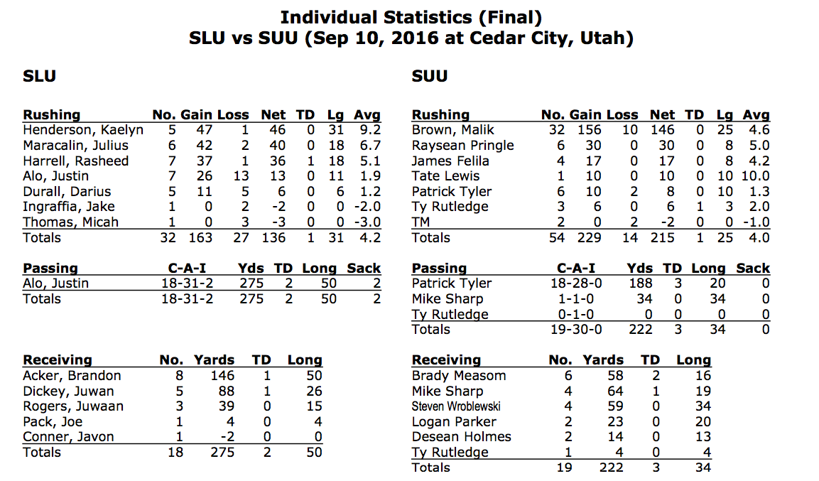
Football

Slide 5
Football Statistical Abbreviations
Att Attempts Avg Average Blk Blocked Kick
BT Broken Tackles Cmp Completions FC Fair Catches
Lost Fumbles-Lost FF Forced Fumbles FG Field Goal
FGA Field Goal Attempt FR Fumbles Recovered Fum Fumbles
G Games Int Interception IntYd Interception Return Yards
Lg Longest Net Avg Net Punting Average Opp Opponent
PD Pass Defensed Pts Points Rcv Recovery
Rec Reception Ret Return Rnk Ranking
Rtg Rating Sk Sacks Stf Stuffs
SckYds Sack Yardage TB Touchback TD Touchdown
Tgt Target Tk Tackles Tm Team
Tot Total XP Extra Point XPA Extra Point Attempt
YAC Yards After Catch Ydl Yards Lost Yds Yards
Yds/G Yards Per Game Yds/Rec Yards Per Reception Yds/Att Yards Per Attempt
Yr Year 1st First Down

Slide 6
Football

Slide 7
Basketball Positional Abbreviations
C Center PF Power Forward SF Small Forward
SG Shooting Guard PG Point Guard
W Wing P Post G Guard
1 Point Guard 2 Shooting Guard 3 Small Forward
4 Power Forward 5 Center

Slide 8
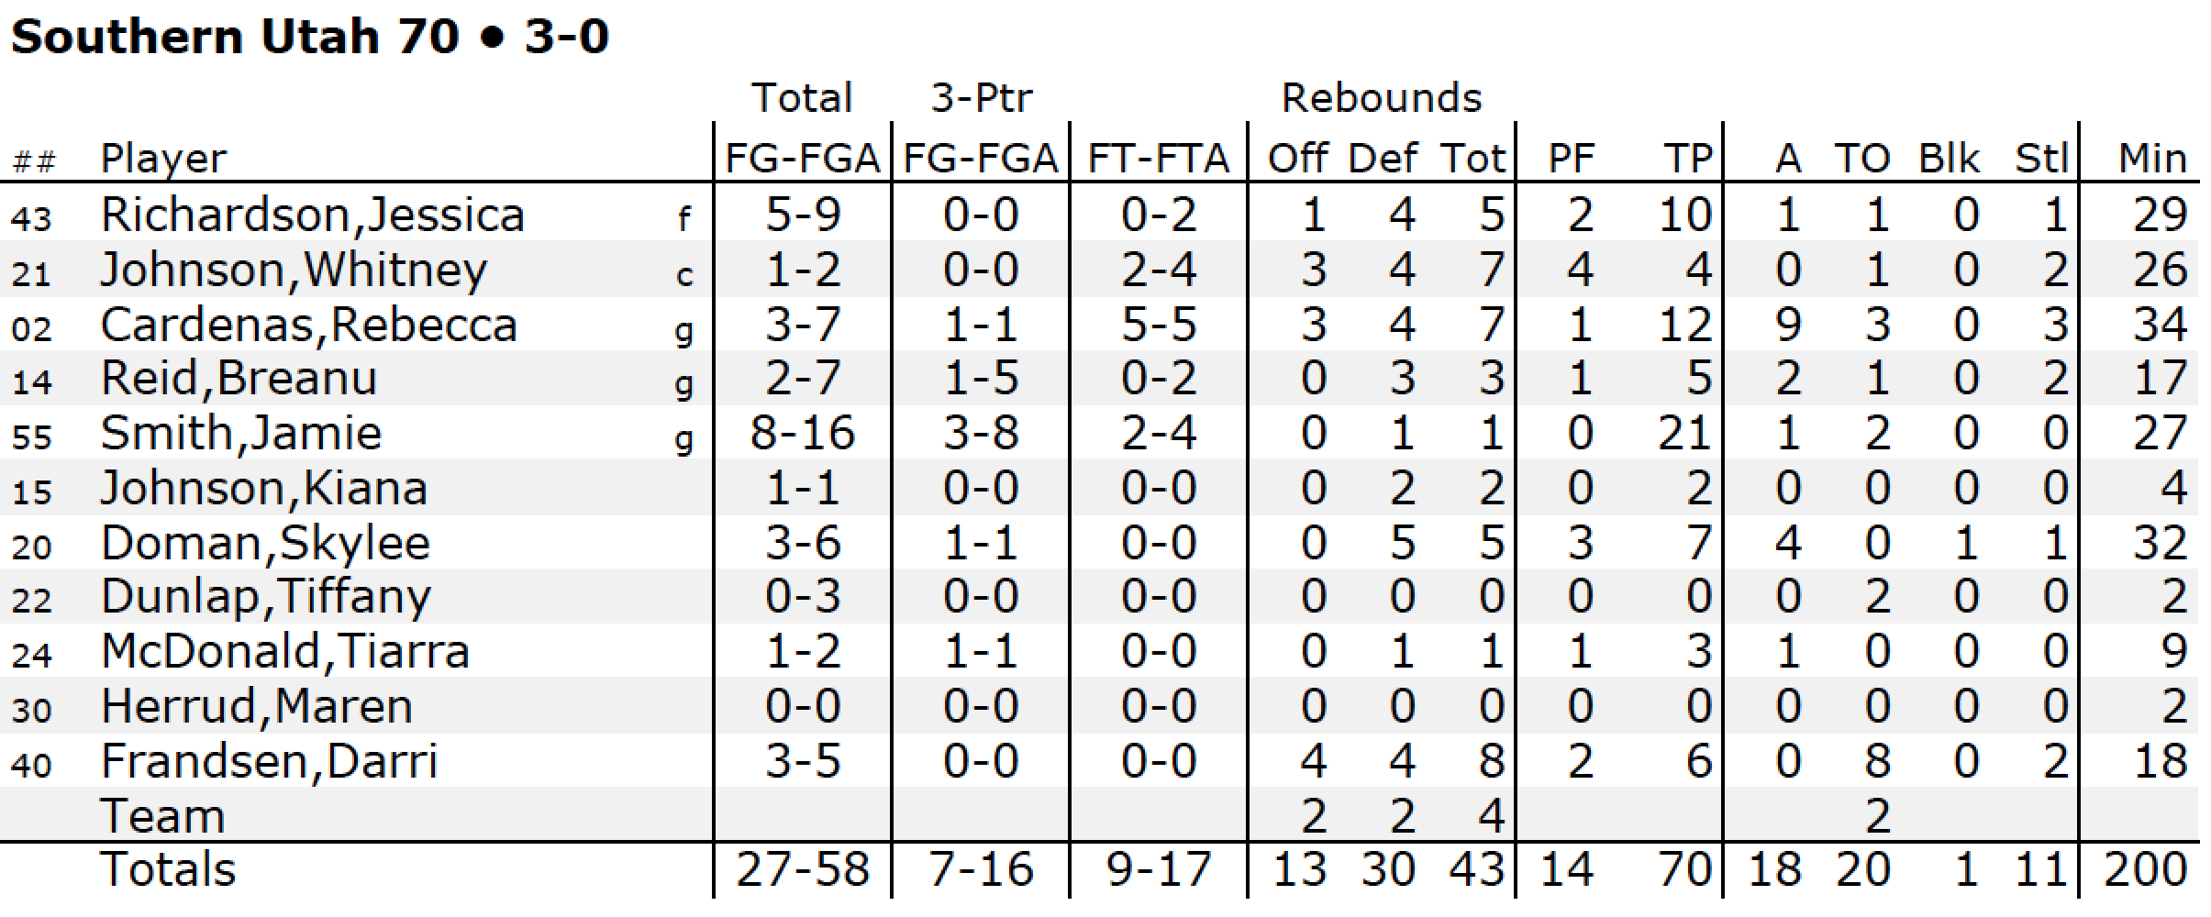

Slide 9
Basketball Statistical Abbreviations
G - Games Played Min - Minutes Played MPG - Minutes per Game
Pts - Total Points PPG - Points per Game FGM - Field Goals Made
FGA - Field Goals Attempted FGP - Field Goal Percentage FTM - Free Throws Made
FTA - Free Throws Attempted FTP - Free Throw Percentage 3PM - Three Pointers Made*
3PA - Three Pointers Attempted 3PP - Three Point Percentage REB - Total Rebounds
RPG - Rebounds per Game AST - Total Assists APG - Assists per Game
STL – Steals BLK – Blocks TO – Turnovers
EFF – Efficiency AV - Approximate Value PF - Total Personal Fouls

Slide 11
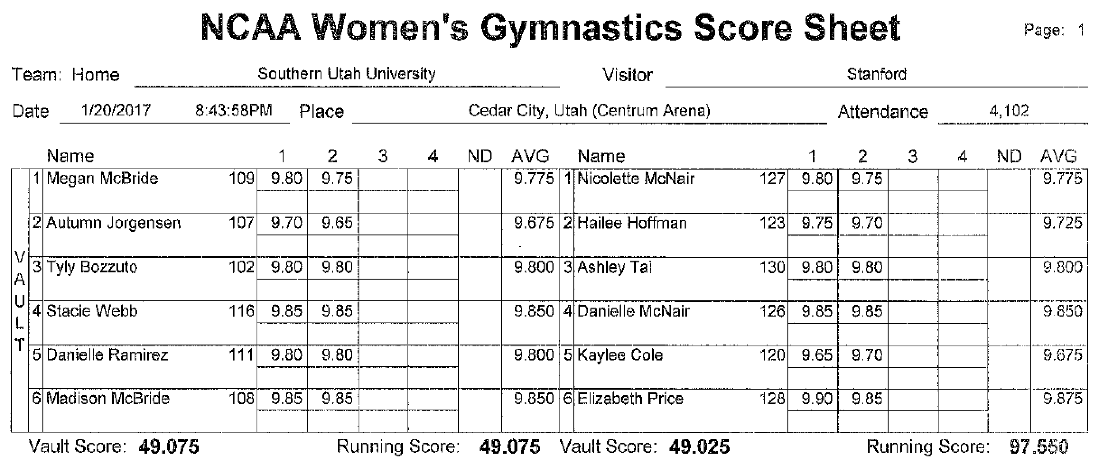
Gymanstics

Slide 12
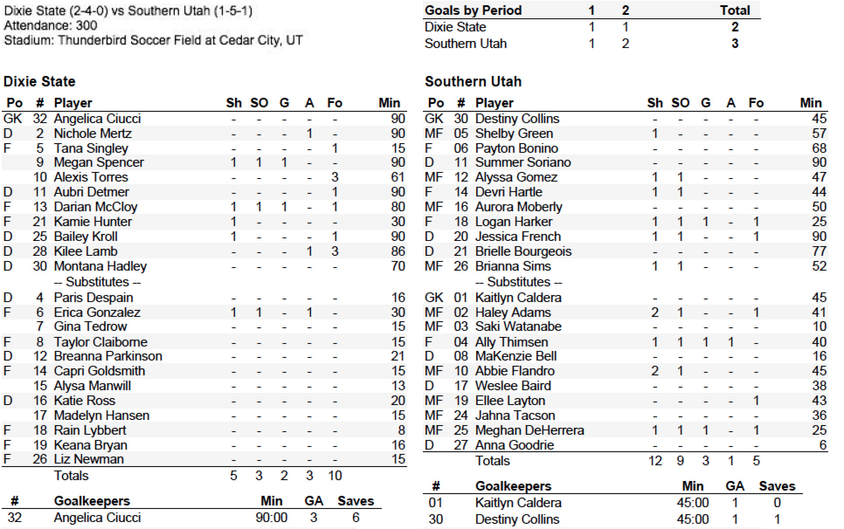
Soccer

Slide 13
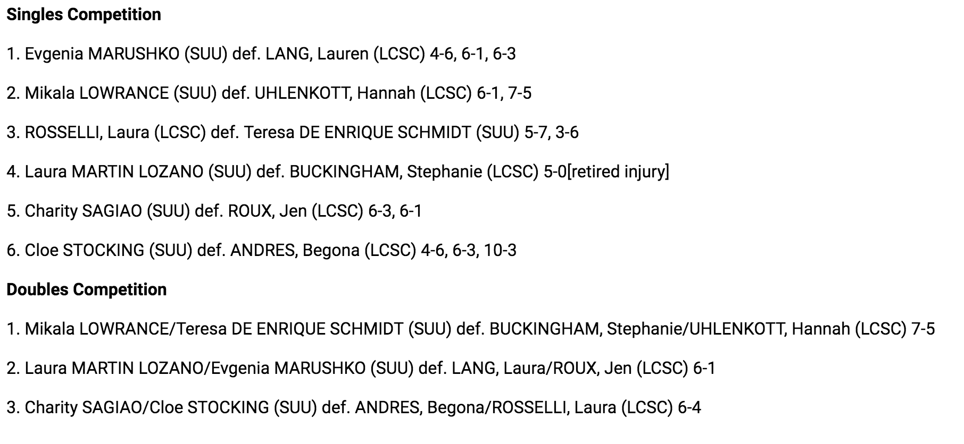
Tennis

Slide 14
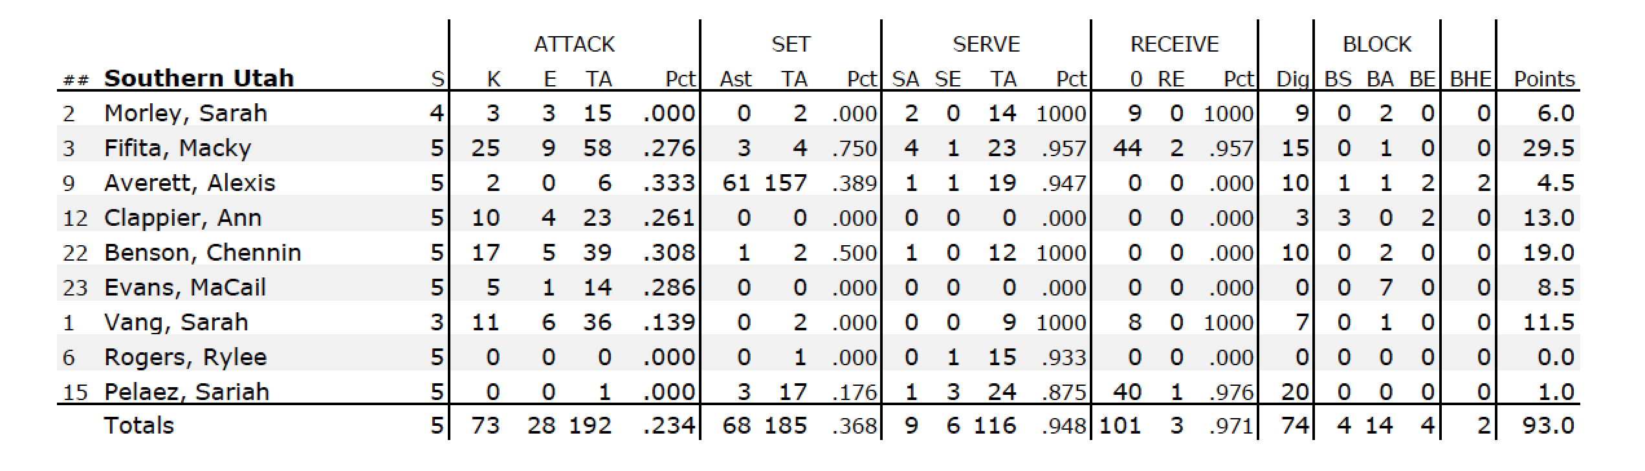
Volleyball

Slide 15
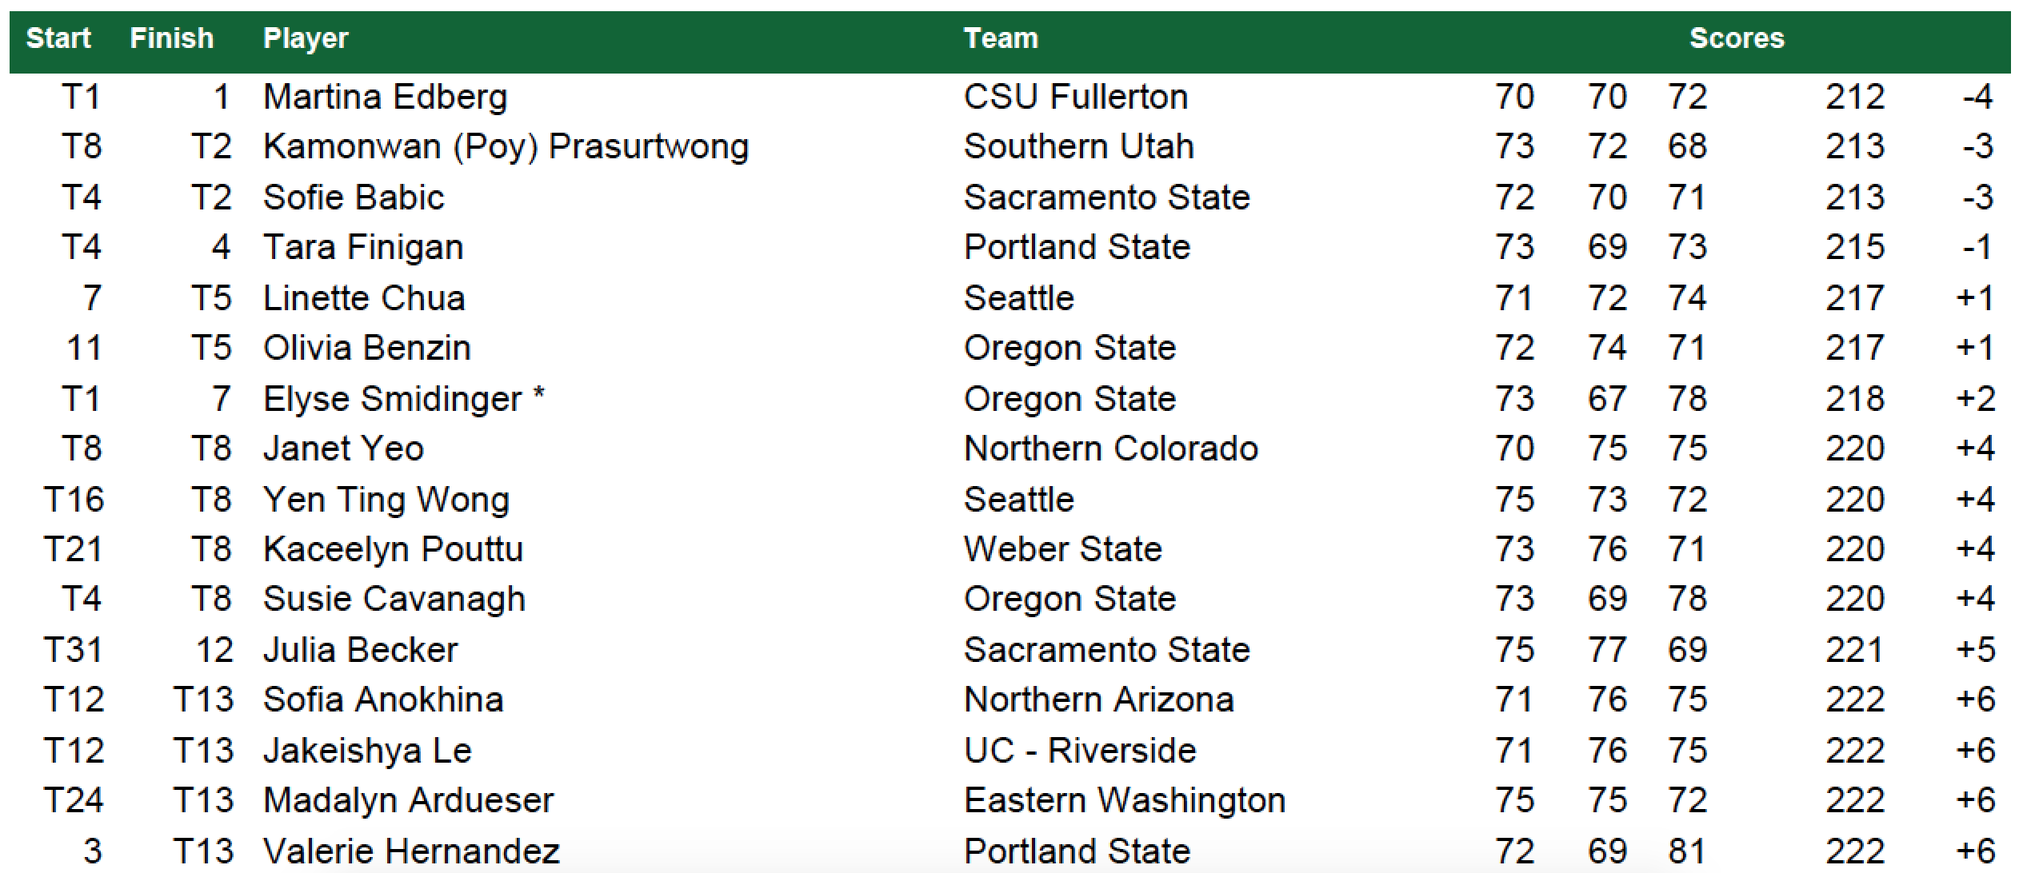
Golf

Slide 16
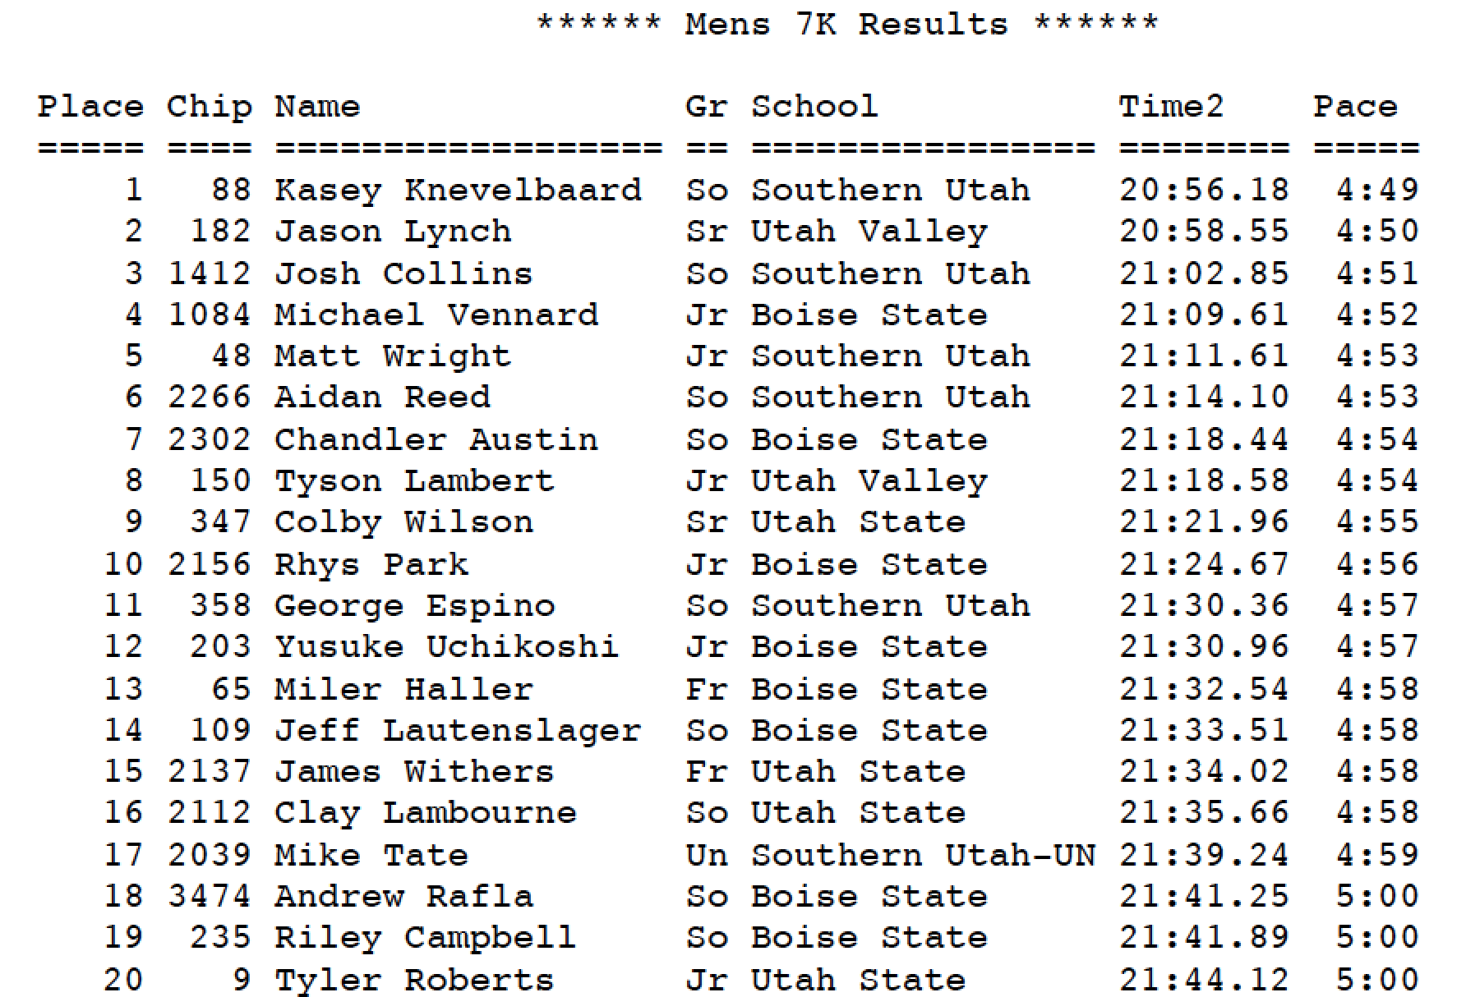
Cross Country

Slide 17
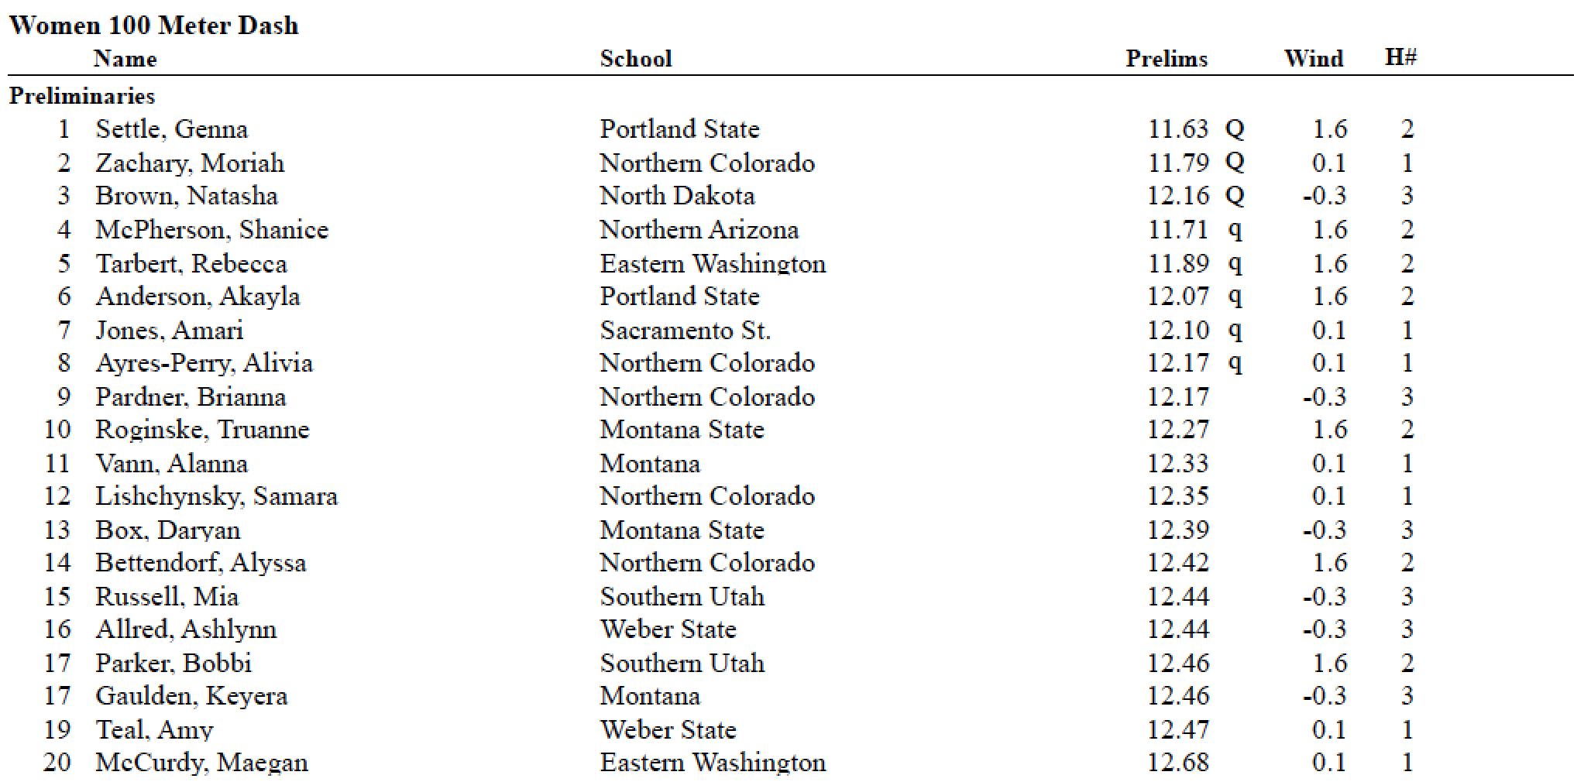
Track & Field

Slide 18
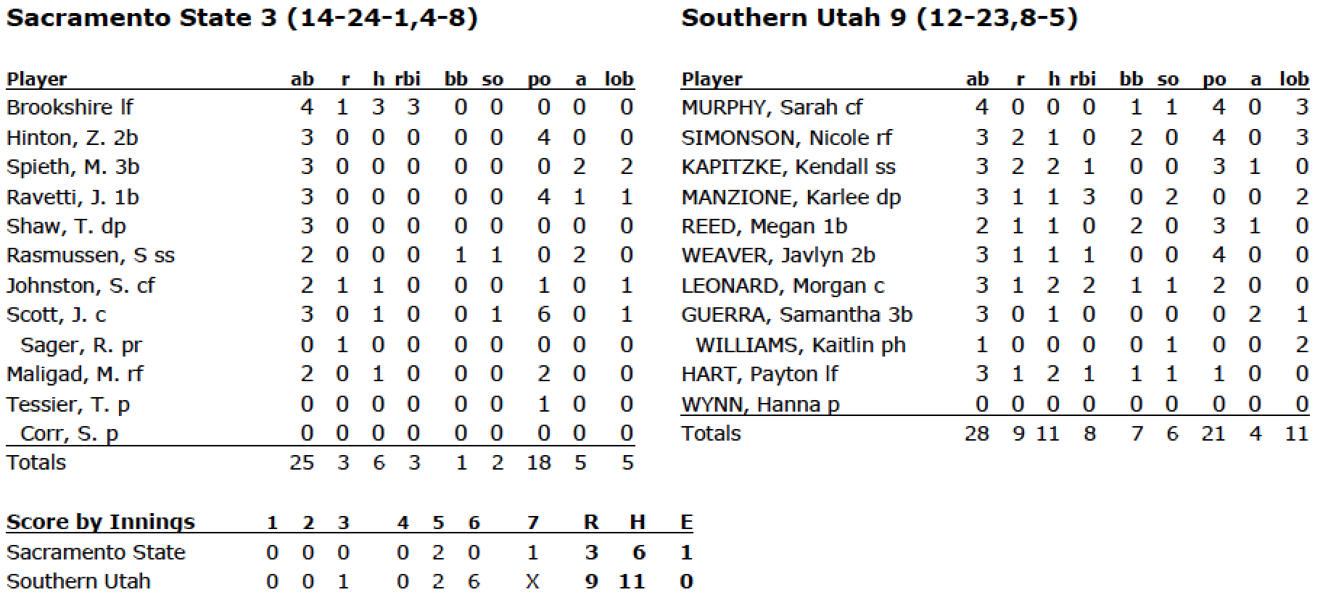
Softball

Slide 19
When to Use Statistics in a Story
  Don’t overload your story with statistics.
  They are important, but use them sparingly.
  Your reader can just look at the box score if they want that kind of information.

