Slide 1
Introduction to
Technical Communication
Practical Strategies for Technical Communication, Chapter 1

Slide 2
What is Technical Communication?
Technical communication is the process of creating, shaping, and communicating technical information so that people can use it safely, effectively, and efficiently.
It can also be thought of as the products of this process: that is, the manuals, websites, reports, and so on that people create.

Slide 3
What is Technical Communication?
Technical communication is carried out by technical professionals (engineers, scientists, businesspeople) and by technical communicators (full-time writers, editors, and document-production people).
It requires the use of all four basic communication modes (listening, speaking, reading, and writing), and these communication skills are essential to workplace success.

Slide 4
What is Technical Communication?
The challenges of producing technical communication involve factors related to:
  audience,
  purpose,
  setting,
  the document itself,
  and the process of creating the document.

Slide 5
What is Technical Communication?
Technical documents are addressed to particular readers, help those readers solve problems, reflect an organization’s goals and culture, are often created collaboratively, use design to increase readability, and consist of words and/or images.

Slide 6

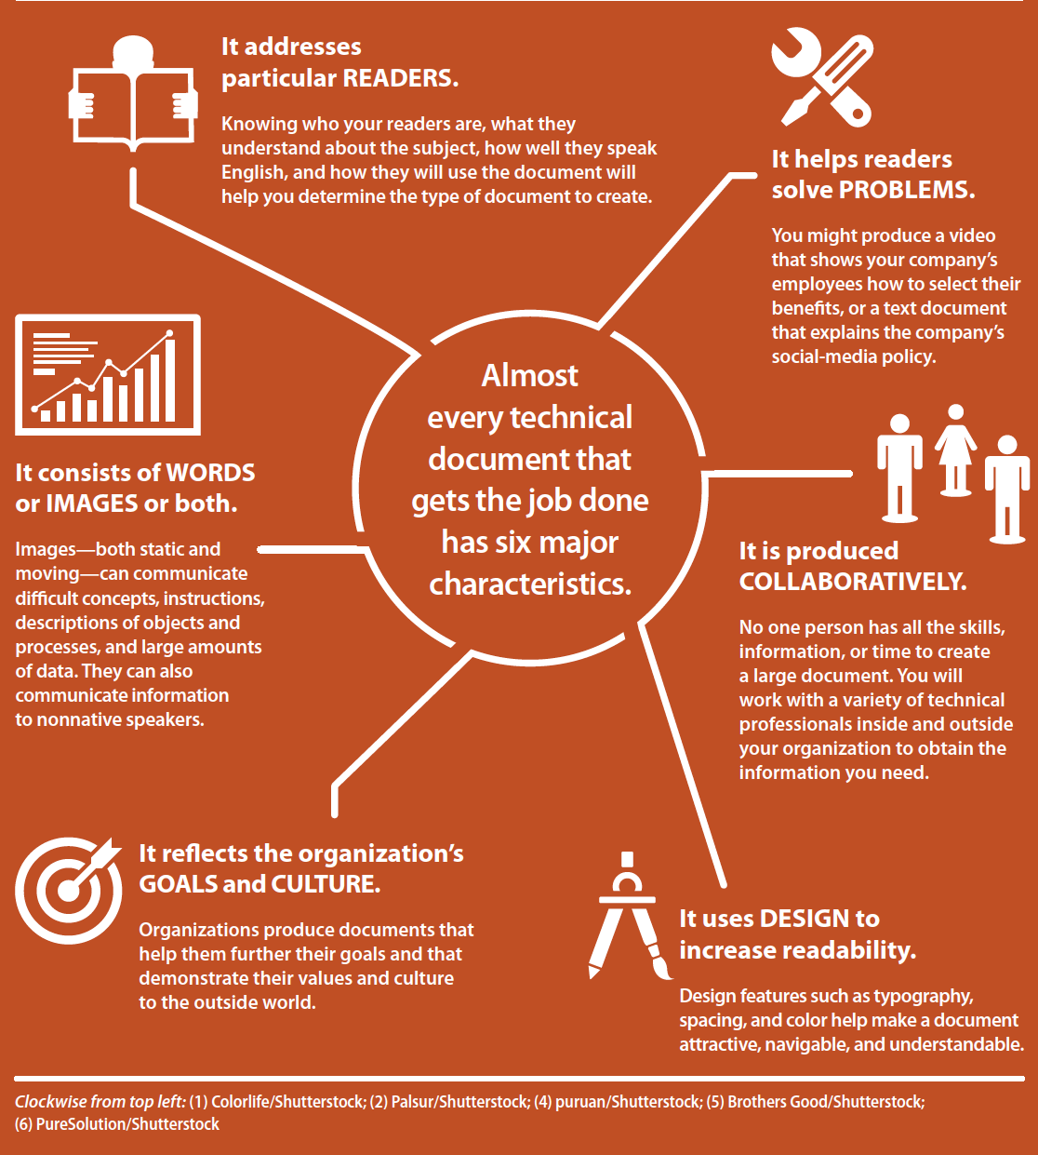
Characteristics of Technical Documents

Slide 7
What is Technical Communication?
Effective technical communication is:
  honest,
  clear,
  accurate,
  comprehensive,
  accessible,
  concise,
  professional in appearance,
  and correct.

Slide 8
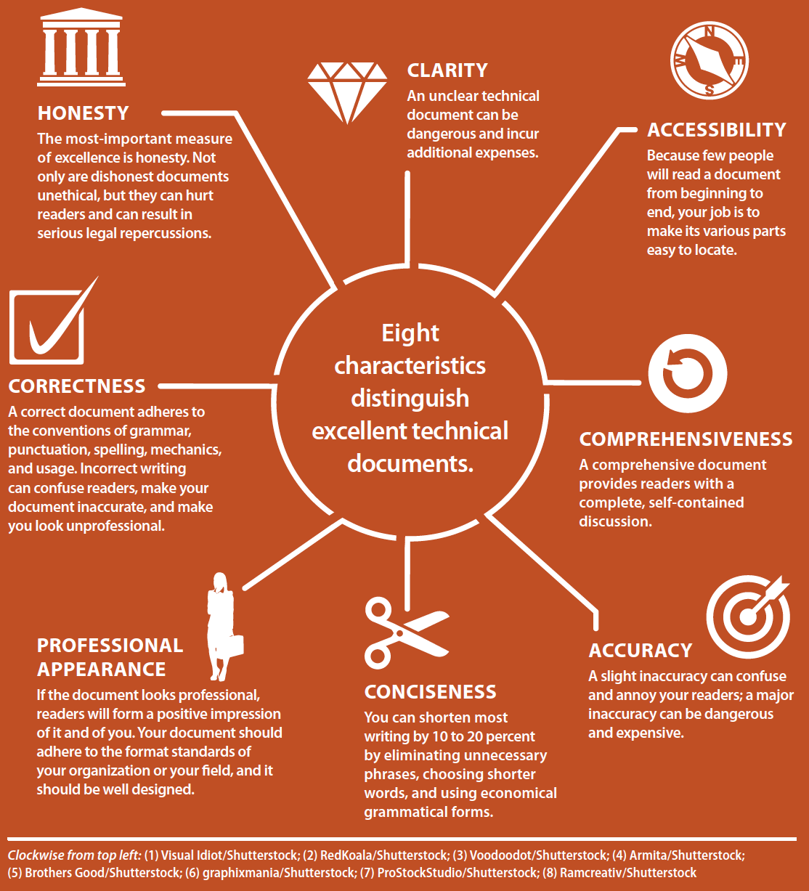
Measures of Excellence in Technical Communication

Slide 9
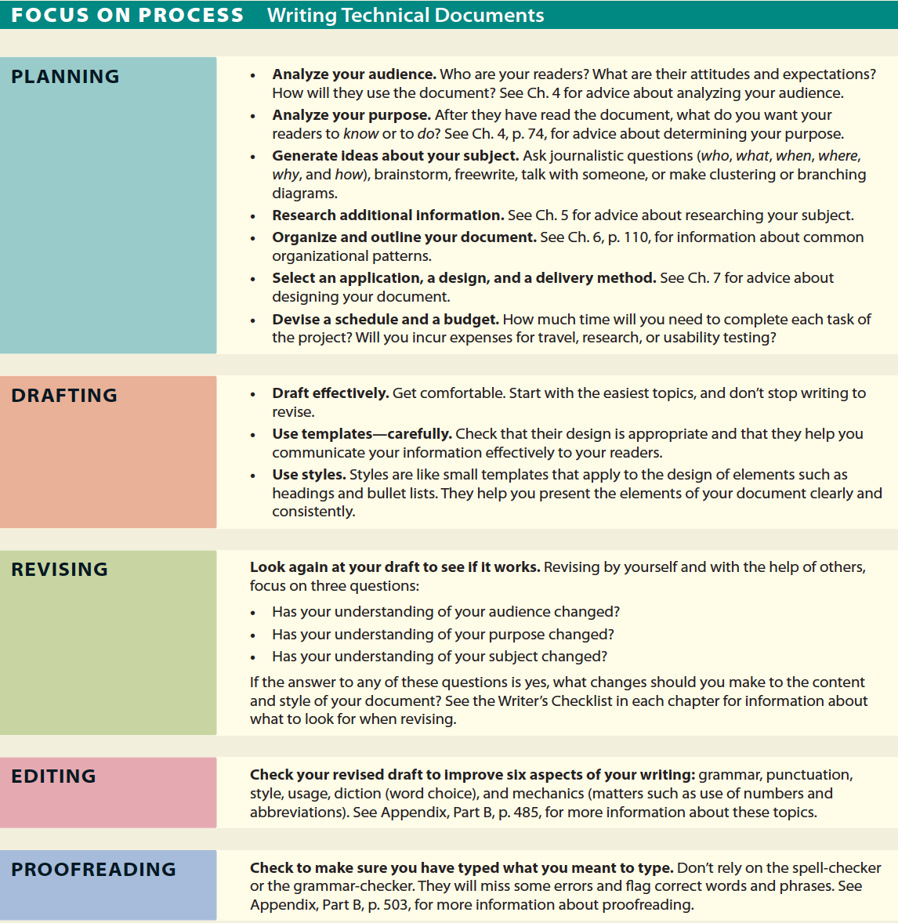
Process of Writing Technical Documents

Slide 10
Exercise
Working with a partner, analyze three different documents: your memo, the class syllabus, and the homepage of the university website.
Focus on three measures of excellence in technical communication: clarity, accessibility, and professional appearance.
How effectively the documents meet each of these measures of excellence? Be prepared to share your findings with the class.
Type up your answers and turn it in on Canvas before you leave.

