Slide 1
Law, Regulations, Ethics
Ch. 2

Slide 2
Law, Regulation, Ethics
Law : refers to rules created by legitimate authority, such as federal, state, county, and city governments.
Regulation : is administrative law, which includes laws and rules created by agencies set up through statute by legislative bodies.
Ethics: refers to standards of conduct and moral principles or to a process of reaching morally acceptable decisions.
Law, regulation, and ethics all deal with what should not occur.

Slide 3
How do ethics affect your daily decision making?
Pt. I

Slide 4
In thinking about ethical dilemmas,
four moral standards are useful:
  Rights: individuals’ basic needs and welfare
  Justice: how the costs and benefits of an action or a policy are distributed among a group
  Utility: the positive and negative effects that an action or a policy has on others
  Care: the relationships we have with other individuals

Slide 5
You have four sets of ethical and legal obligations:
  to your employer
  to the public
  to the environment
  to copyright holders

Slide 6
You have five obligations to your employer:
  competence and diligence
  generosity
  honesty and candor
  confidentiality
  loyalty

Slide 7
Four elements of an organization’s culture
encourage ethical and legal behavior:
ethical leadership
supervisors setting ethical examples
peer support of ethical behavior
organization using informal communication to reinforce the formal policies (ex: company code of conduct)

Slide 8
An effective code of conduct
has three characteristics:
  It protects the public rather than members of the organization or profession.
  It is specific and comprehensive.
  It is enforceable.
    Regulations.

Slide 9
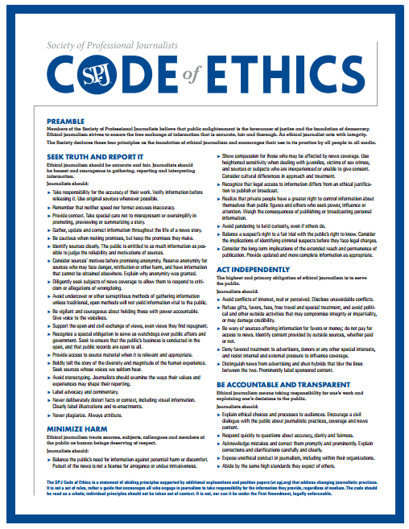
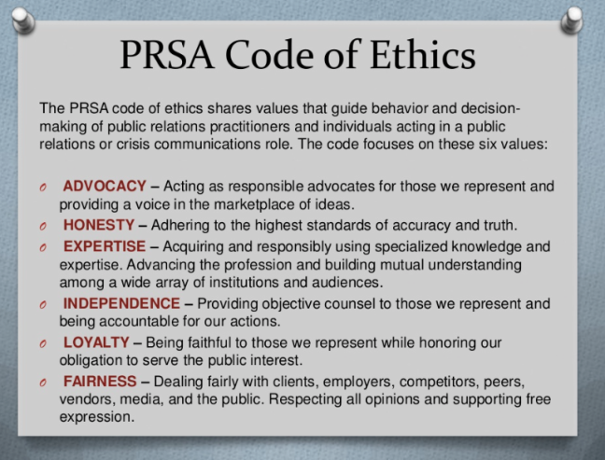
Examples of Ethical Codes
Society of Professional Journalists
Public Relations Society of America

Slide 10
How have you noticed companies act in unethical ways?

Slide 11
Follow these ten principles for ethical communication:
Abide by copyright laws.
Abide by your organization’s professional code of conduct.
Abide by your organization’s policy on social media.
Take advantage of your employer’s ethics resources.
Tell the truth
Don’t mislead your readers.
Bring attention to important ethical and legal information.
Be clear.
Avoid language that discriminates.
Cite your sources and your collaborators.

Slide 12
Avoid four common types of
misleading technical communication:
  false implications about products
  exaggerations about product specifications
  legalistic constructions
  euphemisms

Slide 13
Discussion
It is late April, and you need a summer job. On your town’s news website, you see an ad for a potential job. The only problem is that the ad specifically mentions that the job is “a continuing, full-time position.” You know that you will be returning to college in the fall.
Is it ethical for you to apply for the job without mentioning this fact? Why or why not? If you believe it is unethical to withhold that information, is there any ethical way you can apply?

Slide 14
Ethics and Fair Use
What is fair use?
Fair Use is a legally permissible use of copyrighted material for specific purposes such as commentary, criticism, news reporting, research, teaching or scholarship.

Slide 15
Courts consider four factors
in disputes over “fair use”:
  the purpose and character of the use, especially whether the use is for profit
  the nature and purpose of the copyrighted work
  the amount and substantiality of the portion of the work used
  the effect of the use on the potential market for the copyrighted work

Slide 16
Adhere to these four guidelines when
you use material from another source:
  Abide by the fair-use concept.
  Seek permission.
  Cite your sources accurately.
  Consult legal counsel if you have questions.
  It is ethical to reuse information already produced at your company. Ask your supervisor if you have concerns about doing that.

Slide 17
Which laws affect technical writing?
Pt. II

Slide 18
Technical writing laws to be aware of:
Libel
Privacy
Intellectual Property

Slide 19
Libel
Libel occurs when publication results in false defamation of a person that causes damages.
Defamation makes others think less of a person’s character, but the defamation must cause some actual loss for the plaintiff to win the libel case.
Libel involves information that will likely be perceived as fact.
  Opinion cannot be libel.
  Satire is exempt from libel law.
Many people confuse libel and slander.

Slide 20
Libel
Libel
Slander
Printed defamation
Ex) The University Journal runs a false story about President Wyatt using horse meat instead of hamburger to save money at the cafeteria, which result in him losing his job.
Spoken defamation
Ex) You tell people that President Wyatt is saving money by using horse meat instead of hamburger to save money at the cafeteria, which results in him losing his job.

Slide 21
Libel
Publication includes:
  Articles
  Headlines
  Photo captions
  In-house advertisements
  Promotional material
  Cartoons
  Letters to the editor
  Quotes
  Guest Columns
  Editorials
  Classified advertisements
In print-based media, you are responsible for everything you publish, even when it comes from a third-party.

Slide 22
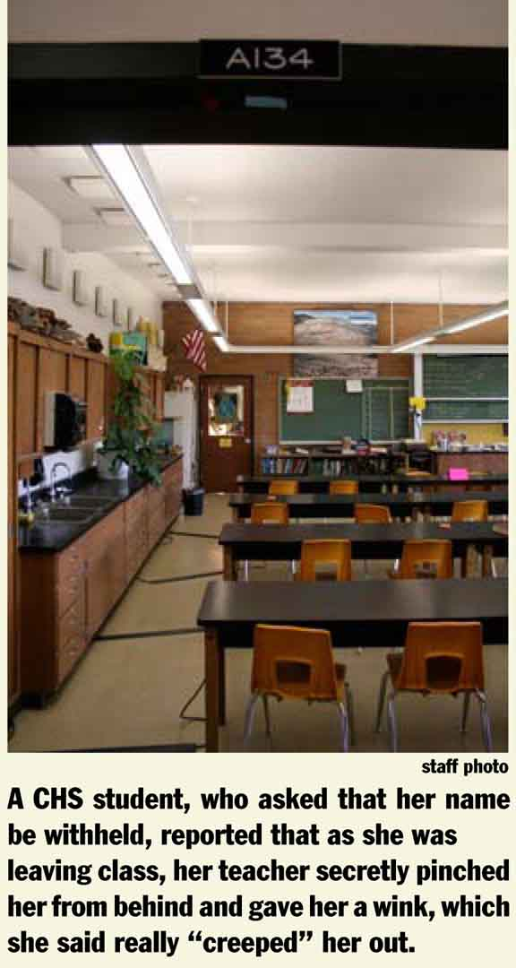
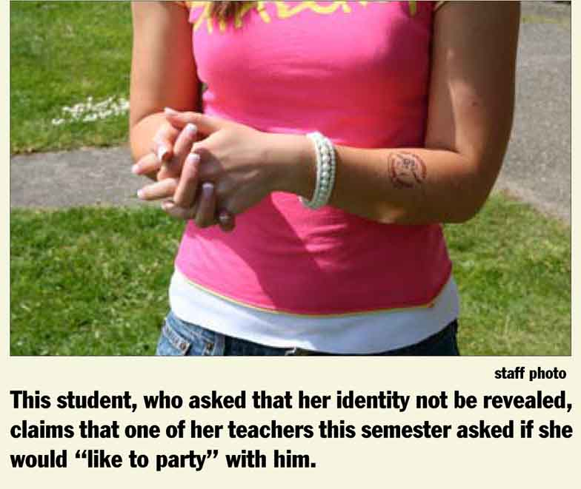
Libel
You can identify
a person by name, description, or photo.

Slide 23
Privacy
“The legal right of privacy has been defined as the right to be left alone, the right of a person "to withhold himself and his property from public scrutiny if he so chooses."

Slide 24
Privacy
Privacy laws apply to the reporting of information that people would prefer not be known by the public.
Privacy is not found in the US Constitution, but is a derivative of the Fourth Amendment.
Four areas of privacy law merit closer inspection for this course:
  Disclosure of private or embarrassing facts
  False light
  Misappropriation

Slide 25
Privacy
Public Disclosure of Private and Embarrassing Facts
Courts have recognized that certain intimate details about people, even though true, may be "off limits" to the press and public.
For example, publishing detailed information about a private person's sexual conduct, medical condition or educational records might result in legal trouble. In order to succeed in this kind of lawsuit, the person suing must show that the information was:
  (1) sufficiently private or not already in the public domain,
  (2) sufficiently intimate, and
  (3) highly offensive to a reasonable person.

Slide 26
Privacy
Public Disclosure of Private and Embarrassing Facts
An organization will be protected from a private facts privacy claim if it can show that the material published was "newsworthy."
Almost any information about a well-known public figure or a public official will be considered newsworthy.
Furthermore, reports of recent involvement in criminal behavior will be considered newsworthy for anyone.

Slide 27
Privacy
False Light
A false light claim can arise anytime you unflatteringly portray — in words or pictures- a person as something that he or she is not.
A typical "false light" problem can arise where a misleading caption is published with a photo (for example, a caption describes a bystander at an unlawful demonstration as a "participant").

Slide 28
Privacy
False Light
The elements of false light are:
  (1) the portrayal must be found to be "highly offensive to a reasonable person" and
  (2) the reporter had knowledge of or acted in reckless disregard as to the falsity of the publicized matter and the false light in which the other would be placed.

Slide 29
Privacy
Misappropriation of Name or Likeness
Misappropriation is the unauthorized use of a person's name, photograph, likeness, voice or endorsement to promote the sale of a commercial product or service. (For example, using a photo of your school's star athlete in an ad for a pizza restaurant without her permission.)
Ed O’Bannon v. NCAA
To avoid problems, publications should routinely have subjects sign a model release form written in simple, straightforward language when using their name or likeness in a commercial ad.

Slide 30
Intellectual property
Intellectual Property- Any intangible personal property resulting from mental processes.
Intellectual property law allows Protection of the owners right to protect or profit from the use of his or her property.

Slide 31
Intellectual property
Patent
Copyright
Trademarks
Trade Names
Trade Dress

Slide 32
Intellectual property
Copyright-
An intangible right given to the author or originator of certain literary or artistic productions.
Works created after January 1, 1978, are automatically given statutory copyright protection for the life of the author plus seventy years.
Copyrights owned by publishing houses expire ninety‑five years after publication or a one hundred-twenty-years from the date of creation, whichever is first.

Slide 33
Intellectual property
Copyright-
Exists automatically upon creation of an original work, but placement of copyright symbol © gives notice .
To judicially enforce copyright requires registration with the US Copyright Office

Slide 34
Intellectual property
Writings (novels, textbooks etc.)
Computer Software
Song writing
Song recordings
My PPT slides (although some parts included fair use copyrighted material from textbook authors).

Slide 35
Intellectual property
Trademark-
Any word, phrase, symbol, design, sound, smell, color, product configuration, group of letters or numbers, or combination of these, adopted and used by a company to identify its products or services, and distinguish them from products and services made, sold, or provided by others
A distinctive mark, motto, device, or implement that a manufacturer stamps, or prints on its goods.
Assists customer in identifying a product without confusion.
If a business uses the trademark of another, consumers are misled as to who made the goods.

Slide 36
Intellectual property
Trademark-
What can be trademarked
  Words that are used as part of a design or device or words that are uncommon or fanciful may be trademarked.
What cannot be trademarked
  Personal names, descriptive or generic words, or place names
    Books
    Pencils
    Carper
    Hawaii

Slide 37
Intellectual property
Trademark-
First person to use a mark in trade owns it.
Registration is not necessary, but does have some advantages.
  Protection becomes nationwide
  Gives public notification of trademark protection
  Holders of registered marks have first priority to use the mark as an Internet domain name
Federal registration
  ® ™ Demonstrates registration of TM with U.S. Patent and Trademark Office

Slide 38
Intellectual property
Trade Names-
Identifies a company, partnerships or business.
Cannot be registered under federal law unless they are also used as trademarks or service marks (used to identify services).
Common law protection.

Slide 39
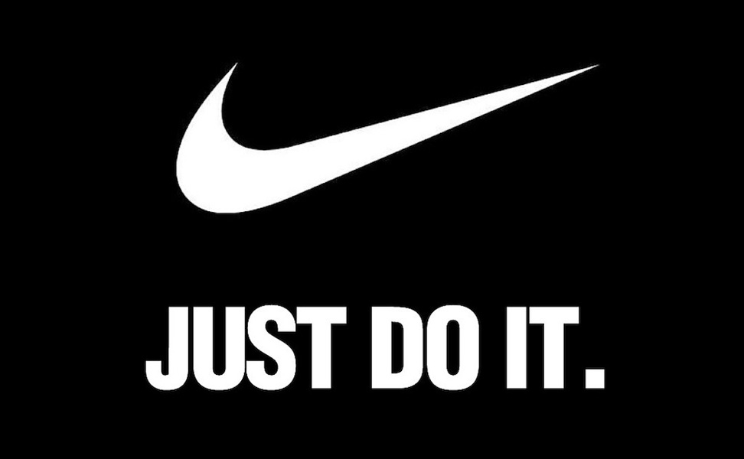
Intellectual property
Trademark
Trade Name
Nike, Inc.
Nike

Slide 40
Team Exercise
In a group of three, study the website of American Pacific (ampac.us), a prominent employer here in Iron County. Find information about the organization’s commitment to ethical and legal conduct. Often, organizations present this information in sections with titles such as “information for investors,” “about the company,” or “values and principles of conduct.”
  One group member could identify the section that states the organization’s values. How effective is this section in presenting information that goes beyond general statements about the importance of ethical behavior?
  A second group member could identify the section that describes the organization’s code of conduct. Does the organization seem to take principles of ethical and legal behavior seriously? Can you get a clear idea from the description whether the organization has a specific, well-defined set of policies, procedures, and resources available for employees who wish to discuss ethical and legal issues?
  A third group member could identify any information related to the organization’s commitment to the environment. What does the organization do, in its normal operations, to limit its carbon footprint and otherwise encourage responsible use of natural resources and limit damage to the environment?
As a team, write a memo to your instructor presenting your findings. Attach the organization’s code to your memo.

