Slide 1
Writing Collaboratively
Ch. 3

Slide 2
What comes to your mind when you hear “Group Work”?

Slide 3
Collaboration has six advantages:
It draws on a wider knowledge base.
It draws on a wider skills base.
It provides a better idea of how the audience will read the document.
It improves communication among employees.
It helps acclimate new employees to an organization.
It motivates employees to share knowledge and skills.

Slide 4
Collaboration has six disadvantages:
It takes more time than individual writing.
It can lead to groupthink.
It can yield a disjointed document.
It can lead to inequitable workloads.
It can reduce a person’s motivation.
It can lead to disagreement and interpersonal conflict.

Slide 5
Follow these seven suggestions for managing your projects:
Break down a large project into several smaller tasks.
Plan your project.
Create and maintain an accurate schedule.
Put your decisions in writing.
Monitor the project.
Distribute and act on information quickly.
Be flexible regarding schedule and responsibilities.

Slide 6
Key aspects of conducting meetings:
listening effectively
setting your team’s agenda
conducting efficient meetings
communicating diplomatically
critiquing a team member's work

Slide 7
Follow these five steps to improve your effectiveness as a listener:
Pay attention to the speaker.
Listen for main ideas.
Don’t get emotionally involved with the speaker's ideas.
Ask questions to clarify what the speaker said.
Provide appropriate feedback.

Slide 8
There are eight tasks involved in setting your team's agenda:
Define the team’s task.
Choose a team leader.
Define tasks for each team member.
Establish working procedures.
Establish a procedure for resolving conflict productively.
Create a style sheet.
Establish a work schedule.
Create evaluation materials.

Slide 9
Follow these four suggestions for conducting efficient meetings:
Arrive on time.
Stick to the agenda.
One group member should act as secretary and record important decisions.
At the meeting’s end, the team leader should summarize the team’s accomplishments and assign new tasks.

Slide 10
Follow these seven suggestions for communicating diplomatically:
Listen carefully, without interrupting.
Give everyone a chance to speak.
Avoid personal remarks and insults.
Don’t overstate your position.
Don’t get emotionally attached to your own ideas.
Ask pertinent questions.
Pay attention to nonverbal communication.

Slide 11
Follow these three suggestions when critiquing a colleague’s work:
Start with a positive comment.
Discuss the larger issues first.
Talk about the document, not the writer.

Slide 12
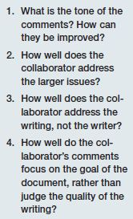
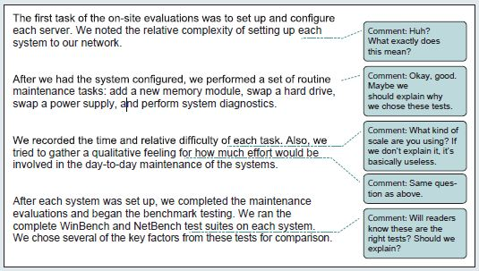
Critique a draft clearly and diplomatically.

Slide 13
Three powerful word-processor features can be useful in collaborative work:
the comment feature
the revision feature
the highlighting feature

Slide 14
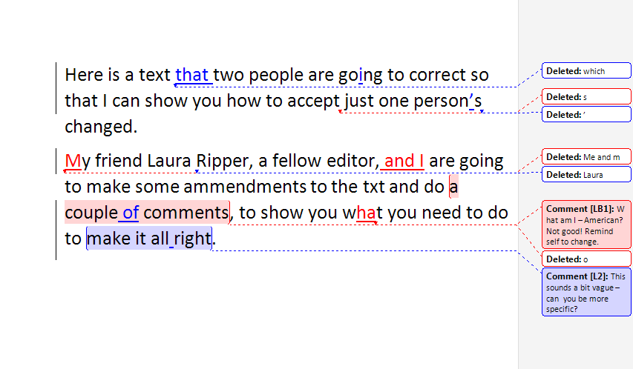

Slide 15
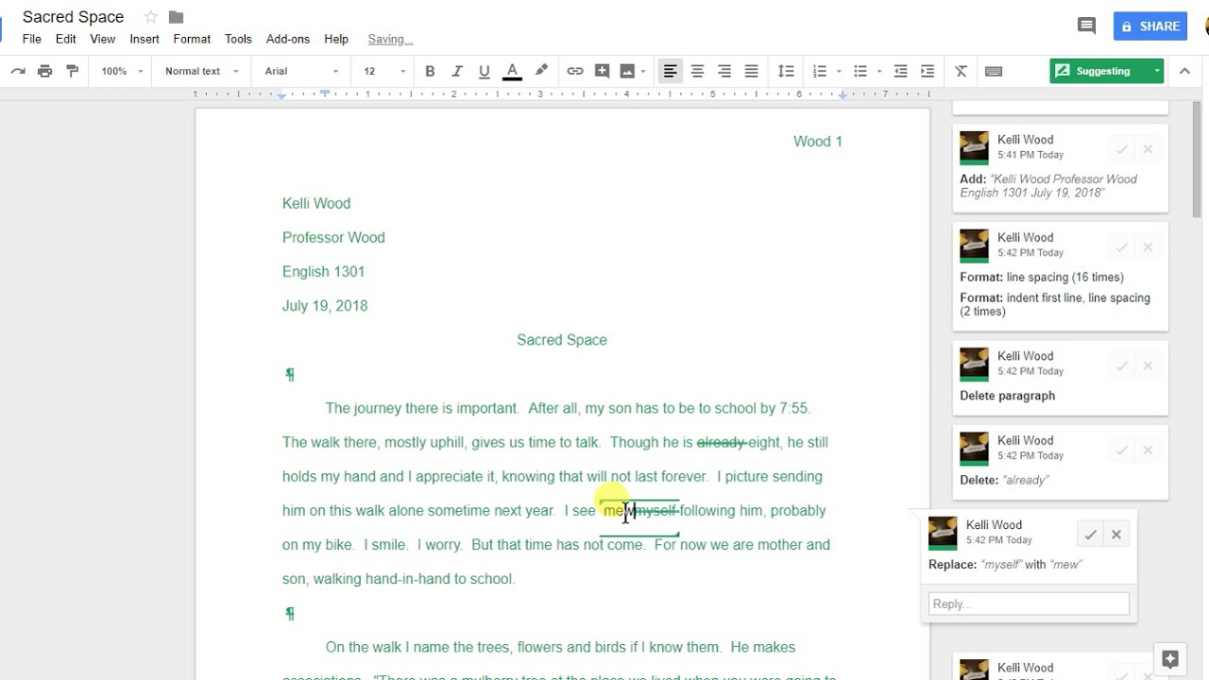

Slide 16
Besides word processors, three major technologies enable collaboration:
messaging technologies
videoconferencing
wikis and shared document workspaces

Slide 17
Follow these six suggestions for participating in videoconferences:
Practice using the technology.
Arrange for tech support at each site.
Organize the room to encourage participation.
Make eye contact with the camera.
Dress as you would for a face-to-face meeting.
Minimize distracting noises and movements.

Slide 18
If you use your organization’s social media, maintain a professional online presence:
Don’t use social media for nonbusiness purposes.
Don’t divulge secure information.
Don’t divulge private information about anyone.
Don’t make racist or sexist comments or post pictures of people drinking.

Slide 19
Consider five ways in which cultural differences can affect team behavior:
People from other cultures might find it difficult to assert themselves in collaborative teams.
They might be unwilling to respond with a definite “no.”
They might be reluctant to admit when they are confused or to ask for clarification.
People from other cultures might avoid criticizing others.
They might avoid initiating new tasks or performing creatively.

Slide 20
Discussion
Have you ever had to work in a group on a writing project?
How did it go?
What were the positives and negatives of working in a group vs. working by yourself?
How can we improve on this idea of writing and editing collaboratively?

Slide 21
Copy Editing
Content vs. Context

Slide 22
Why can the editing process be so uncomfortable?

Slide 23
Working with Writers
Editing is individual,
but it’s not subjective.
Editing is not personal. You are editing the copy, not the person.
Writers may have an easier time saying out loud what they mean.
Engage the writer in the editing process.
It’s usually easier to do a SECOND READ with the writer at hand.

Slide 24
Editing for Context
Why this information, and why now?
Who or what benefits?
Who or what is harmed?
Is it factual but still misleading?
Are there any holes?
Does it answer: who, what, where, when, how, how much, why and why care?
Is there enough background?
Do headlines and section headings make sense?

Slide 25
Voices and Sources
Where are you getting your data?
  Is it a credible source?
  How can you verify your sources?
Are more voices needed for dimension and/or fairness?
Is topic placed in context by including information from an outside or unbiased observer?
  Third-person source.

Slide 26
Voices and Sources
Is there “another side” to the story or to the contentions of the main sources?
Is that other side, or sides, presented and is it given appropriate weight?
When an explicit or implicit accusation is raised, does the target have an opportunity to respond?
Are racial, sexual, religious or ethnic references relevant? Are they applied equally?
Are there too many quotes? Are there too many numbers?
  Should they be paraphrased?

Slide 27
Tone and Style
Be short, familiar and specific.
An attempt to sound intellectual by being wordy or using big words?
Too much jargon or insider terms?
Does the tone fit the subject matter?
Is the tone consistent?

Slide 28
Details
Grammar is crucial; style can be adapted.
Too many adjectives because the nouns and verbs aren’t more more specific?
Is background information inserted in the right sentences?

Slide 29
Proof-Reading
Double-check proper names and claims of distinction (first, best, oldest, tallest).
Does the math work? Is it “millions” or “billions”? Percentages figured correctly?
Look for typos early and often: misspellings, missing or duplicated words.
If you see something, mark it immediately. You may not remember it later.

Slide 30
Team Exercise: Group Editing
Your college or university wishes to update its website to include a section called “For Prospective International Students.”
Working with your “Edit & Revise” partner, first determine whether your school’s website already has information of particular interest to prospective international students.
If it does, write a 2-page memo to your instructor describing and evaluating the information. Is it accurate? Comprehensive? Clear? Useful? What kind of information should be added to the site to make it more effective?
In your memo, include a list of edits that need to be made to the website’s content.

