Slide 1
Analyzing Your Audience
Writing for the Right People
Ch. 4

Slide 2
The following passage is an advertisement for a translation service. Revise the passage to make it more appropriate for a multicultural audience.
  If your technical documents have to meet the needs of a global market but you find that most translation houses are swamped by the huge volume, fail to accommodate the various languages you require, or fail to make your deadlines, where do you turn?
  Well, your search is over!!! Translations, Inc. provides comprehensive translations in addition to full-service documentation publishing. We utilize ultrasophisticated translation programs that can translate a page in a blink of an eye. Then our crack linguists comb each document to give it that personalized touch.
  No job too large! No schedule too tight! Give us a call today!

Slide 3
Understanding Audience and Purpose
Who’s expectations should you consider when doing an assignment?
Who’s expectations should you consider when doing the edit and revise assignment?
  What (or who) else should you consider?

Slide 4
Understanding Audience and Purpose
Analyzing an audience means thinking about who your audience is, what they already know about your subject, how they feel about it, and how they are going to use the information you present.
You analyze your audience as you plan your document so that it appeals to their interests and needs, is easy for them to understand, and motivates them to pay attention to your message and consider your recommendations.

Slide 5
Understanding Audience and Purpose
The word purpose refers to what you want to accomplish with the document you are producing.
Most often, your purpose is to explain to your audience how something occurs (how regenerative braking systems work in hybrid cars), how to carry out a task (how to set up a Skype connection), or why some situation is either good or bad (why the new county guidelines for water use will help or hurt your company).
When your purpose is to explain why a situation is either good or bad, you are trying to reinforce or change the audience’s attitudes toward the situation and perhaps urge them to take action.

Slide 6
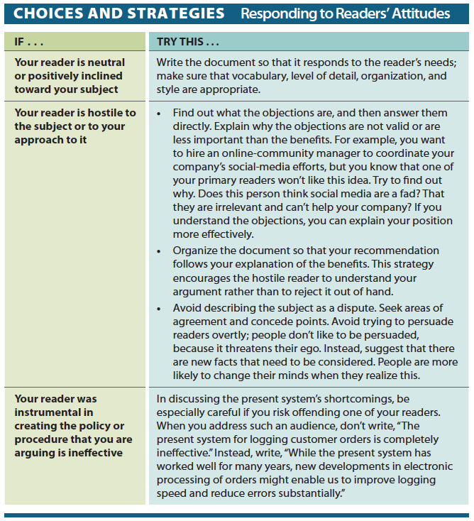
Utilizing an Audience Profile Sheet
It is your job to effectively analyze what your client’s needs and target audience’s needs are.
  What do you know?
  Do you need to conduct an interview?
  Where can you go for research?
  Have they produced and posted any documents on social media?
  How can you analyze their social media data? What does it tell you?

Slide 7
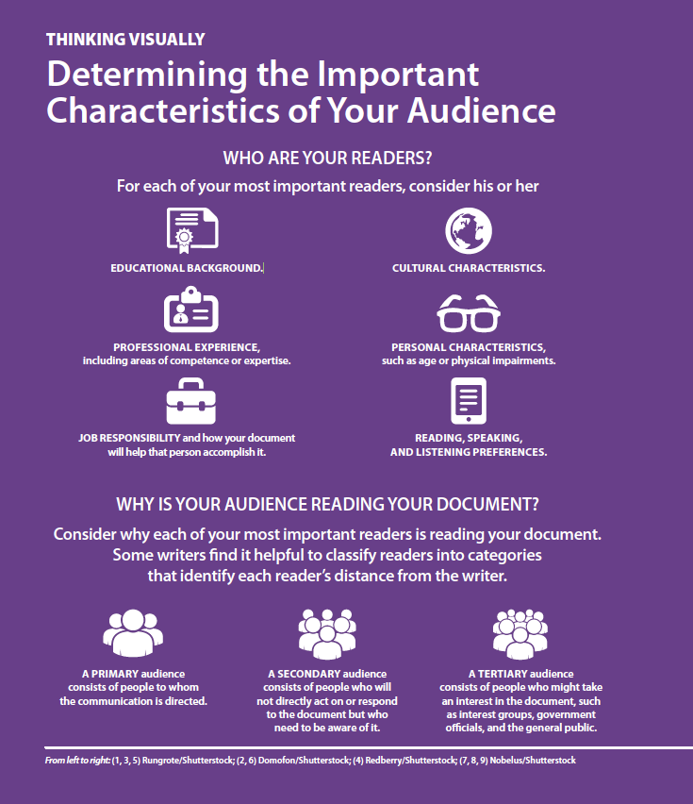
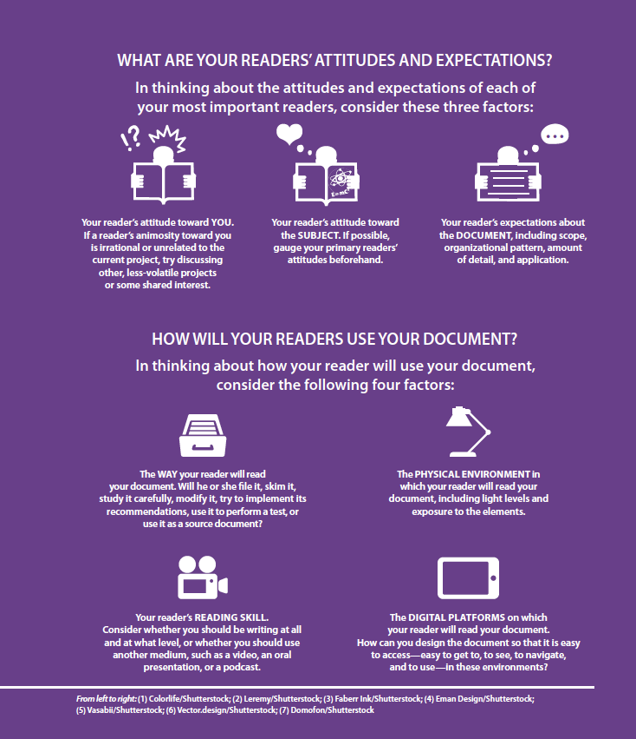
Determining the Defining
Characteristics of Your Audience
You can effective define major characteristics of our audience by responding to the following questions:
Who are your readers?
Why is your audience reading your document?
What are your readers’ attitudes and expectations?
How will your readers use your document?

Slide 8
Determining the Defining
Characteristics of Your Audience
Who are your readers?
Educational background?
Cultural characteristics?
Professional experience and areas of competence?
Personal characteristics (any physiological or psychological impairments)?
Job responsibility and how your document will that person accomplish it?
Reading, speaking, listening preferences?

Slide 9
Determining the Defining
Characteristics of Your Audience
Why is your audience reading your document?
Primary audience: People to whom the communication is directed.
Secondary audience: People who will not directly act on or respond to the document, but who need to be aware of it.
Tertiary audience: People who might take an interest in the document, such as government officials, general public, and/or interest groups.

Slide 10
Determining the Defining
Characteristics of Your Audience
What are your readers’ attitudes and expectations?
You: If a reader’s animosity toward you is irrational or unrelated to the current project, try discussing other, less-volatile projects or some shared interest.
Subject: If possible, gauge your primary readers’ attitudes beforehand.
Document: Including scope, organizational pattern, amount of detail, and application.

Slide 11
Determining the Defining
Characteristics of Your Audience
How will your readers use your document?
The way your reader will read your document. Will he or she file it, skim it, study it carefully, modify it, try to implement its recommendations, use it to perform a test, or use it as a source document?
The physical environment in which your reader will read your document, including light levels and exposure to the elements.
Your reader’s reading skill. Consider whether you should be writing at all and at what level, or whether you should use another medium, such as a video, an oral presentation, or a podcast.
The digital platforms on which your reader will read your document. How can you design the document so that it is easy to access—easy to get to, to see, to navigate, and to use—in these environments?

Slide 12
Audience Analysis Questions
Identity and Needs
1. Who is my primary audience? Who else will read the document?
2. What is my relationship to this audience?
3. How will my document be used (to solve a problem, make a decision, perform a task, answer a question)?
4. How much is my audience likely to already know about this topic?
5. What main questions are most users likely to have?
Audience and Personality
6. What attitudes or misconceptions are the audience likely to have toward the topic?
7. How receptive to new ideas in this organization?
8. Who will be most affected by this document?
9. What reaction to this document can I expect?
10. Do I risk alienating anyone?
Expectations About the Document
11. Has this document been requested or am I initiating it?
12. How will the cultural context shape the audience's expectations?
13. What length will the audience expect and tolerate (spell it out or keep it short and sweet)?
14. For this audience, what kinds of details will be most important (conclusions, a summary, cost factors, etc.)?
15. What is this document's intended effect on its audience?

Slide 13
Revise Advertisement: Audience Profile Sheet
Using the statement from the beginning of this lecture, answer the 15 audience analysis questions to the best of your ability and turn them in on canvas.
After you have completed your analysis, then revise the passage to make it more appropriate for a multicultural audience.

