Slide 1
Chapter 6
Language, Grammar, and syntax in the workplace

Slide 2
Language is Symbolic
There is only an arbitrary connection between words and ideas or things to which they refer.
The natural world:
  Smoke means something is burning
  A fever means you are ill
Language operates the same way.

Slide 3
Understanding and Misunderstandings
Semantic rules: the ways in which users of a language assign meaning to a linguistic symbol.
  Usually a word, but can be noises.
  Ride a bike, read a book.
  How would we communicate without semantic rules?
Equivocation: statements have more than one commonly accepted definition.
  Cultural impacts
    Shooting
    Proposal- “It’s too small.”
    News headlines often struggle with this principle

Slide 4
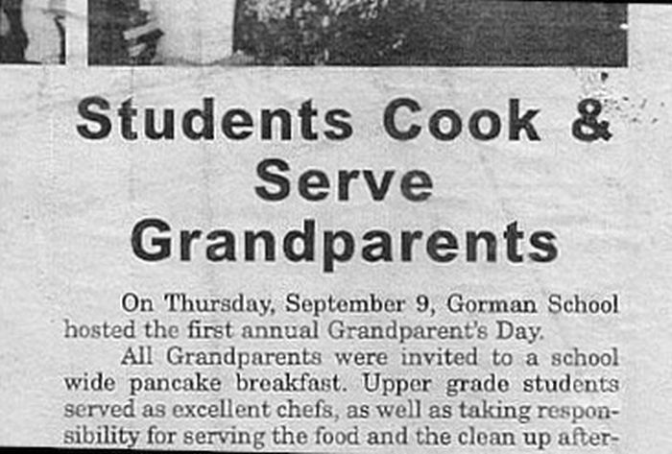
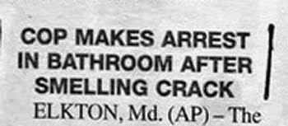
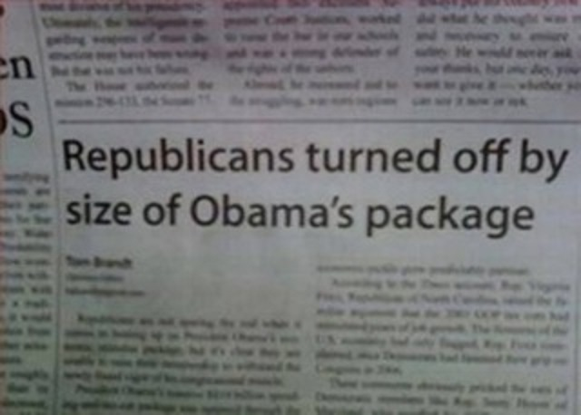
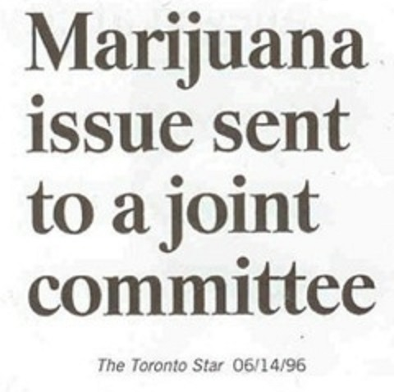

Slide 5
Understanding and Misunderstandings
Relative Language: words gain their respective meanings by comparison.
  Did you attend a big high school or a small high school?
  Is Cedar City a big town?
  Am I tall or short?
  “I’ll be home soon.”
Static Evaluation: Statements that lead to the mistaken assumption that things are consistent and unchanging.
  Robert is loud.
  Alexandra is quiet.
  People change more often than they stay the same.
  “You’re a professor now?”
Abstraction: Vague language that can be interpreted in multiple ways.
  “You need to have a better attitude about this class” vs “You need to complain less about the chapter captures.”
  Can cause people to speak in generalities: “Athletes are the worst.”

Slide 6
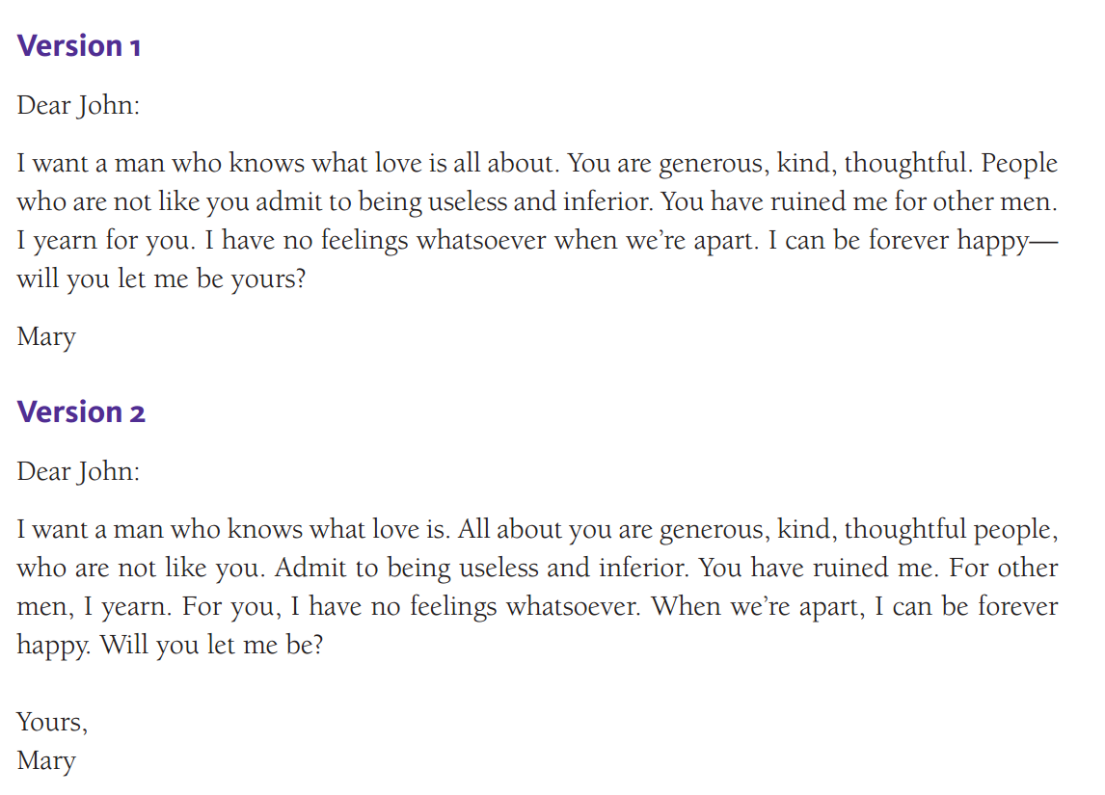
ConteNT: Understanding Structure
Syntactic rules govern the grammar of language. Syntax.

Slide 7
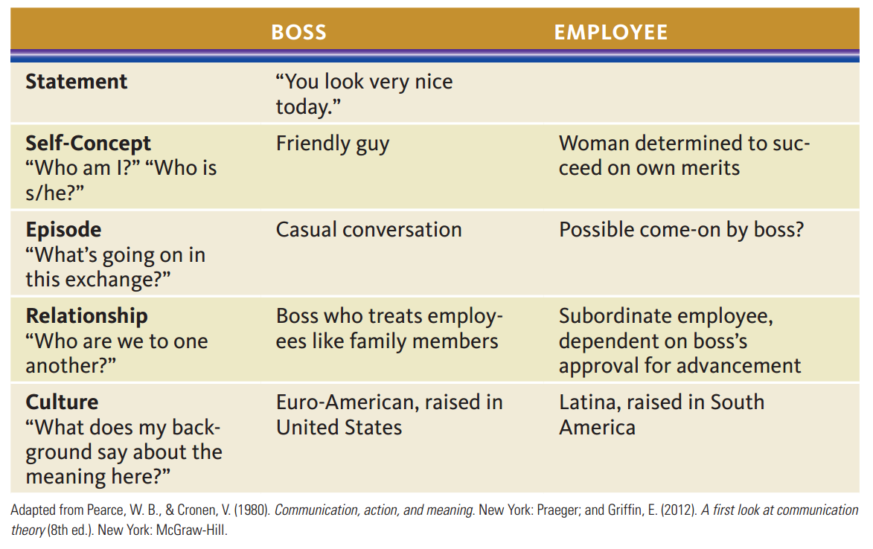
Context: Understanding Structure
Pragmatic rules govern the way speech works in everyday interactions.
  How we interpret messages in a given context.

Slide 8
The Impact of Language
Affiliation
  Speech can build and demonstrate solidarity with others.
  Convergence: The process of adapting one’s speech style to match others.
  Divergence: Speaking in a way that emphasizes one’s differences from others.

Slide 9
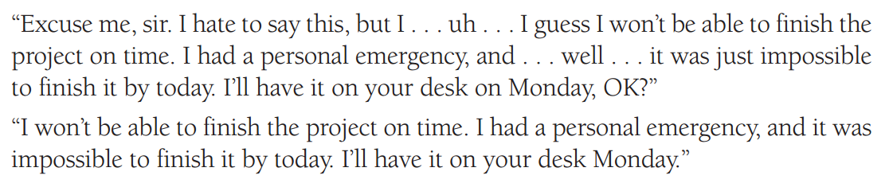
The Impact of Language
Power
  Language patterns can add to or detract from a speaker’s power to influence others.
  There is a cultural standard here as well.
  Powerful and polite speech working together is the most effective combination.

Slide 10
The Impact of Language
Emotive Language
  Seems to describe something, but actually announces the speakers attitude toward it.
    If you approve, you say… If you disapprove, you say…
    Thrifty Cheap
    Vintage Old
    Cautious Cowardly

Slide 11
The Language of Responsibility
“It” Statements: allow communicators to avoid responsibility for ownership of a message.
  Notice the difference:
    “It bothers me when you don’t show up for class” vs “I’m worried when you don’t show up…”
    “It’s nice to see you” vs “I’m glad to see you”
“But” Statements: when the word ‘but’ cancels out the thought that precedes it.
  “You’re really a great person, but I think we should see other people.”
  “You’ve done good work for us, but we’re going to have to let you go.”
Questions: often used as a way to avoid making a declaration
  “What are we having for dinner?” could mean, “I don’t want to cook.”
  “How many textbooks are assigned in that class?” could mean, “I’m afraid to get into a class with too much reading.”

Slide 12
The Language of Responsibility
“I” and “You” Language
  “I” statements accept responsibility for a message.
    “I don’t want to be responsible for all of the cleaning in the apartment.”
  “You” statements express judgment.
    “You left this place a mess!”
“We” Language
  “We” implies that an issue is the concern and responsibility of both communicators.
    “We aren’t doing a very good job of keeping the place clean, are we?”

Slide 13
Most Common Workplace errors
Sentence fragments.
Comma splices.
Run-on sentences.
Ambiguous pronoun references.
Comparing items clearly.
Using adjectives clearly.
Maintaining subject-verb agreement.
Maintaining pronoun-antecedent agreement.
Using tenses correctly.

Slide 14
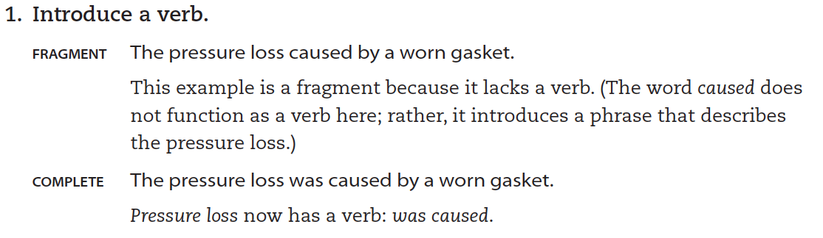
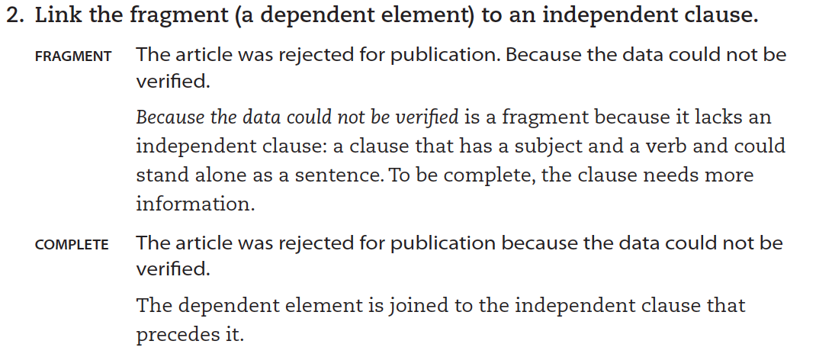
Most Common Workplace errors
Sentence fragments
A sentence fragment is an incomplete sentence.
A sentence fragment occurs when a sentence is missing either a verb or an independent clause.

Slide 15
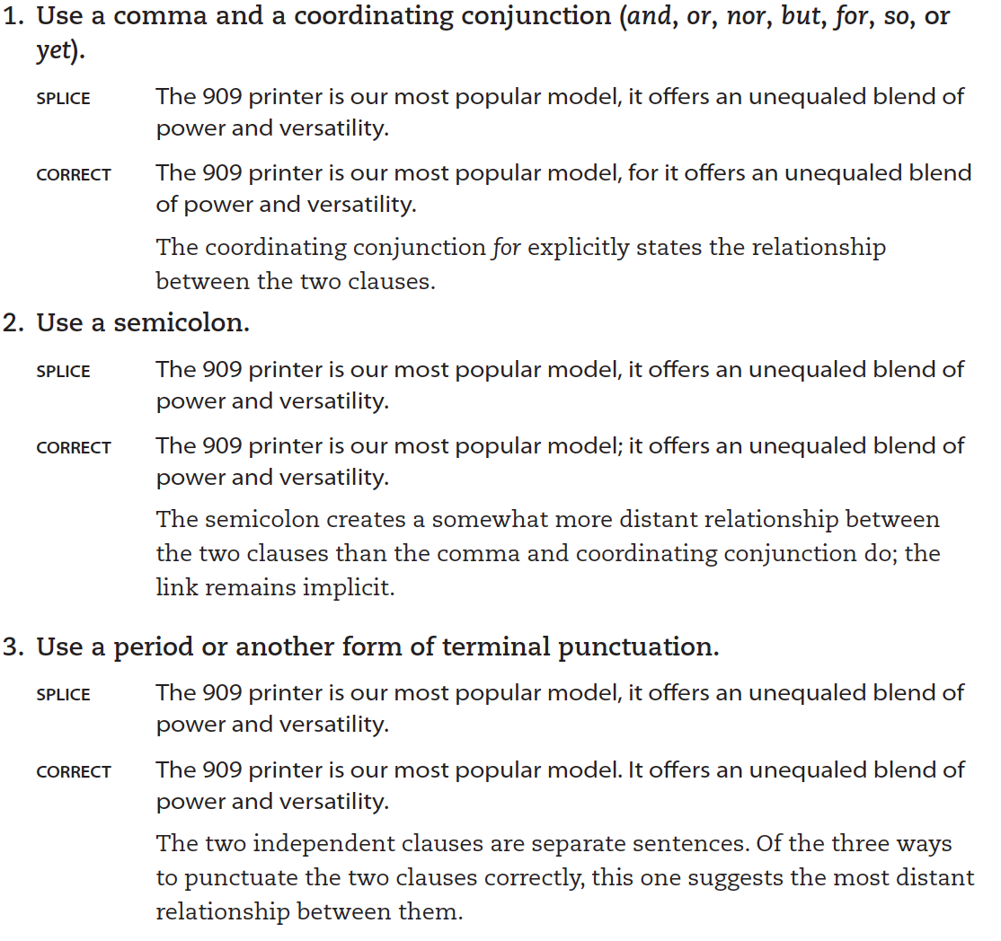
Most Common Workplace errors
Comma splices
A comma splice is an error that occurs when two independent clauses are joined, or spliced together, by a comma.

Slide 16
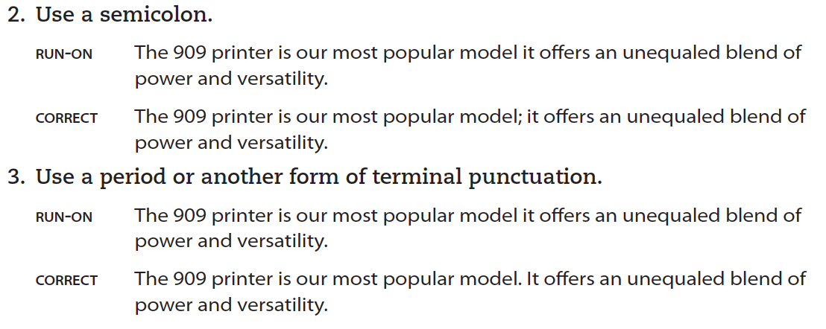
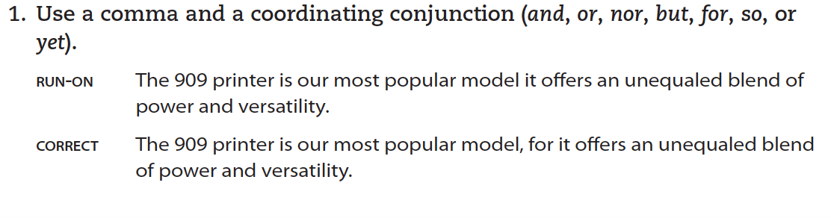
Most Common Workplace errors
Run-on sentences
In a run-on sentence (sometimes called a fused sentence), two independent clauses appear together with no punctuation between them.

Slide 17
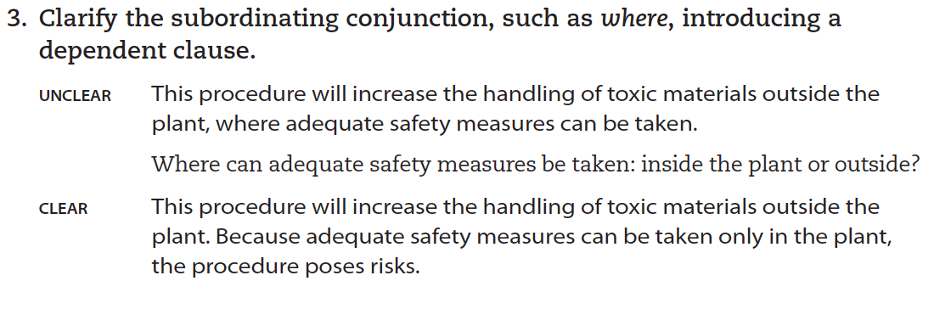
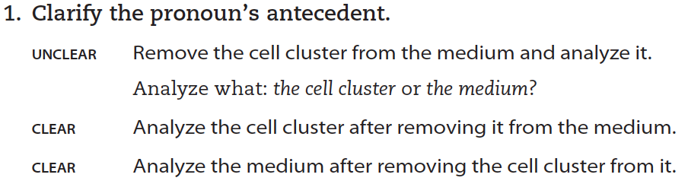
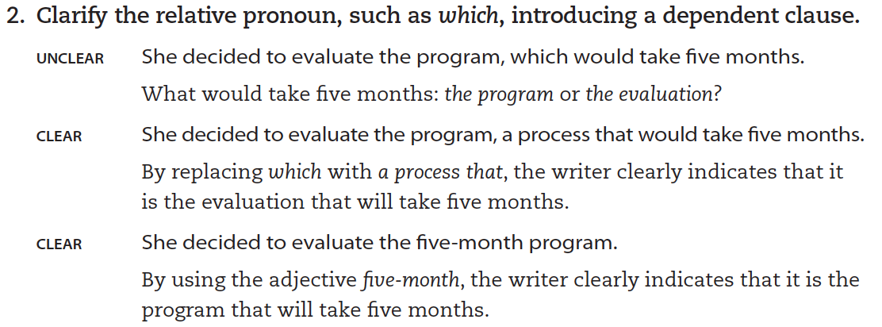
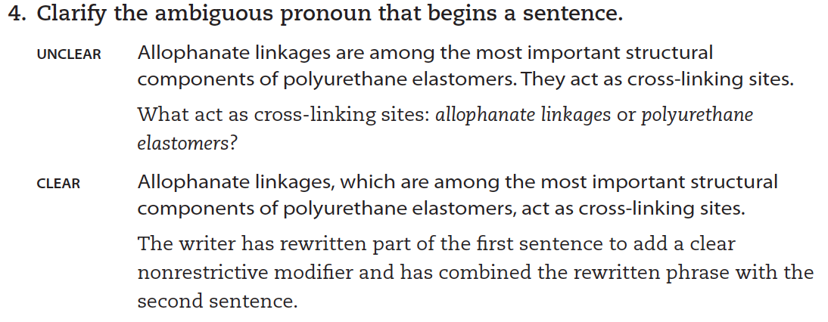
Most Common Workplace errors
Ambiguous pronoun references
Pronouns must refer clearly to their antecedents—the words or phrases they replace.

Slide 18
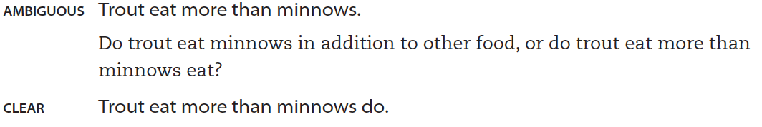
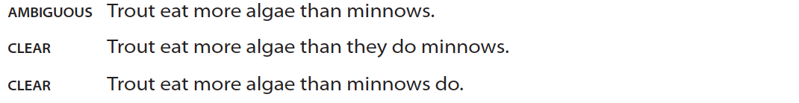
Most Common Workplace errors
Comparing items clearly.
When comparing or contrasting items, make sure your sentence communicates their relationship clearly.
A simple comparison between two items usually causes no problems: “The X3000 has more storage than the X2500.”

Slide 19
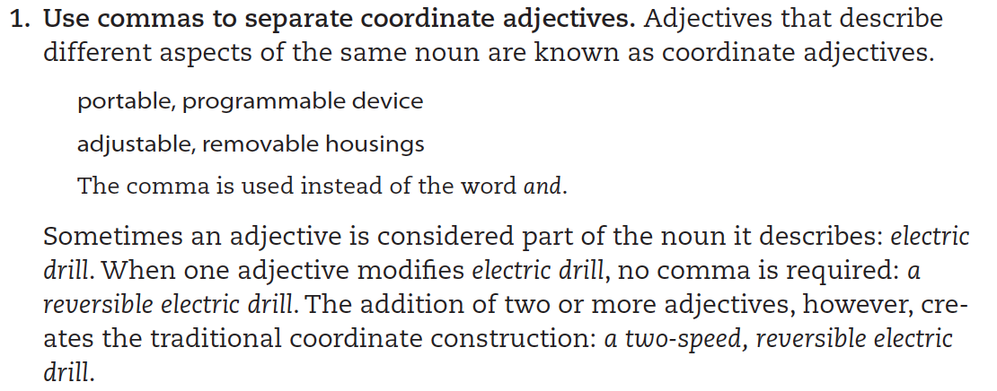
Most Common Workplace errors
Using adjectives clearly
In general, adjectives are placed before the nouns that they modify: the plastic washer.
In technical communication, however, writers often need to use clusters of adjectives.

Slide 20
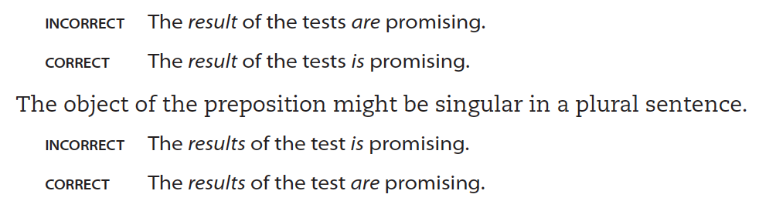
Most Common Workplace errors
Maintaining subject-verb agreement
The subject and verb of a sentence must agree in number, even when a prepositional phrase comes between them. The object of the preposition might be plural in a singular sentence.

Slide 21
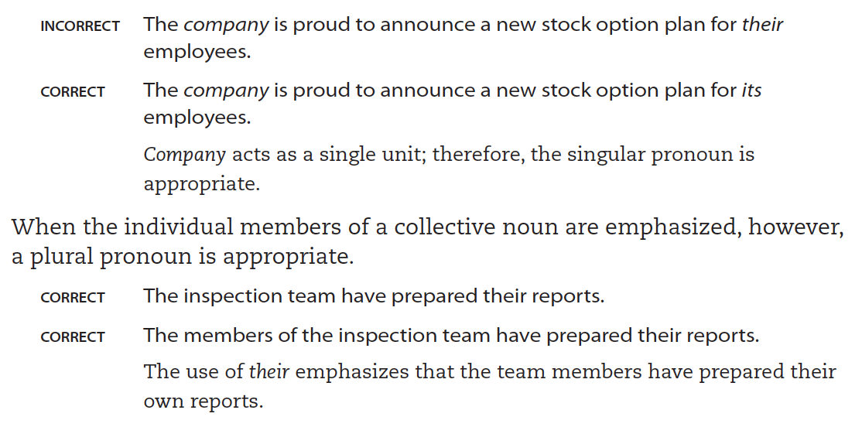
Most Common Workplace errors
Maintaining pronoun-antecedent agreement
A pronoun and its antecedent (the word or phrase being replaced by the pronoun) must agree in number.
Often an error occurs when the antecedent is a collective noun—one that can be interpreted as either singular or plural, depending on its usage.

Slide 22
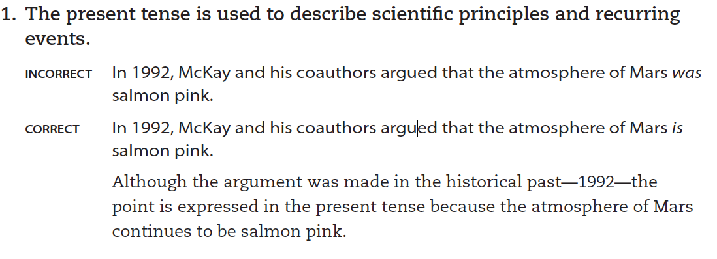
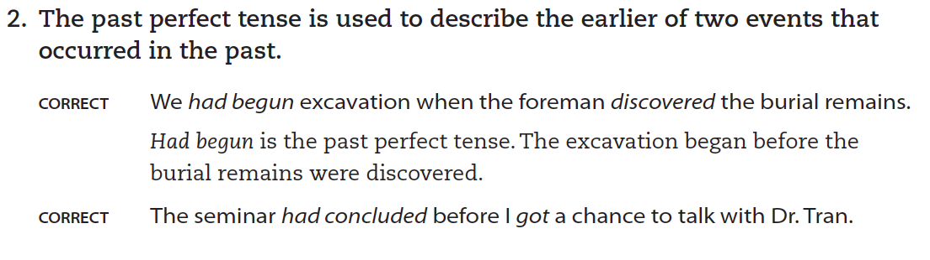
Most Common Workplace errors
Using tenses correctly
Two verb tenses are commonly used in technical communication: the present tense and the past perfect tense.
It is important to understand the specific purpose of each.

Slide 23
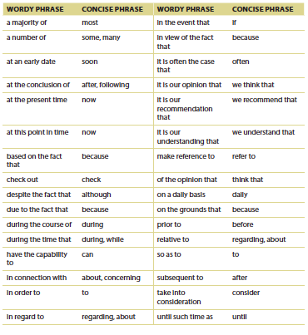
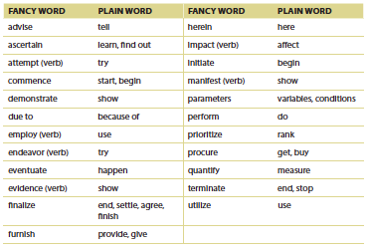
Good Writing is concise writing

Slide 24
Team Exercise: Write More Better
Working with a partner, write a one-paragraph evaluation of each of the following titles. How clearly does the title indicate the subject and purpose of the document? In what ways does it fall short of incorporating this chapter’s advice about titles? On the basis of your analysis, rewrite each title.
  A Study of Digital Cameras
  Agriculture in the West: A 10-Year View
  Multigroup Processing Technique Review Board Report Findings
  The Great Depression of 1929

