Slide 1
Creating User-Friendly Documents
Chapter 7

Slide 2
You have five goals when designing:
to make a good impression on readers
to help readers understand the structure and hierarchy of the information
to help readers find the information they need
to help readers understand the information
to help readers remember the information

Slide 3
When planning a design, follow these 4 steps:
Analyze your audience and purpose.
Consider multicultural readers.
Consider your purpose.
Determine your resources.

Slide 4
4 principles of design to help your documents:
proximity
alignment
repetition
contrast

Slide 5
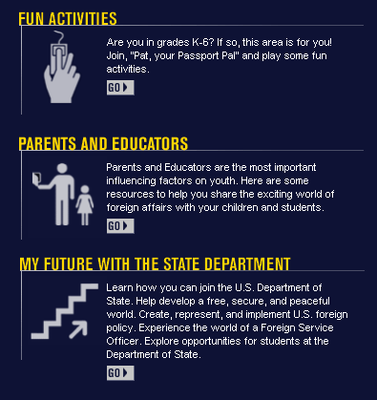
Proximity

Slide 6
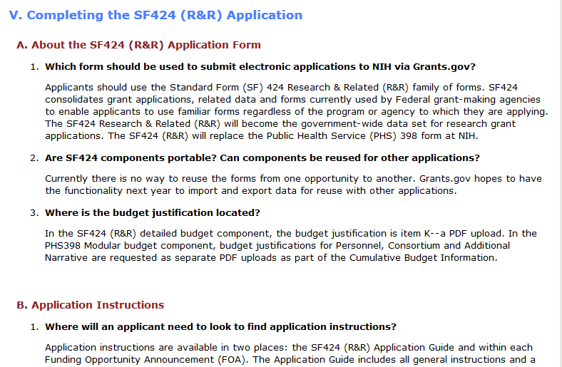
Alignment

Slide 7
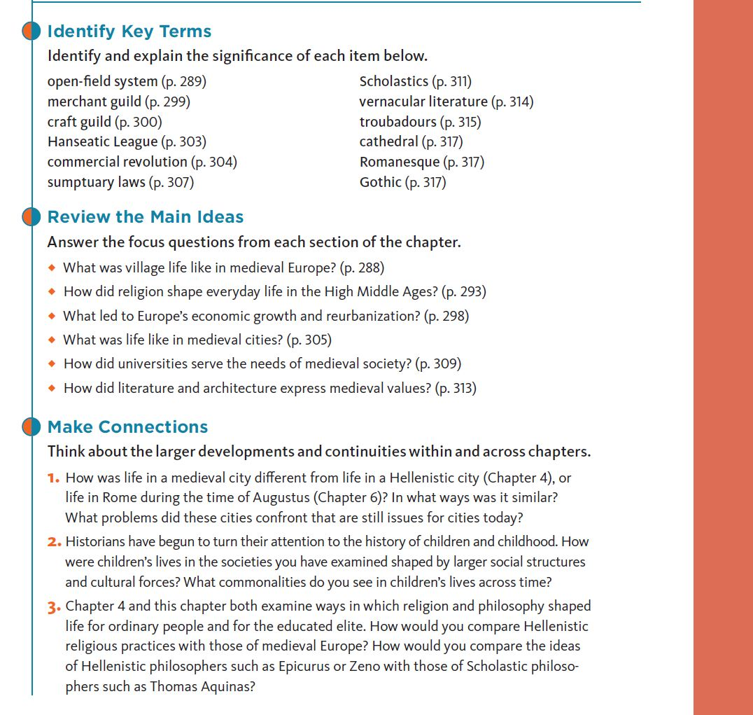
Repetition

Slide 8
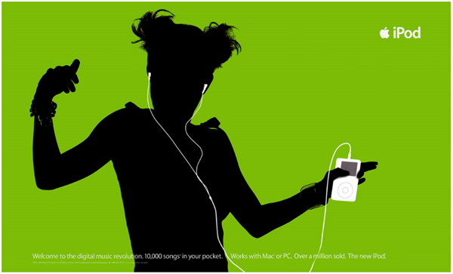
Contrast

Slide 9
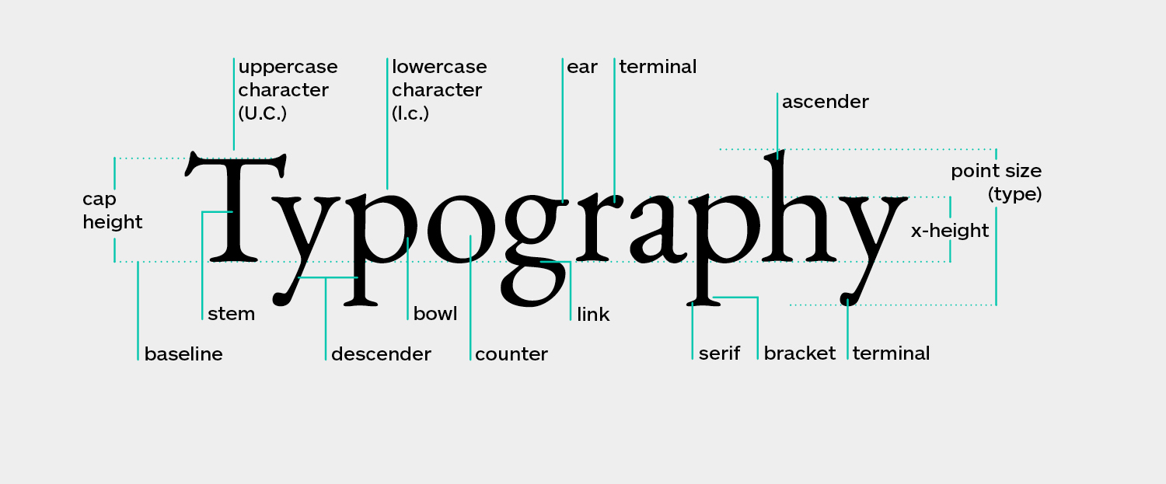
Typography

Slide 10
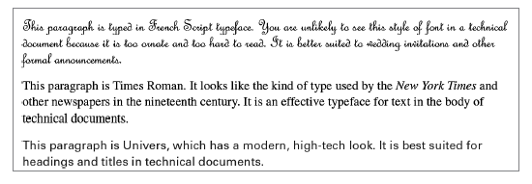
Beware of your typography
typefaces
type families
case
type size
line length
line spacing
justification

Slide 11
2 main typeface categories:
        N N
        serif sans serif

Slide 12
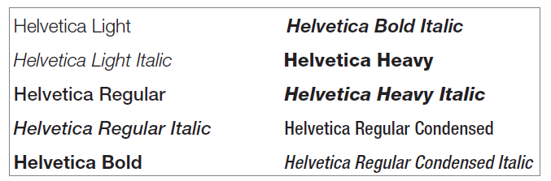
Type family variations:

Slide 13
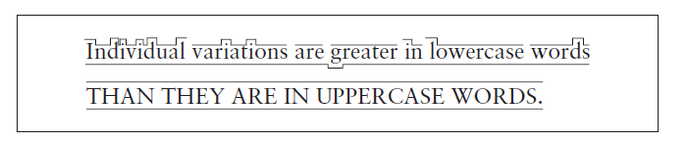
Case affects readability

Slide 14
Different functions call for different type sizes:
footnotes 8- or 9-point type
body text 10-, 11-, or 12-point type
headings 14-point type
indexes 2 points smaller than body text
titles 18 or 24 points
slides 24- to 36-point type

Slide 15
Use type sizes responsibly
Use large type to emphasize headings and important info
It is unethical (sometimes illegal) to use excessively small type (6-point or less)

Slide 16
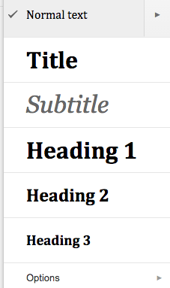
Headings

Slide 17
Use line spacing carefully and consistently
Summary
In this example, the writer has skipped a line between the heading and the text that follows it.
Summary
In this example, the writer has not skipped a line. The heading stands out, but not as emphatically.
Summary. This run-in style makes the heading stand out the least.

Slide 18
Titles and headings should stand out
Display title of document clearly and prominently
  On a cover page or title page, use a large size (18 or 24 points)
Use size variations to distinguish between headings
  Boldface can also achieve this distinction

Slide 19
Tools available for SUU students:
Adobe CC
Microsoft Office
Canva

Slide 20
Adobe CC
All computers in the library and computer labs have the adobe creative suite available for SUU students to use.
Includes:
Photoshop & Lightroom
InDesign
Illustrator
Adobe Stock
Premiere Pro
Audition
Etc.

Slide 21
Adobe CC
Robust tools that have very few limitations.
Take a lot of time to learn how to use effectively.
Multiple courses offered just for these products.
YouTube is also a great way to learn.

Slide 22
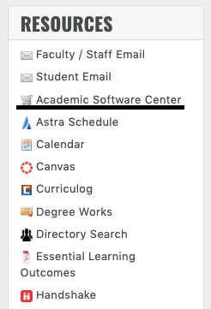
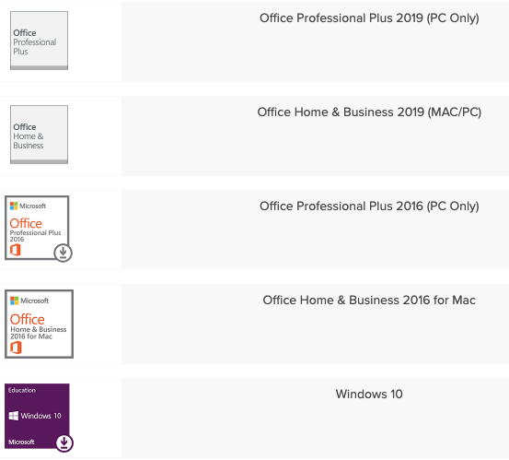
Microsoft Office
Not only do all computers on campus have the Microsoft Office Suite, but it is available to all students to download for free.

Slide 23
Microsoft Office
The Microsoft Office suite includes:
Word
Excel
PowerPoint
Publisher
Etc.
All of these programs have the ability to generate graphics.
The Google Drive counter parts to these programs also offer graphical capabilities.

Slide 24
Canva
A simplified graphic-design tool website that uses a drag-and-drop format and provides access to photographs, vector images, graphics, and fonts.
It is used by non-designers as well as professionals.
The tools can be used for both web and print media design and graphics.

Slide 25
Canva
Canva is primarily used for crating social media graphics, but offers templates for:
Certificates
Resumes and cover letters
Posters
Custom logos
Flyers
Etc.
Canva is cloud-based, meaning no software is needed.
It is also free to use.

