Slide 1
User-Friendly Documents
Chapter 8

Slide 2

Using Graphics

Slide 3
Graphics serve 5 functions:
They catch readers’ attention and interest.
They help writers communicate information that is difficult to communicate with words.
They help writers clarify and emphasize information.
They help nonnative speakers of English understand information.
They help writers communicate information to multiple audiences with different interests, aptitudes, and reading habits.

Slide 4
Benefits that graphics offer:
Graphics are indispensable in demonstrating logical and numerical relationships.
Graphics can communicate spatial information more effectively than words alone.
Graphics can communicate steps in a process more effectively than words alone.
Graphics can save space.
Graphics can reduce the cost of documents intended for international readers.

Slide 5
Effective graphics have 5 characteristics:
It serves a purpose.
It is simple and uncluttered.
It presents a manageable amount of information.
It meets readers’ format expectations.
It is clearly labeled.

Slide 6
Creating graphics includes 4 steps:
planning
producing
revising
citing sources

Slide 7
When planning graphics consider:
audience
purpose of the graphic and the document
kind of information you want to communicate
physical conditions in which readers will use the document

Slide 8
Presenting graphics honestly:
Cite your source and obtain permission.
Include all relevant data.
Begin the axes in your graphs at zero—or mark them clearly.
Do not use a table to hide a data point that would be obvious in a graph.
Show items as they really are.
Do not use color or shading to misrepresent an item’s importance.

Slide 9
4 approaches to creating graphics:
use existing graphics
modify existing graphics
create graphics on a computer
have someone else create the graphics

Slide 10
5 guidelines to integrating graphics with text:
Place the graphic in an appropriate location.
Introduce the graphic in the text.
Explain the graphic in the text.
Make the graphic clearly visible.
Make the graphic accessible.

Slide 11
Commonly used graphics
Tables
Bar graphs
Infographics
Line graphs
Pie charts

Slide 12
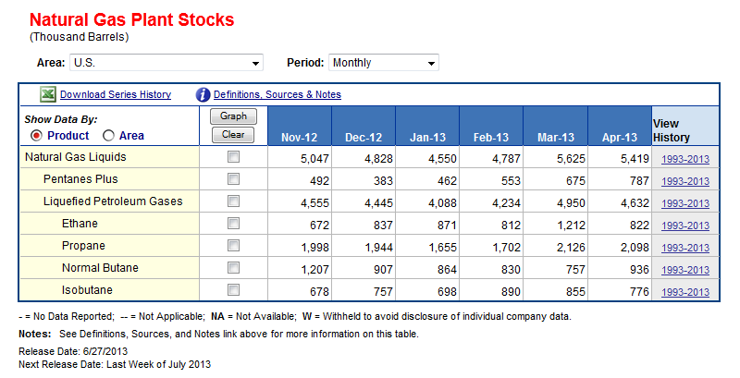
Tables
Indicate the units of measure.
In the stub—the left-hand column—list the items being compared.
In the columns, arrange the data clearly and logically.
Do the math.
Provide footnotes where necessary.

Slide 13
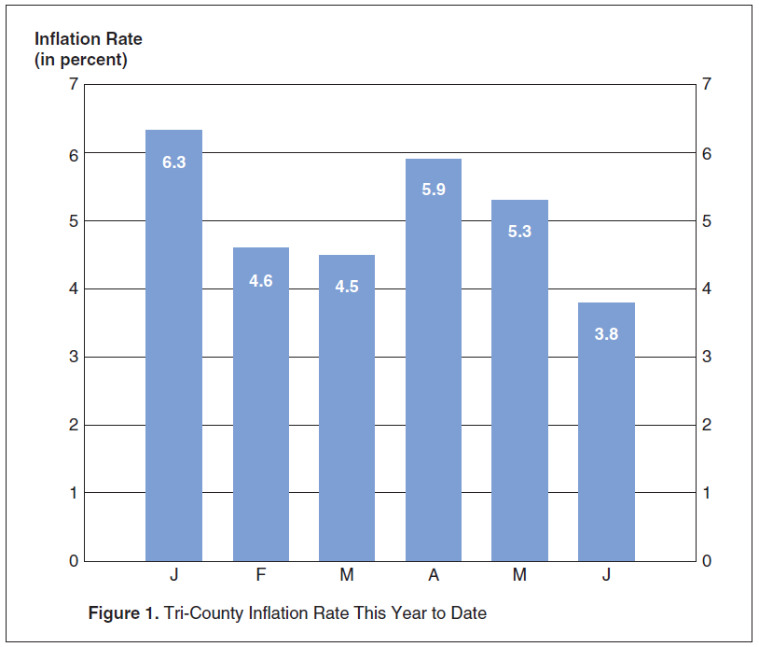
Bar graphs
Make the proportions fair.
If possible, begin the quantity scale at zero.
Use tick marks—marks along the axis—to signal the amounts.
Place the title below the figure.
Indicate the source of your information.

Slide 14
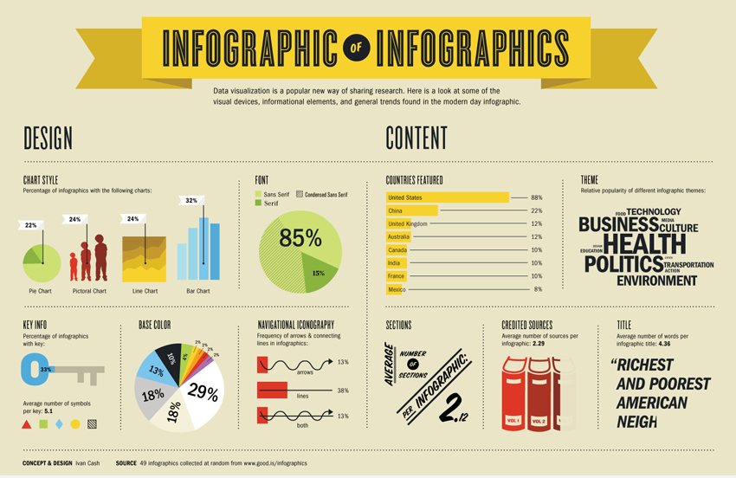
Infographics
Make a claim.
Use accurate data.
Write concisely.
Don’t present too much information.
Don’t go on forever.
Test the infographic.

Slide 15
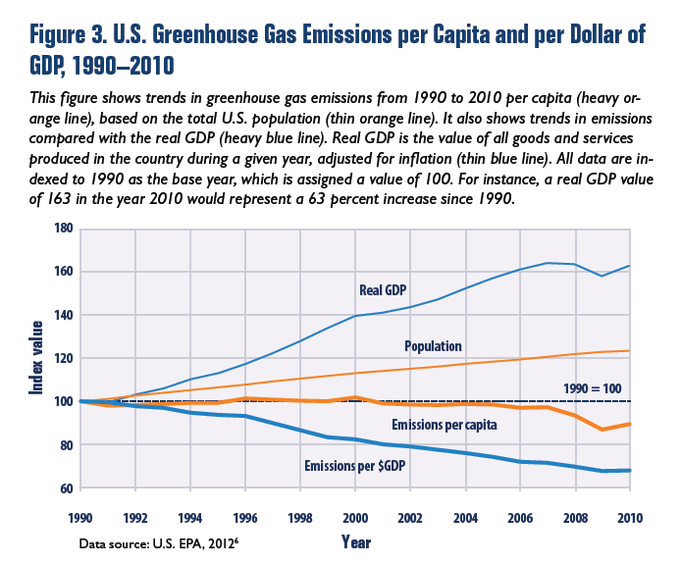
Line Graphs
If possible, begin the quantity scale at zero.
Use reasonable proportions for the vertical and horizontal axes.
Use grid lines—horizontal, vertical, or both—rather than tick marks when your readers need to read the quantities precisely.

Slide 16
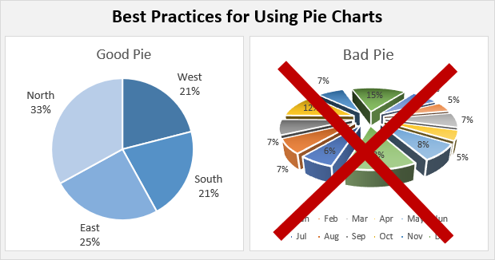
Pie Charts
Restrict the number of slices to no more than seven.
Put very small quantities together in one slice.
Place a label (horizontally, not radially) inside the slice.
To emphasize one slice, use a bright, contrasting color or separate the slice from the pie.
Don’t overdo fill patterns.
Check that your percentages add up to 100.

Slide 17
Other types of graphics you may need to use:
checklists
flowcharts
techniques for showing action or motion
photographs
screen shots
line drawings
maps

Slide 18

Checklist

Slide 19

Flowchart

Slide 20
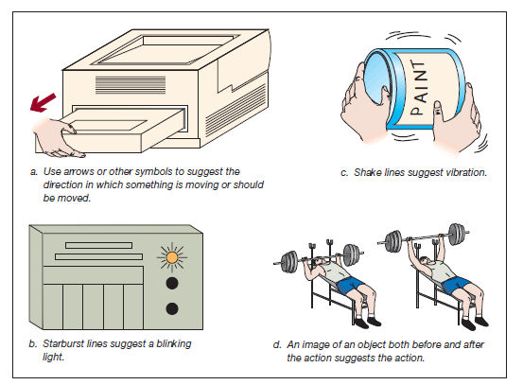
Motion or Action:

Slide 21
Photographs
Eliminate extraneous background clutter that can distract readers.
Do not electronically manipulate the image.
Help readers understand the perspective.
If appropriate, include a common object in the photograph to give readers a sense of scale.
If appropriate, label components or important features.

Slide 22

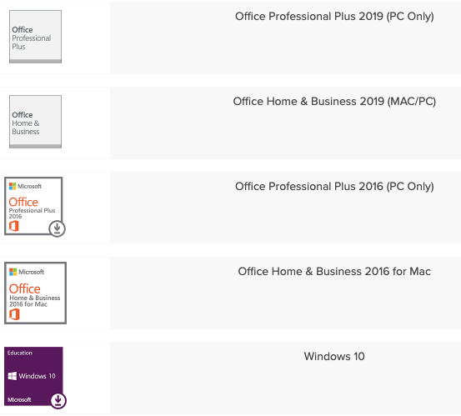
Screenshots

Slide 23
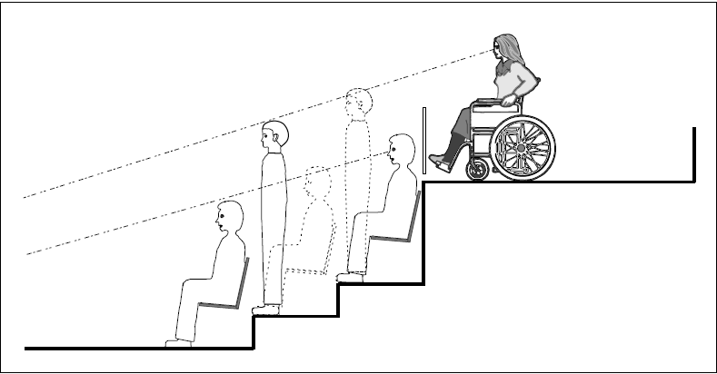
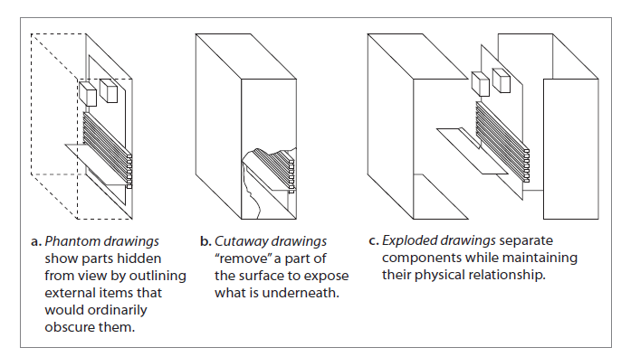
Line Drawings

Slide 24
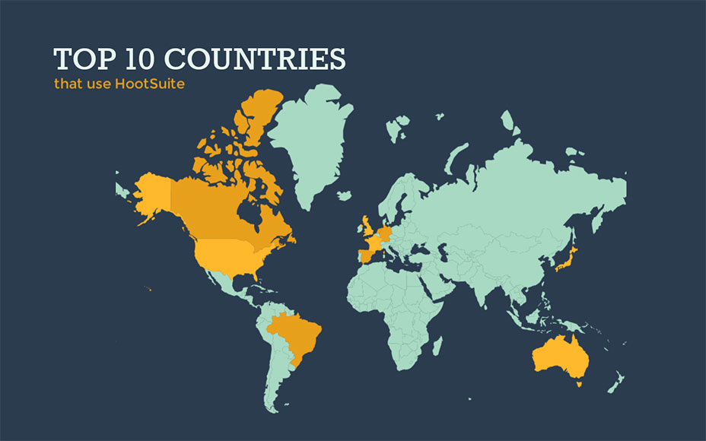
Maps

Slide 25
Creating graphics for multicultural readers:
Be aware that reading patterns differ.
Be aware of varying cultural attitudes toward giving instruction.
Deemphasize trivial details.
Avoid culture-specific language, symbols, and references.
Portray people very carefully.
Be particularly careful in portraying hand gestures.

Slide 26
Team Exercise

