Slide 1
Interpersonal Communication
Chapter topics
Why We Communicate
The Process of Communication
Communication Principles and Misconceptions
The Nature of Interpersonal Communication
What Makes an Effective Communicator

Slide 2


Slide 3
Why We Communicate
Physical Needs
Identity Needs
Social Needs
Practical Goals

Slide 4
Why We Communicate
Physical Needs
  Communication is essential to our well-being.
    Not everyone needs the same amount.
    The quality is just as important as the quantity
    Research has identified measurable health benefits.
  Positive communication and strong social ties lead to better health

Slide 5
Why We Communicate
Identity Needs
  Identity comes from how we interact with others
    How we develop our sense of self-identity
  Messages influence our identity throughout our lives
    Most prevalent during childhood
  Acting human is a learned process

Slide 6
Why We Communicate
Social Needs
  Communication is used to:
    Obtain pleasure, affection, companionship, relaxation, escape and control
    Create happier relationships and social lives
  Positive relationships may be the most important source of human satisfaction and emotional well-being.

Slide 7
Why We Communicate
Practical Goals
  Getting others to behave in ways we want
    Can be very basic or very intense.
  Essential in virtually every career
  Abraham Maslow’s Hierarchy of Needs
    Physical
    Safety
    Social
    Esteem
    Self-Actualization

Slide 8
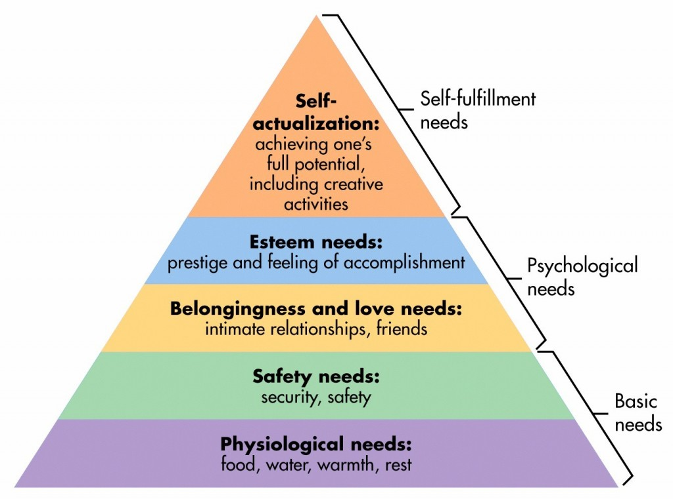
Why We Communicate

Slide 9
The Process of Communication
Communication involves:
  A sender- the person creating the message
  Encoding- how the message is being delivered; symbols, words
  Message- the information being transmitted
  Channel- the medium through which the message passes
  Receiver- person attending to the message
  Decoding- making sense of the message
  Noise- external distractions that disrupt the message
  Environment- location, experience, background

Slide 10
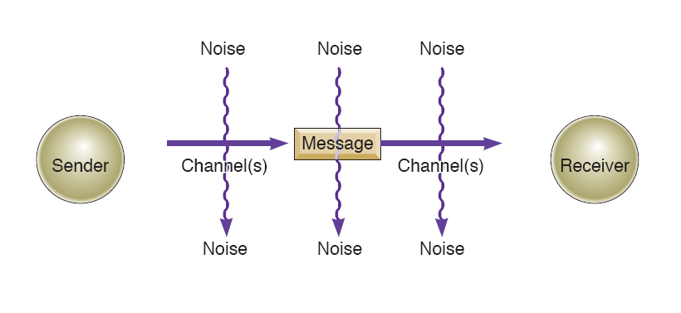
The Process of Communication
A Linear View
  Communication is “done to” a receiver
Figure 1.1 Page 10

Slide 11
The Process of Communication
Linear Communication
  Created by scientists interested in electronic media
    Suited to radio and television
  Affected the way we think and talk about communication
  Is there really only one sender and one receiver?

Slide 12
The Process of Communication
A Linear View
  Communication is “done to” a receiver
Figure 1.1 Page 10

Slide 13
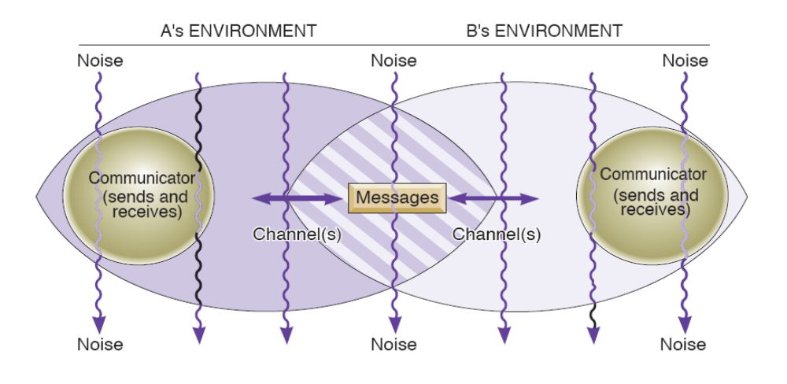
The Process of Communication
A Transactional View
  Communication as a uniquely human process
Figure 1.2 Page 11

Slide 14
The Process of Communication
Transactional Communication
  Messages are sent and received simultaneously (no sender/receiver)
  Environments
    Physical location, personal experiences, and cultural backgrounds
  Noise
    Internal as well as external noise
  Channels retain significant role

Slide 15
The Process of Communication
A Transactional View
  Communication as a uniquely human process
Figure 1.2 Page 11

Slide 16
Principles of Communication
Communication can be intentional or unintentional.
Communication is irreversible.
It’s impossible to not communicate.
Communication is unrepeatable.
Communication has a content and relational dimension.

Slide 17
Principles of Communication
Communication can be intentional or unintentional.
  Some communication is clearly intentional, while some communication is never meant to be conveyed.
When is communication intentional?
Unintentional?

Slide 18

Principles of Communication
Communication is irreversible.
Is it ever possible to uncommunicate
something?

Slide 19
Principles of Communication
It’s impossible to not communicate.
Because both intentional and unintentional behaviors send a message, many theorists agree that it is impossible not to communicate.
  Those who decode your message may not interpret it accurately.

Slide 20
Principles of Communication
Communication is unrepeatable.
Nothing can be truly replicated.
Nothing will be received the same way twice.
Why?

Slide 21
Principles of Communication
Communication has a content and relational dimension.
The content dimension involves the information being explicitly discussed:
  “Turn left at the next corner.”
  “You can buy that for less online.”
  “You’re standing on my foot.”
Messages also have a relational dimension that expresses how you feel about the other person:
  whether you like or dislike the other person,
  feel in control or subordinate,
  feel comfortable or anxious, etc.

Slide 22
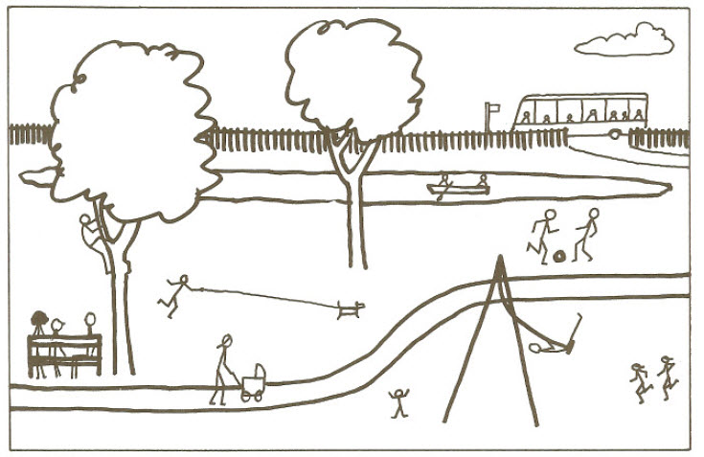

Slide 23
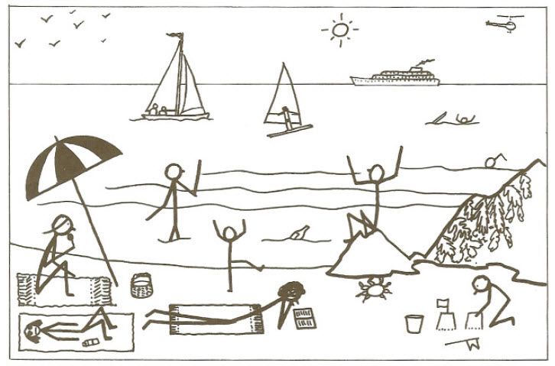

Slide 24
Mediated Communication
Mediated communication refers to communication carried out by the use of information communication technology, and can be contrasted to face-to-face communication.
Mediated communication channels include:
  Facebook/Instagram
  Texting
  Skype/FaceTime
  Emailing
  Blogging
  Discussion Boards

Slide 25
Simon Sinek on Millennials
https://www.youtube.com/watch?time_continue=2&v=hER0Qp6QJNU

Slide 26
Mediated Communication
Benefits
Challenges
More social networks
Those who regularly communicate with friends/family online are more likely to call and visit them more often.
Mediated communication makes it easier to maintain relationships.
Mediated messages are leaner; they lack richness.
Disinhibition- Transmitting a message without considering its consequences.
Permanence- Digital messages can be (and are) archived forever.

Slide 27
Communication Misconceptions
More communication is not always better.
  When?
Meanings are not in words.
  Saying ≠ Communicating
No single person or event causes another’s reaction.
  What does this mean?
Communication will not solve all problems.
  Example.
  When is clear communication the problem?

Slide 28
Communication Competence
Competence- the ability to do something successfully or efficiently.
  Proficient, High ability, Capable
A competent communicator seeks to utilize effective and appropriate communication tools while looking out both for himself/herself and for others.

Slide 29
Communication Competence
There is no ideal way to communicate.
Competence is situational.
Competence is relational.
Competence can be learned.

Slide 30
Being a Competent Communicator
Possess a wide range of behaviors.
Able to choose the most appropriate behavior.
  Context- The time and place will influence how you act.
  Goal- Will determine the approach you take.
  Knowledge- Will shape the approach you take.
Demonstrates skills at performing behaviors.
Cognitive complexity- Considering an issue from multiple angles.
Empathetic to others and monitors one’s self.
Shows a sincere commitment to others.
  Sin Cera

Slide 31
Topic Paper: Go to Lunch
https://www.ted.com/talks/elizabeth_lesser_take_the_other_to_lunch?language=en
One page, size 10-12 font, single-spaced.
Due Wednesday, February 7, 11:59 p.m.
Find an opportunity to ”take the other to lunch."
Write about who you went with, what you talked about, and what you gained from this experience.
Remember that this needs to be with someone who holds a contrasting belief or perspective than you.
You don’t actually have to go to lunch.

