Slide 1
CULTURE & SELF
Chapter 2 discussion

Slide 2
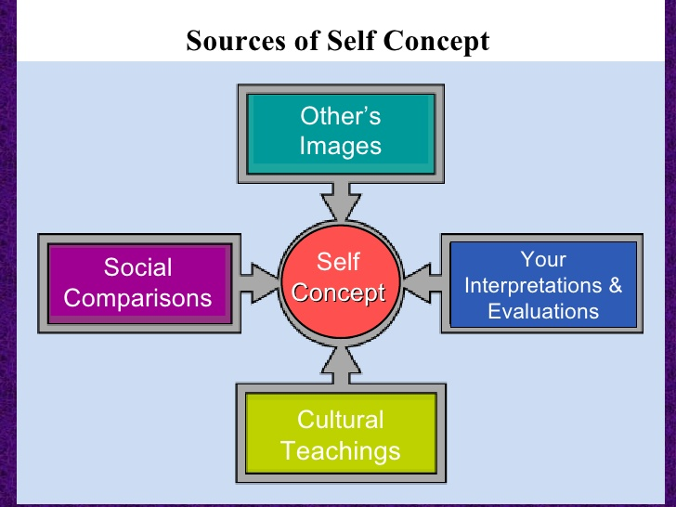
Self-Concept
Who you think you are can be described as your self-concept: the relatively stable set of perceptions you hold of yourself.
  The concept of self is perhaps our most fundamental possession.
  Knowing who we are is essential, because without a self-concept it would be impossible to relate to the world.
  “Who am I?”
    Your self concept describes who
    you think you are.

Slide 3
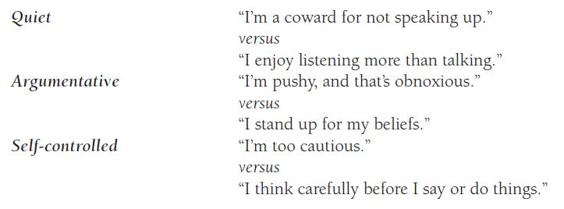
Self-Esteem
While your self-concept describes who you think you are, self-esteem involves evaluations of self-worth.
  A hypothetical communicator’s self-concept might include being quiet, argumentative, or self-controlled. His or her self-esteem would be determined by how he or she felt about these qualities.

Slide 4
Self-Esteem
People with high self-esteem:
  Likely to think well of others
  Expect to be accepted by others
  Evaluate their own performance more favorably
  Perform well when being watched
  Inclined to feel comfortable with views of others
  Able to defend themselves against negative comments

Slide 5
Self-Concept vs. Self-Esteem
Self-Concept
Self-Esteem
What I know about myself.
  I wear contacts
  I am tall
  I teach COMM 2110
  I am colorblind
  I have spikey hair
  I have two daughters
How I feel about these fragments of knowledge
  I hated wearing glasses, now I feel better
  I wish I were taller
  I enjoy teaching
  I’m not a fan of this
  I love my hair
  I love being a father

Slide 6
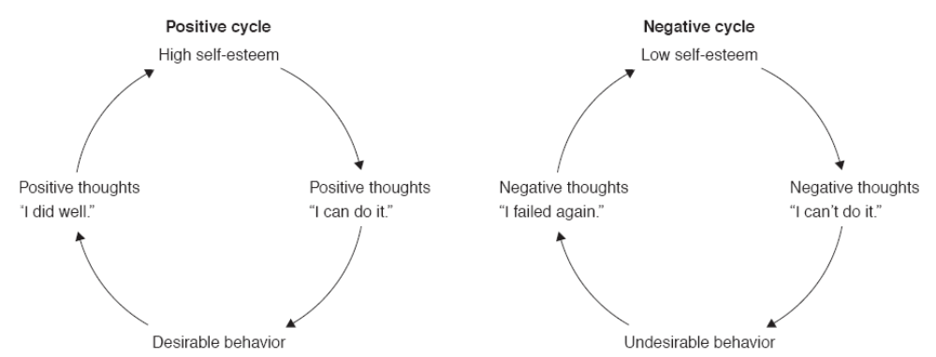
Communication and the Self
Self-Concept and Self-Esteem
  Self-esteem and communication behavior cycles
Figure 2.1 Page 43

Slide 7
Communication and the Self
Biological and Social Roots to the Self
Biology and the self
  Personality is part of our genetic makeup
    People who were judged shy as children still show a reaction as adults when they encounter new situations
  Biology influenced traits
    Extroversion
    Shyness
    Assertiveness
    Verbal Aggression
    Willingness to communicate

Slide 8
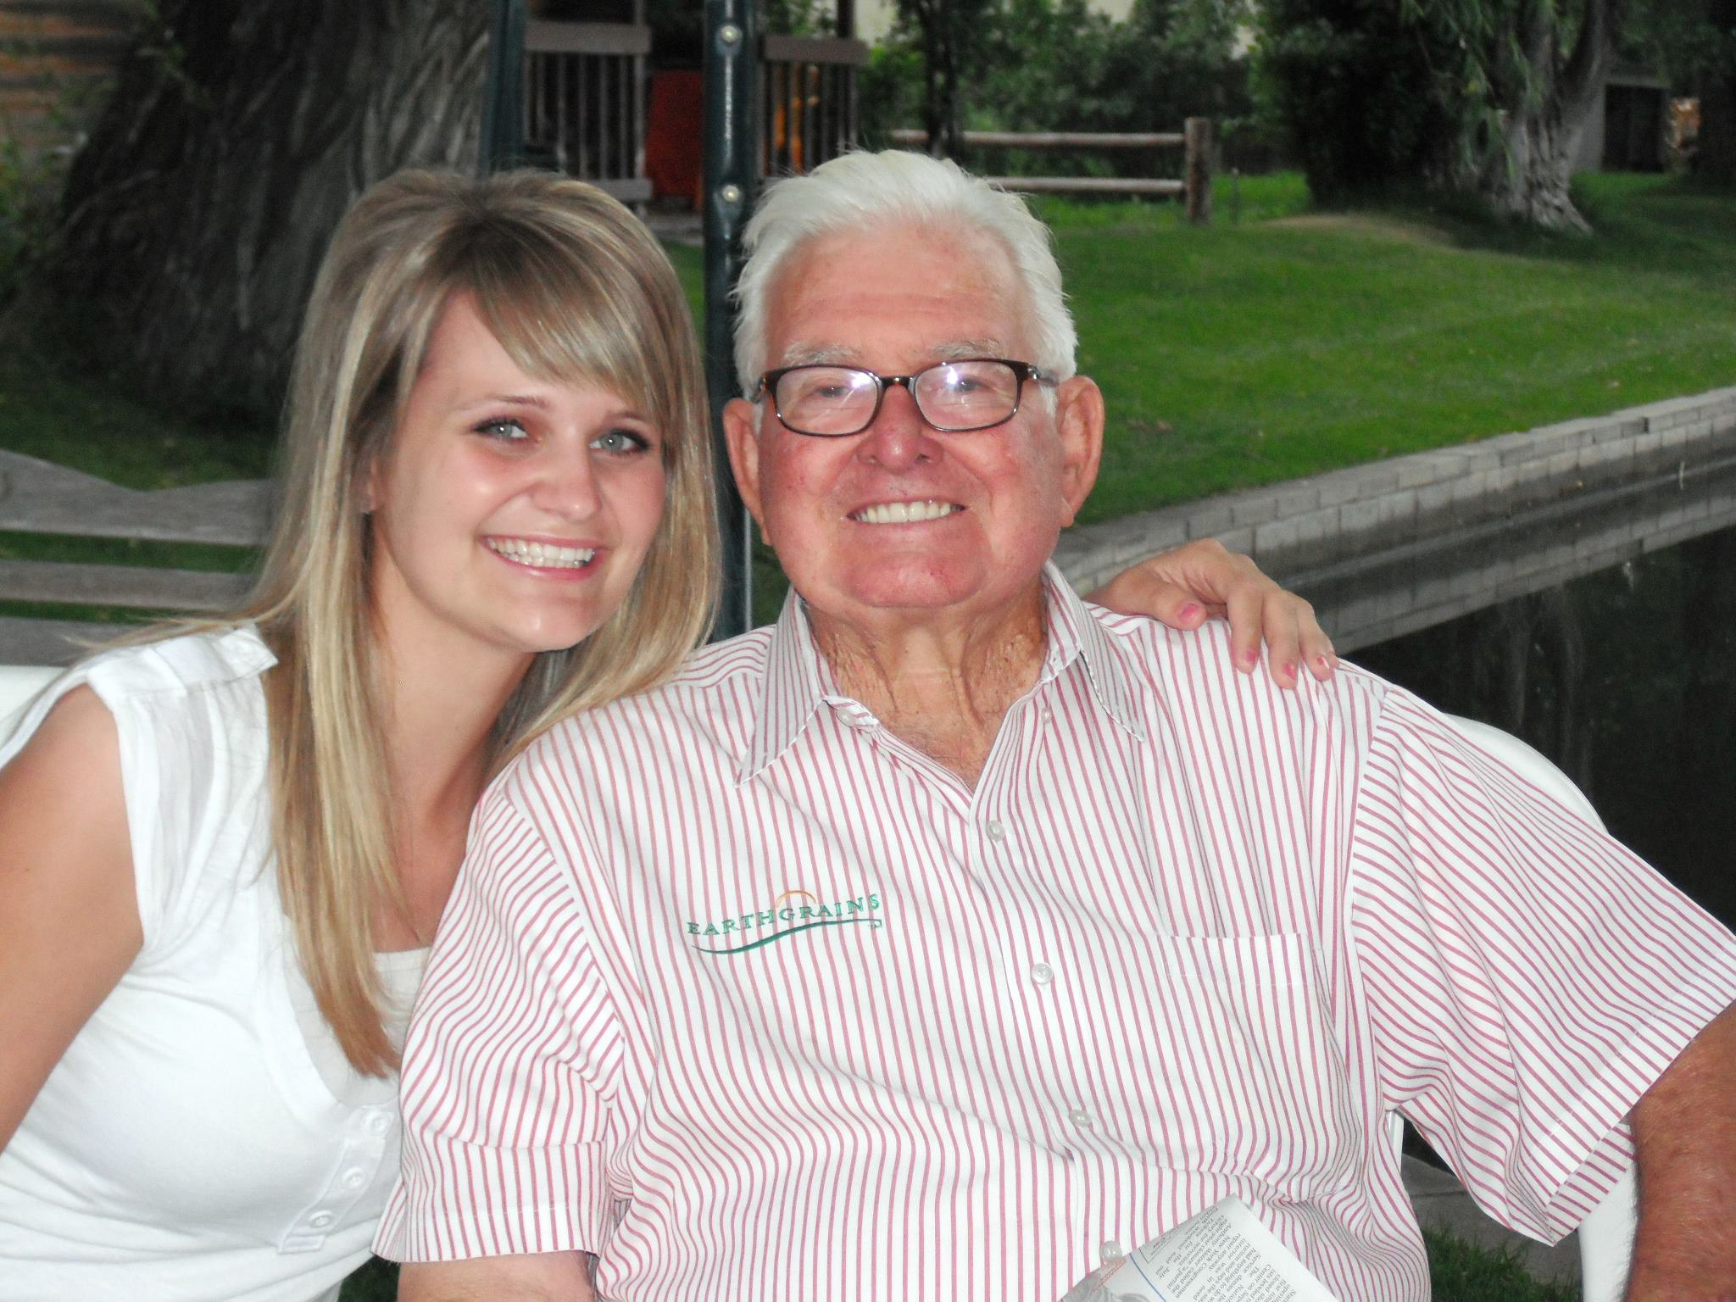
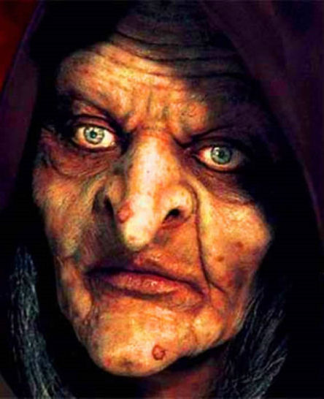
Communication and the Self
Socialization and the Self-Concept
Reflected Appraisal
  Each of us develops a self-concept that reflects the way we believe others see us
  Children are not born with a sense of identity
  Children are bombarded with messages
    “You’re so cute!” “I love you.” “What a big girl.”
    “What’s the matter with you?” “You’re a bad boy.”
  Evaluations like the those above are the mirror by which we know ourselves

Slide 9

Communication and the Self
Socialization and the Self-Concept
Social Comparison
  Evaluating ourselves in terms of how we compare with others
  Two Types of Comparison
    Superior or Inferior
    Attractive or Ugly
    Success or Failure
  These comparisons depend on the person we measure ourselves against

Slide 10
Communication and the Self
Socialization and the Self-Concept
Social Comparison and The Media
  Young women who measure themselves against ultra thin models develop negative appraisals
  Men who compare themselves to the media-idealized male form develop negative appraisals
  Social media effects
  Comparisons go beyond physical appearance.

Slide 11
Communication and the Self
Characteristics of the Self-Concept
The self-concept is subjective
Distorted self-evaluations can (will) occur
These distortions can be based on:
  Obsolete information
  Distorted feedback
  Emphasis on perfection

Slide 12
Communication and the Self
The Self-Concept Resists Change
Cognitive Conservatism
  We seek out people who support our self-concept
    Are you funny? Or, do you surround yourself with people who tell you that you’re funny?
  An inaccurate self-concept can lead to:
    Self-delusion
    Lack of growth
  Most communicators are reluctant to downgrade a favorable impression of themselves

Slide 13
Ego Boosters & Busters
Ego booster: Someone who helped enhance your self-esteem by acting in a way that made you feel accepted, competent, worthwhile, important, appreciated, or loved.
  Can be someone you know well, or a complete stranger.
Ego buster: Someone who acted in a large or small way to reduce your self-esteem.
  Could have been intentional or completely unintentional.

Slide 14
A Healthy Self
1. Have a realistic perception of yourself. While some people have inaccurately inflated egos, others are their own worst critic.
  Keep a healthy perspective.
2. Have realistic expectations. If you demand that you handle every act of communication perfectly, you’re bound to be disappointed.
  Try not to compare yourself to others.
3. Have the will to change. You can change in many ways, if only you are motivated to do so.
4. Have the skill to change. Trying isn’t always enough. In some instances you would change if you knew how to do so.
  Seek advice from those you trust.

Slide 15
What is culture?
Culture is defined as: “the language, values, beliefs, traditions, and customs people share and learn.”
Culture is (1) the relatively specialized lifestyle of a group of people (2) that is passed on from one generation to the next through communication, not through genes.
  (1) Included in a social group’s “culture” is everything that members of that group have produced and developed—their values, beliefs, artifacts, and language; their ways of behaving; their art, laws, religion, and, of course, communication theories, styles, and attitudes.
  (2) Culture is passed on from one generation to the next through communication, not through genes. Culture is not synonymous with race or nationality. The term culture does not refer to color of skin or shape of eyes, as these are passed on through genes, not communication.

Slide 16
The relevance of culture
It is impossible to communicate effectively without being aware of how culture influences human communication.
While someone’s culture can be similar and/or heavily influenced by another’s culture, no two people share the exact same culture.
Aspects of one’s culture
  Race
  Language
  Traditions
  Values
  Religion
  Many, many, many more

Slide 17
Communication and the Self
Culture, Gender, and Identity
Culture
  Individualistic Culture
    Self is separate, unique individual
    Should be independent, self-sufficient
  Collectivistic Culture
    People belong to extended families or in-groups
    “We” or group orientation

Slide 18
Communication and the Self
Culture, Gender, and Identity
Sex and gender
  Your gender shapes the way people communicate with you
  Shaping children with language
    Boys – focus on size, strength and activity
      “What a big boy!” “Look at how strong.”
    Girls – focus on beauty and sweetness
      “She looks beautiful.” “You’re so sweet.”

Slide 19
Communication and the Self
The Self-Fulfilling Prophecy
Self-fulfilling prophecy
  A person’s expectations and subsequent behavior make an event more likely to occur
  Four stages of the self-fulfilling prophecy:
    Holding an expectation (for yourself or others)
    Behaving in accordance with that expectation
    The expectation comes to pass
    Reinforcing the original expectation

Slide 20
Communication and the Self
The Self-Fulfilling Prophecy
Types of Self-Fulfilling Prophecies
  Self-imposed prophecies
    When your own expectations influence your behavior
  Prophecies imposed by others
    Expectations and behaviors of one, govern another’s actions
Pygmalion in the Classroom
  Teacher’s impact on students
  The selected students did better

Slide 21
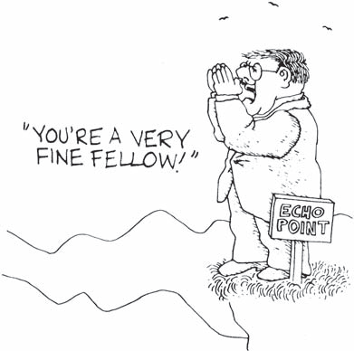
Communication and the Self
Changing Your Self-Concept
Have a realistic perception of yourself
Have realistic expectations
Have the will to change
Have the skill to change
  Seek Advice
  Observe Models

Slide 22
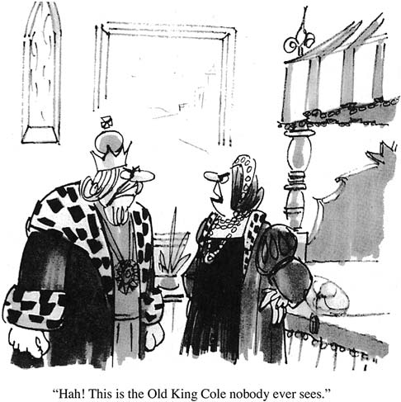
Communication as Identity Management
Public and Private Selves
  Perceived Self (Private)
    A reflection of the self concept
  Presenting Self (Public)
    The way we want others to view us

Slide 23
Communication as Identity Management
Constructing Multiple Identities
Common Identities
  Respectful Student
  Joking Friend
  Friendly Neighbor
  Helpful Worker
Constructing multiple identities is an element of communication competence
Why you act differently depending on where you are, who you’re with.

Slide 24
Communication as Identity Management
Why Manage Identities
We manage our identities to:
  Start and manage relationships
  Gain compliance of others
    Why we communicate/Getting others to behave/think a certain way
  Save the face of others
    We often modify the way we present ourselves to support the way others want to be seen
  Explore new selves

Slide 25
Communication as Identity Management
Identity Management and Honesty
Managing impressions doesn’t make you a liar
Each of us has a repertoire of faces
Which face we choose to show to others is an important decision

Slide 26
Organizational Culture
Organizational culture: the actions, ways of thinking, practices, stories, and artifacts that characterize a particular organization.
We study the culture of an organization through close examination of its environment as well as through its use of symbols.
  Environment: Arrangement of desks, the room temperature, technology that is being utilized
  Symbols: Topics of conversation, vocabulary, awards

Slide 27
Johari Window of Self-Disclosure
A simple and useful tool for understanding and training self-awareness, personal development, improving communications, interpersonal relationships, group dynamics, team development and intergroup relationships.
Created by two psychologists named Joe and Harry.
  Joe + Harry = Johari

Slide 28
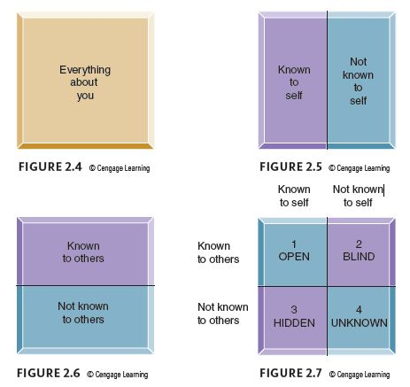
Johari Window of Self-Disclosure
1. Open area, open self, free area, free self, or 'the arena‘: what is known by the person about him/herself and is also known by others.
2. Blind area, blind self, or 'blindspot‘: what is unknown by the person about him/herself but which others know
3. Hidden area, hidden self, avoided area, avoided self or 'façade’: what the person knows about him/herself that others do not know
4. Unknown area or unknown self: what is unknown by the person about him/herself and is also unknown by others

