Slide 1
Perception
Chapter 3

Slide 2


Slide 3
What is perception?
Perception is the active process of assessing information in your surroundings.
It involves becoming aware of one's environment in a way that is unique to the individual and is strongly influence by communication.

Slide 4
Activity #1
OCEAN

Slide 5
What is perception?
Perception is the active process of assessing information in your surroundings.
It involves becoming aware of one's environment in a way that is unique to the individual and is strongly influence by communication.

Slide 6
The perception process
Selection
Organization
Interpretation
Negotiation

Slide 7
selection
We consciously and unconsciously select which impressions we will attend to.
Determining factors in selecting include:
  Intense Stimuli
  Repetition
  Contrast/change in stimuli
  Motives

Slide 8

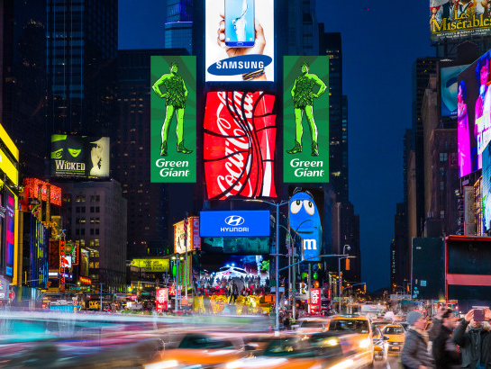
selection
Intense Stimuli
  Larger, louder, brighter stand out.

Slide 9
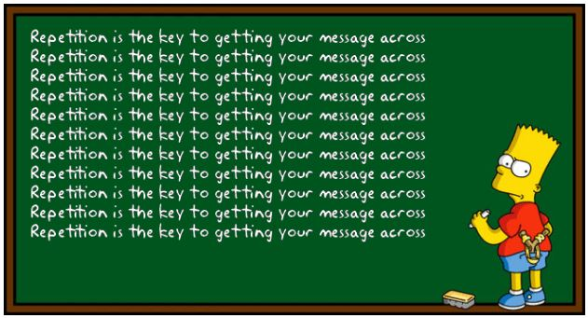
selection
Repetition
  This attracts attracts attracts attract attracts attracts attention.

Slide 10
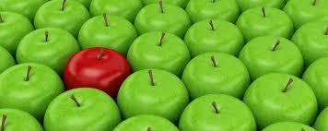
selection
Contrast/change in stimuli
  ThInGs THAT don’t CHaNGe Are lESS NOticeABLe.

Slide 11

selection
Motives
  You notice what is on your mind.

Slide 12

Organization
What you see depends on how you organize information.

Slide 13
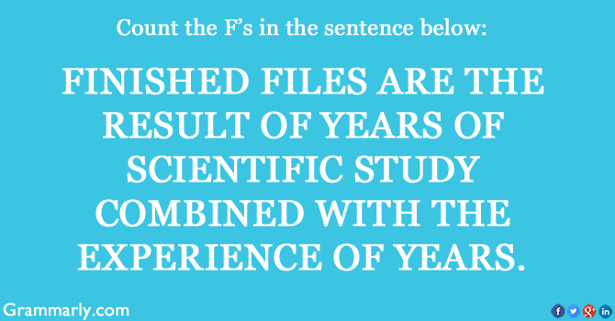

Slide 14


Slide 15


Slide 16
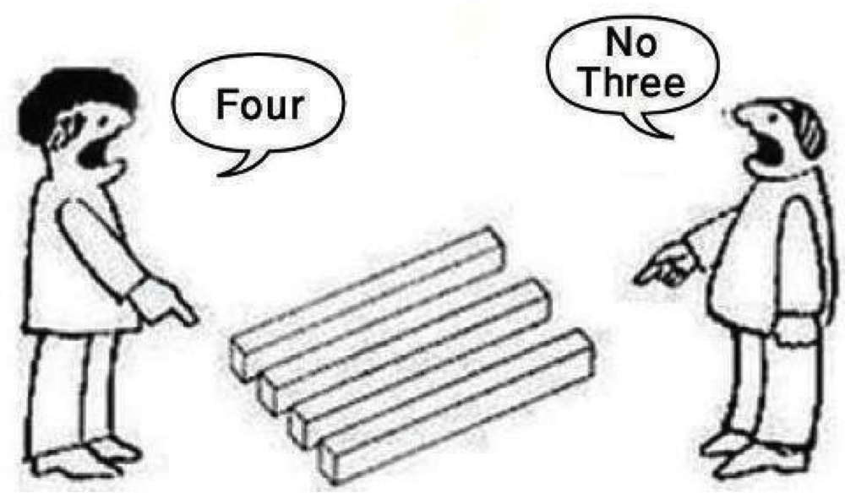

Slide 17
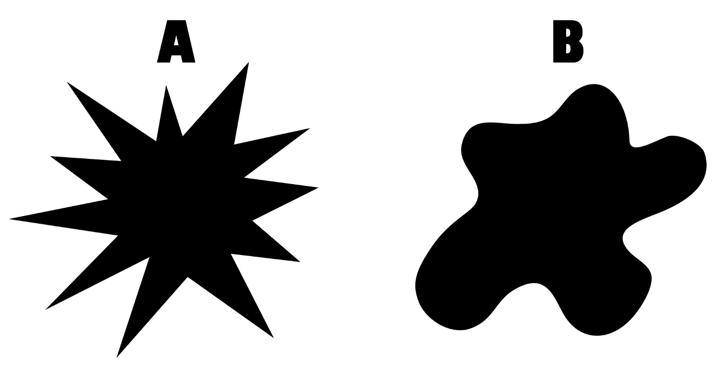

Slide 18
Organization
There are more than just two ways to organize information.
Classifying people according to appearance:
  Male or female
  Beautiful or ugly
  Heavy or thin
  Young or old
The way we organize information of other people impacts how we communicate with them.

Slide 19
Organization
Organization can lead to generalizations.
  Over exaggerated generalizations are called stereotypes.
  Stereotypes may be based on kernels of truth, but they go beyond the facts at hand and usually have no valid basis.
Women are _____. Men are _____. Vegans are _____. Old people are ____.
  Do you often categorize people on the basis of an easily organized characteristic?
  Do you ascribe a set of characteristics to most or all members of a category?
  Do you apply the set of characteristics to any member of the group?
Why are stereotypes dangerous?

Slide 20
Organization
Punctuation- the determination of causes and effects in a series of interactions.
  What came first, the chicken or the egg?
Punctuation #1
  Nagging → Withdrawing → Nagging → Withdrawing
Punctuation #2
  Withdrawing → Nagging → Withdrawing → Nagging

Slide 21
Interpretation
Third step after selection and organization.
Our individual interpretations are influenced by:
  The degree of involvement w/the other party
  Personal experience
  Assumptions about human behavior
  Attitudes
  Expectations
  Knowledge
  Self-concept
  Relational satisfaction

Slide 22
negotiation
The process by which communicators exchange narratives in order to arrive upon a shared perspective.
  Sharing stories back and forth until common ground is reached. Narratives.
  Virtually every narrative can be described by more than one narrative.
    Children fighting.
When narrative clash, you can either hang on to your own point (perspective) and refuse to consider any other, or you can try to neogitate on at least some common ground.
Shared narratives don’t have to be accurate to be powerful.
Unshared narratives don’t always result in conflict.

Slide 23


Slide 24
Activity #2
You are driving down the road.
A limo pulls up next to you.
The passenger rolls down the window.

Slide 25
Influences on Perception
There are many influences that cause us to select, organize, interpret, and negotiate information.
Physiological Influences
Cultural Differences
Social Roles

Slide 26
Influences on Perception
Physiological Influences
The Senses- The differences in how each of us sees, hears, tastes, touches, and smells stimuli can affect interpersonal relationships.
  “It’s freezing in here.”
Age- Scope and experience.
Health and fatigue- Does the way you feel make you more or less sociable?
Hunger- Hangry
Biological cycles- Morning person or night person? How you handle your daily cycle.
Psychological challenges- ADD, ADHD, etc.

Slide 27
Influences on Perception
Cultural Differences
Culture- the language, values, beliefs, traditions, and customs people share and learn.
How has your perception of the world been changed by experiencing other cultures?
How has your perception of SUU been changed by experiencing other campuses?
Ethnocentrism- the attitude that one's own culture is superior to others.

Slide 28
Influences on Perception
Social Roles
From the time we’re born, each of us are indirectly taught a whole set of roles we’re expected to play.
How do you act with friends?
How do you act with family?
Gender roles
  Sex refers to biological characteristics of a male or female.
  Gender refers to the social and psychological dimensions of masculine and feminine behavior.
Occupational roles
Relational roles- “Who am I?”

Slide 29
Influences on Perception
Physiological Influence
Cultural Differences
Social Roles
The senses
Age
Health and fatigue
Hunger
Biological cycles
Psychological challenges
“the language, values, beliefs, traditions, and customs people share and learn.”
Ethnocentrism- the attitude that one's own culture is superior to others.
Gender roles
Occupational roles
Relational roles

Slide 30
Common Tendencies
We judge ourselves more charitably than others.
  We seldom give others the “benefit of doubt,” but expect them to give it to us.
  Self-serving bias.
  Whose fault was it the last time you got a bad grade?
We cling to first impressions.
  Keep an open mind and be willing to change your opinion.
  Halo effect.

Slide 31
Common Tendencies
We assume that others are similar to us.
  People with low self-esteem assume others view them unfavorably.
  People with high self-esteem assume others view them favorably, too.
We are influenced by the obvious.
  The most obvious factor is not necessarily the only one, or the most significant.

Slide 32
Empathy
The ability to re-create another person’s perspective, or to experience the world from the other’s point of view.
  Perspective taking
  Emotional
  Concern
Sympathy is viewing another person’s situation from your point of view.
Empathy is viewing another person’s situation from their point of view.

Slide 33
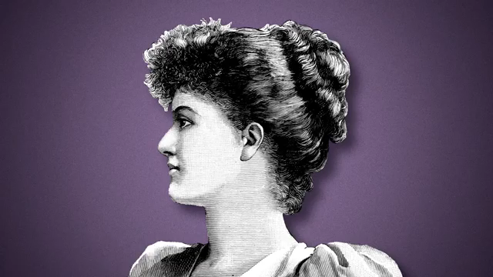
Brene Brown - Empathy

Slide 34

Cognitive complexity
Cognitive complexity- The ability to
construct a variety of frameworks
for understanding an issue.
Cognitive complexity increases the
chances of satisfying
communication in a variety of
contexts.

