Slide 1
Emotions
Chapter 4

Slide 2
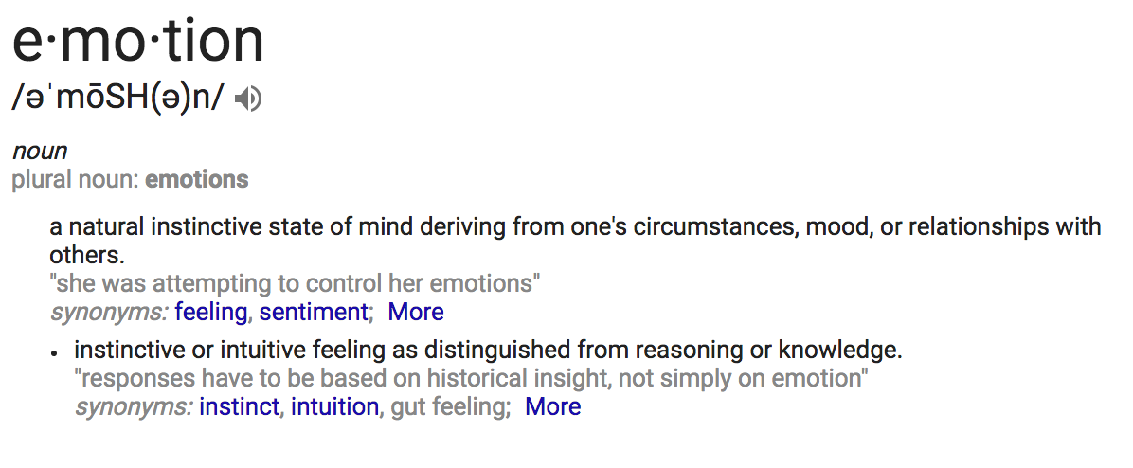
What Are Emotions?

Slide 3
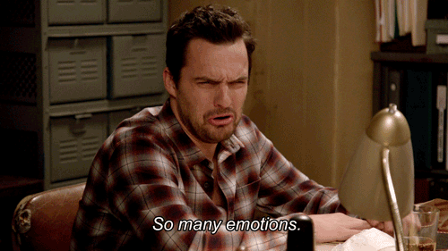
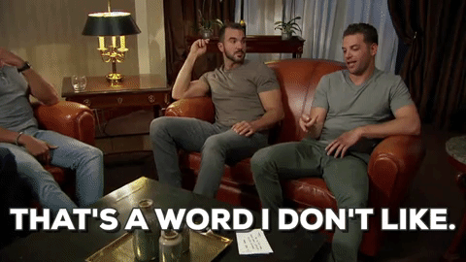
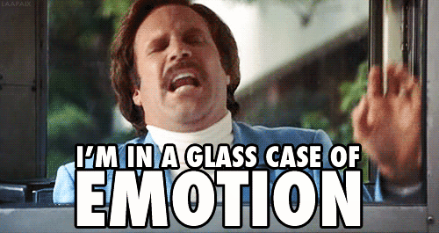
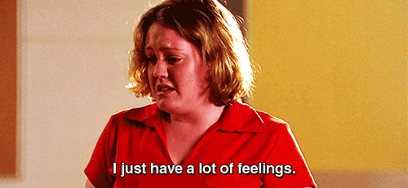

Slide 4
What Are Emotions?
Capture with your neighbor for 10 minutes.
What are the different factors of emotions?
What are the major influences on your emotional expression?
What were the major points (central messages) that stood out to you in this chapter?

Slide 5
What Are Emotions?
How would you explain emotions to a toddler?
Feelings vs. Emotions

Slide 6
What Are Emotions?
Emotions involve a number of factors, including:
  Physiological Factors
  Nonverbal Reactions
  Cognitive Interpretations
  Verbal Expressions

Slide 7
What Are Emotions?
Physiological Factors- Things your body does when experiencing emotion.
    Outward physical changes.
    Sometimes noticeable, sometime not.
    Physical components of fear: Increased heart rate, rise in blood pressure, increase in adrenaline secretions.

Slide 8
What Are Emotions?
Nonverbal Reactions- Outward physical changes.
  Unintentional communication
  Facial expressions, posture, etc.
  Affirmations

Slide 9
What Are Emotions?
Cognitive Interpretations- The role your mind plays in determining emotional states.
  Cognition- The mental action or process of acquiring knowledge and understanding through thought and experiences.
    The symptoms of fear discussed earlier are similar to those of excitement, joy and other emotions
    Reappraisal- Rethinking the meaning of emotionally charged events in ways that alter their emotional impact.

Slide 10
What Are Emotions?
Verbal Expression- Sometimes words are necessary to express feelings.
    A new acquaintance mistaking your friendlessness as a come-on.
    We simply cannot rely on perceptiveness to be sure that a message is communicated and understood accurately.
    What happens if you are not able to talk about emotions constructively?

Slide 11
Influences on Emotional Expression
Most people rarely express their emotions verbally.
  Why?
  People are usually comfortable making statements of fact, look for opportunities to share opinions, but rarely disclose how they feel and express genuine emotion.
Some influences include:
  Personality
  Culture
  Gender
  Social Conventions
  Fear

Slide 12
Influences on Emotional Expression
Personality
There is a clear relationship between personality and the way we experience and express emotions
How would you expect an extraverted person to report their emotions?
What about mediated communication?

Slide 13
Influences on Emotional Expression
Culture
Do you come from individualistic or collectivistic culture?
  Individualistic (United States and Canada): These cultures feel comfortable revealing their emotions to people with whom they are close
  Collectivistic (Japan and India): These cultures prize harmony and discourage expressions of negative emotions which may upset relationships

Slide 14
Influences on Emotional Expression
Gender
Biological sex is the best predictor of the ability to detect/interpret emotional expression.
  Research suggests that women are more attuned to emotions than men.
  Women are more likely to express emotion than men.
  Boys Will Be Girls
  https://www.youtube.com/watch?v=gspaoaecNAg
  Girls Will Be Boys
  https://www.youtube.com/watch?v=paNiEdFTvuA

Slide 15
Influences on Emotional Expression
Social Conventions
The unwritten rules of communication discourage the direct expression of emotion
  How many genuine emotional expressions do you see in daily life?
  Emotional Labor- Managing or even suppressing emotions is both appropriate and necessary.

Slide 16
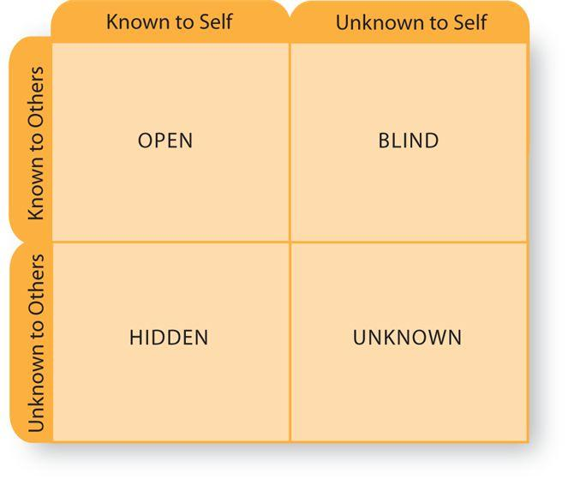
Influences on Emotional Expression
Fear of Self-Disclosure
In a society that discourages the expression of emotions, revealing them can seem risky.
  Why?

Slide 17
Influences on Emotional Expression
Emotional Contagion
The process by which emotions are transferred from one person to another.
Is it possible to catch someone’s mood?
  Emotions become more infectious with prolonged contact.

Slide 18
Story Time
Emotions include:
  Physiological Factors
    What your body does
  Nonverbal Reactions
    Unintentional communication
  Cognitive Interpretations
    How your mind interprets the situation
  Verbal Expression
    Using words
Influences on emotion:
  Personality
  Culture
  Gender
  Social Convention
  Fear of Self-Disclosure
  Emotional Contagion

Slide 19
Guidelines for Expressing Emotion
There is not a universal rule for expression of emotion.
  Personality, culture, gender, play a part.
  The key is to express emotion constructively.
    Think about a time when you expressed your emotion clearly, then wish you hadn’t.
Recognize Your Feelings
  Beyond being aware, also try to identify.

Slide 20
Guidelines for Expressing Emotion
Expand your emotional vocabulary
Share multiple feelings
  You might often express anger but overlook confusion, disappointment or frustration
Consider When and Where to Express Your Feelings
Accept responsibility for your feelings
    “You’re making me angry!” try “I’m getting angry.”
    “You hurt my feelings,” say “I feel hurt when you do that.”

Slide 21
Guidelines for Expressing Emotion
Be Mindful of the Communication Channel
  Mediated Channels
    Email
    Text Message
    Voice Mail
  Is it appropriate to end a relationship via text?
  What is the result of using CAPITAL LETTERS in an instant message or email?

Slide 22
Managing Difficult Emotions
Facilitative and Debilitative Emotions
  Facilitative Emotions
    Are emotions which contribute to effective functioning
  Debilitative Emotions
    Are emotions which detract from effective functioning
  Intensity
    Anger or irritation may be beneficial
    Rage usually makes matters worse

Slide 23
Managing Difficult Emotions
Sources of Debilitative Emotions
  Physiology- Our genetic makeup
  Emotional memory
    Harmless events can trigger debilitative feelings.

Slide 24
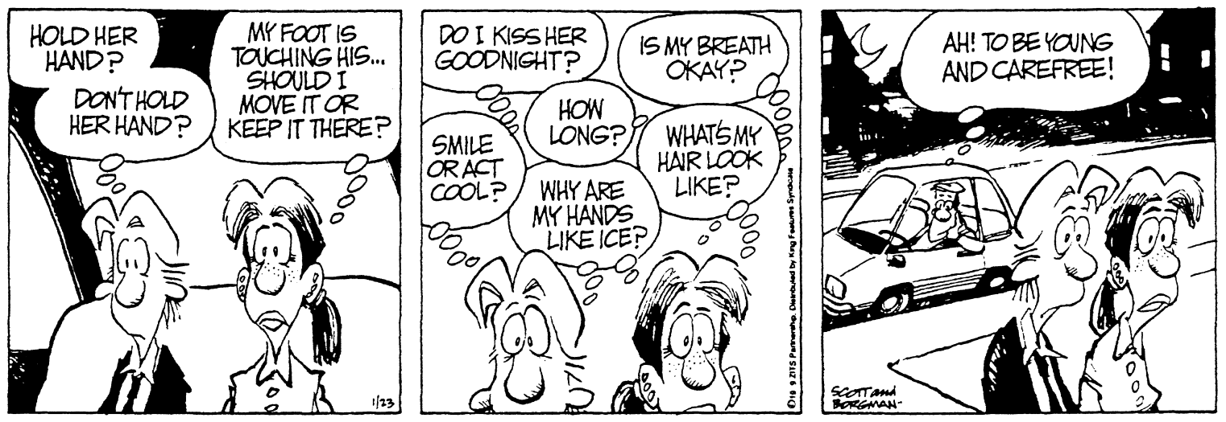
Managing Difficult Emotions
Self-Talk
  Interpretations people make of an event, during the process of self-talk that determine their feelings

Slide 25
Irrational Thinking
Emotional Fallacies
Irrational thoughts that lead to illogical conclusions and, in time, turn to debilitative emotions.
We usually aren’t aware of these thoughts, which makes them increasingly powerful.

Slide 26
Irrational Thinking
The Fallacy of Perfection
  The belief that a worthwhile communication should be able to handle every situation
The Fallacy of Approval
  That it is vital to gain the approval of virtually every person

Slide 27
Irrational Thinking
The Fallacy of Shoulds
  The inability to distinguish between what is and what should be
The Fallacy of Overgeneralization
  Basing a decision on limited information
  When we exaggerate shortcomings

Slide 28
Irrational Thinking
The Fallacy of Causation
  The irrational belief that emotions are caused by others rather than by one’s own self-talk
The Fallacy of Helplessness
  Satisfaction in life is determined by forces beyond your control
The Fallacy of Catastrophic Expectations
  The assumption that if something bad can happen, then it is going to happen

Slide 29
Managing Difficult Emotions
Monitor your emotional reactions.
Note the activating event.
Record your self-talk.
Reappraise your irrational beliefs.

Slide 30
Awkward Game Paper
Use the time I give you at the end of class to play the awkward game around campus. Write about your experience.
  What did you do?
  How did people react?
As always, I'm looking for about one page, size 10-12 font, single-spaced.
The Awkward Game
Violate social constructs:
- Sit too closely to someone
- Speak loudly in public on the phone
- Ask someone for a bite of their food
- Appropriately violate spatial zones
- Social faux pas

