Slide 1
Communication and
Relational Dynamics
CHAPTER 8

Slide 2
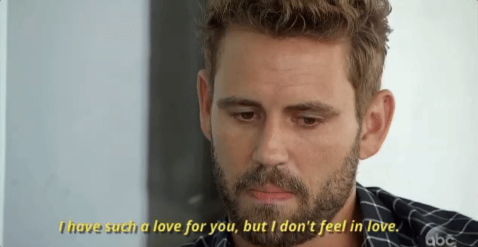


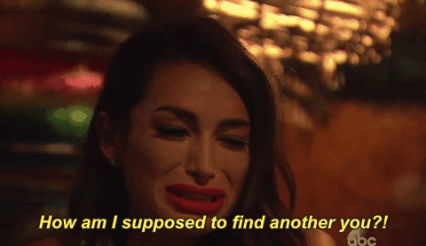
The Breakup Chapter 💔

Slide 3
Good Breakup Stories
https://www.youtube.com/watch?v=N4frP0YC2qE
https://www.youtube.com/watch?v=PjqS8iE7cS8
What’s your best breakup story?

Slide 4
Relationships
Why do you form relationships?
What do you look for in a relationship?
What characterizes a “bad” relationship?
What makes you seek out a relationship with some people and not others?

Slide 5
Why We Form Relationships
What makes us seek relationships with some people and not with others?
Appearance
Similarity
Complementary
Reciprocal Attraction
Competence
Disclosure
Proximity
Rewards

Slide 6
Why We Form Relationships
Appearance-
  The first stage of a relationship.
    Blind date study: Attractiveness matters, social skills and intelligence don’t.
  Over time appearance becomes less important.
    Pleasing personalities become more attractive.
    Physical factors become less important
  “Attractive features may open doors, but apparently, it takes more than physical beauty to keep them open.”

Slide 7
Why We Form Relationships
Similarity-
  We naturally are drawn to people who are similar to us.
    Friendships and relationships last longer the more you have in common.
    Low communication, high communication, doesn’t matter.
    Key areas outweigh trivial disagreements.
  How do you make friends in a new place?
    Egotism
  Turns to dislike when you share interests, but the other person behaves differently.
    Why?

Slide 8
Why We Form Relationships
Complementary-
  When each partner’s characteristics satisfy the other’s needs.
    Example: One person is dominant, the other passive.
    I handle the finances, you handle the decorating.
      Issues arise when these agreements are broken/threatened.
    Keeps things interesting.
      Johari Window: Discovery of new information.

Slide 9
Why We Form Relationships
Reciprocal Attraction-
  We like people who like us.
    Bolster our self-esteem.
  We don’t care for people who attack or seem indifferent to us.
    Especially those whom we judge to be insincere.

Slide 10
Why We Form Relationships
Competence-
  Talented, but still “human.”
    We want to surround ourselves with talented people, but avoid those who make us look bad.
  More impressed by “human” subjects.
    The best way to gain the liking of others is to be good at what you do, but to also admit your mistakes.

Slide 11
Why We Form Relationships
Disclosure-
  Revealing important information about yourself can build stronger relationships.
    “We also had a miscarriage,” “I broke off an engagement, too.”
  These actions suggests trust and respect.
  Reciprocity- You get back what you put out.
  Timing- A time and a place for everything.
  Only reveal important information when the other party can be trusted.

Slide 12
Why We Form Relationships
Proximity-
  We are more likely to develop relationships with those we interact with frequently.
    Who are your closest friends here?
  Proximity allows us to get more information about other people and benefit from a relationship with them.

Slide 13
Why We Form Relationships
Rewards-
  What we get out of a relationship.
  Social Exchange Theory: Rewards – Costs = Outcomes
  We do this unconsciously to decide if a relationship is worth the effort or not.
    Rewards may be tangible or intangible.
    Business relationship?
    Friendships?
    Romantic relationship?

Slide 14
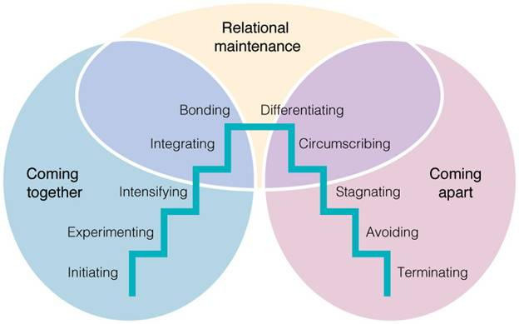
Mark Knapp’s Relational Development Model

Slide 15

Relational Development
Initiating-
  The earliest stage of a relationship.
  Shaking hands, exchanging pleasantries, etc.
  Very difficult for shy people.

Slide 16
Relational Development
Experimenting-
  The process of getting to know others by gaining more information about them.
  Searching for common ground, small talk.

Slide 17
Relational Development
Intensifying-
  Expression of feelings become more common.
  Openly discussing the state of the relationship and/or spending more time together, talking more

Slide 18
Relational Development
Integrating-
  Taking on a single identity.
  Social circles merge, traditions are formed.

Slide 19
Relational Development
Bonding-
  Public commitment.
  Symbolic gestures to show the world that a relationship exists.

Slide 20
Relational Development
Differentiating-
  When we assert our individual identities,
  Less talk about “we,” more about “me.”

Slide 21
Relational Development
Circumscribing-
  Communication decreasing in quantity and quality.
  Shrinking of interest and commitment.

Slide 22
Relational Development
Stagnating-
  Loss of enthusiasm.
  No relational growth is occurring.

Slide 23
Relational Development
Avoiding-
  Putting physical distance between you and your partner.
  Communication ceases to exist.

Slide 24
Relational Development
Terminating-
  How a relationship ends.
  Usually involves a dialogue of where the relationship has gone and a desire to disassociate.

Slide 25
Mark Knapp’s Relational Development Model

Slide 26
Bean’s Relationship Model
Fall into lust
  Physical attraction
Fall into love
  Emotional connection
Fall out of love
  Realization that partner is real/mortal.
Learn to love
  Hard work, selfless act.
The first three stages are uncontrollable, they happen to you.
Last stage is a desire to make relationship last or end.

Slide 27
Hayden’s Relationship Model
Getting Down
Friendline
Face Punch
Where does miscommunication occur in this model?

Slide 28
Problems with Relationship Models
Not all theorists agree that stage-related models like the ones are the best way to explain interaction in relationships.
  They argue that communicators seek important but inherently incompatible goals throughout virtually all of their relationships.
  The struggle to achieve these goals creates dialectical tensions.
Dialectical tensions: conflicts that arise when two opposing or incompatible forces exist simultaneously.

Slide 29
Problems with Relationship Models
Connection versus Autonomy
No one is an island.
We seek out involvement with others. But, at the same time, we are unwilling to sacrifice our entire identity to even the most satisfying relationship.
The conflicting desires for both dependence and independence are embodied in the connection-autonomy dialectic.

Slide 30
Problems with Relationship Models
Openness versus Privacy
Disclosure is one characteristic of interpersonal relationships.
Yet, along with the need to disclose, we have an equally important drive to maintain some space between ourselves and others.
These conflicting needs create the openness-privacy dialectic.
  Even the strongest interpersonal relationships require some distance.

Slide 31
Problems with Relationship Models
Predictability versus Novelty
Stability is an important need in relationships, but too much of it can lead to feelings of staleness.
The predictability-novelty dialectic reflects this tension.
Although too much familiarity can lead to the risk of boredom and stagnation, nobody wants a completely unpredictable relational partner.
  Too many surprises can threaten the foundations upon which the relationship is based.

Slide 32
Managing Dialectical Tensions
Although all of the dialectical tensions play an important role in managing relationships, some occur more frequently than others.
  Denial
  Disorientation
  Alternation
  Segmentation
  Balance
  Integration
  Recalibration
  Reaffirmation

Slide 33
Managing Dialectical Tensions
Denial
In the strategy of denial, communicators respond to one end of the dialectical spectrum and ignore the other.
  For example, a couple caught between the conflicting desires for predictability and novelty might find their struggle for change too difficult to manage and choose to follow predictable, if unexciting, patterns of relating to each other.

Slide 34
Managing Dialectical Tensions
Disorientation
In this strategy, communicators feel so overwhelmed and helpless that they are unable to confront their problems.
  In the face of dialectical tensions, they might fight, freeze, or even leave the relationship. Two people who discover soon after the honeymoon that a “happily ever after,” conflict-free life isn’t realistic might become so terrified that they would come to view their marriage as a mistake.

Slide 35
Managing Dialectical Tensions
Alternation
Communicators who use this strategy choose one end of the dialectical spectrum at some times and the other end at other times.
  Friends, for example, might manage the connection-autonomy dialectic by alternating between times when they spend a large amount of time together and other times when they live independent lives.

Slide 36
Managing Dialectical Tensions
Segmentation
Partners who use this tactic compartmentalize different areas of their relationship.
  For example, a couple might manage the openness-privacy dialectic by sharing almost all their feelings about mutual friends with each other, but keeping certain parts of their past romantic histories private.

Slide 37
Managing Dialectical Tensions
Balance
Communicators who try to balance dialectical tensions recognize that both forces are legitimate and try to manage them through compromise.
  A compromise is inherently a situation in which everybody loses at least a little of what he or she wants.
  A couple caught between the conflicting desires for predictability and novelty might seek balance by compromising with a lifestyle that is neither as predictable as one wants nor as surprise-filled as the other wants—not an ideal outcome.

Slide 38
Managing Dialectical Tensions
Integration
With this strategy, communicators simultaneously accept opposing forces without trying to diminish them.
  Communication researcher Barbara Montgomery describes a couple that accepts the needs for both predictability and novelty by devising a “predictably novel” approach: Once a week they would do something together that they had never done before.
  In a similar way, some stepfamilies manage the tension between the “old family” and the “new family” by adapting and blending their family rituals.

Slide 39
Managing Dialectical Tensions
Recalibration
Communicators can respond to dialectical challenges by reframing them so that the apparent contradiction disappears.
  For example, a change in thinking can transform your attitude from loving someone despite your differences to loving him or her because of those differences.
  Or consider how two people who each felt hurt by each other’s unwillingness to share parts of his or her past might redefine the secrets to create an attractive aura of mystery, instead of seeing them as a problem to be solved.
  The desire for privacy would still remain, but it would no longer compete with a need for openness about every aspect of the past.

Slide 40
Managing Dialectical Tensions
Reaffirmation
This strategy acknowledges that dialectical tensions will never disappear.
  Instead of trying to make them go away, reaffirming communicators accept—or even embrace—the challenges that the tensions present.
  The metaphorical view of relational life as a kind of roller coaster reflects this strategy, and communicators who use reaffirmation view dialectical tensions as part of the ride.

Slide 41
Relationships Specifics
Relationships are constantly changing.
  That is okay! Normal, constantly repeating.
Relationships are affected by culture.
  How?
Relationships require maintenance.
  Positivity, Openness, Assurances, Social networks, Sharing tasks.
Relationships require commitment.
  Can be implicit or explicit

Slide 42
Repairing Damaged Relationships
Relational transgression- When one partner violates the explicit or implicit terms of the relationship, letting the other person down in some important way.
  Minor vs. Significant
  Social vs. Relational
  Deliberate vs. Unintentional
  Once vs. Incremental

Slide 43
Repairing Damaged Relationships
Research shows an apology requires three elements for the best chance of repairing a damaged relationship:
  An explicit acknowledgement that the transgression was wrong.
    “I acted like a selfish jerk.”
  A sincere apology.
    ”I’m really sorry, I feel awful for letting you down.”
  Compensation
    “If I act that way again, please call me on it.”

Slide 44
Repairing Damaged Relationships
Research suggests that most effective conversations about forgiveness contain two elements:
  An explicit statement.
    “I can’t forget what you did, but I believe your apology and I accept it.”
  A discussion of the implications of the transgression and the future of the relationship.
    ”I have to be honest, it’s going to take time before I can trust you again.”

