Slide 1
Intimacy in relationships
Chapter 9

Slide 2
Intimacy in Relationships
Dimensions of Intimacy
Intimacy- A state of “close union, contact, association, or acquaintance.”
When college students were asked to identify their “closest, deepest, most involved relationship”
  47% said their romantic partner
  36% said a close friend
  14% cited a family member

Slide 3
Intimacy in Relationships
Dimensions of Intimacy
Physical
Intellectual
Emotional
Shared Activities

Slide 4
Intimacy in Relationships
Masculine and Feminine Styles
Research shows that women are somewhat more willing than men to share their feelings.
  In terms of amount and depth:
    Female – Quality and quantity
    Male – Less likely to disclose feelings
Generalizations do not apply to every person.
Biological sex is not as important as the chosen gender role when expressing emotion.

Slide 5
Intimacy in Relationships
Intimacy in Mediated Communication
Studies show that intimacy may develop more quickly through mediated channels.
Instant messaging, emailing, and text messages offer more constant contact with friends, family and partners.
Communicators chose varying levels of self-disclosure.

Slide 6
Intimacy in Relationships
The Limits of Intimacy
It is impossible to have a close relationship with everyone.
Obsession with intimacy can lead to less satisfying relationships.
Intimacy is rewarding but it isn’t the only way of relating to others.

Slide 7
Self-Disclosure in Relationships
Self-Disclosure
  The process of deliberately revealing information about oneself that is significant and would not normally be known by others
Characteristics of Self-Disclosure
  Usually occurs in dyads
  Incremental
  Relatively scarce
  Best in context of positive relationships

Slide 8
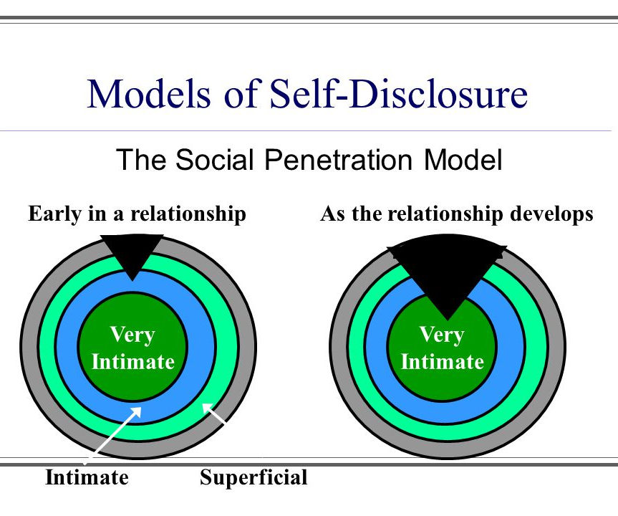
Self-Disclosure in Relationships
Degrees of Self-Disclosure
Not all self-disclosure is equally revealing.
Depth of self-disclosure and the types of information we share.
  Clichés
  Facts
  Opinions
  Feelings

Slide 9

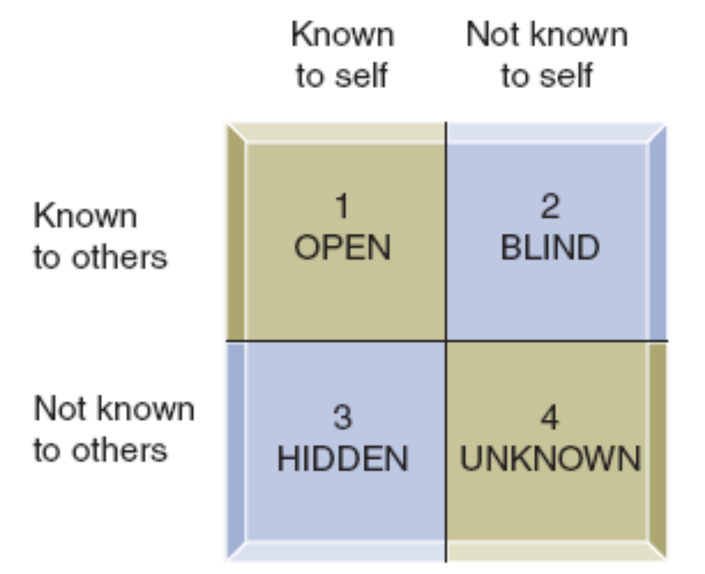
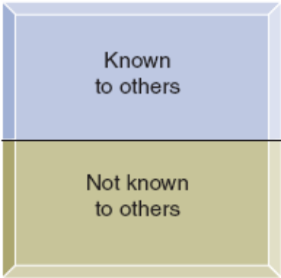
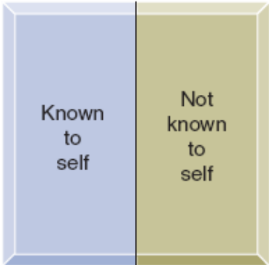
Self-Disclosure in Relationships

Slide 10
Self-Disclosure in Relationships
Benefits and Risks of Self-Disclosure
Benefits
  Catharsis
    Getting something off your chest
  Reciprocity
    Self-disclosure usually begets another
    There is no guarantee that disclosure will be reciprocal
  Self-Clarification
    Used to clarify your beliefs, opinions, thoughts
    Can occur with hairdressers, bartenders or close friends

Slide 11
Self-Disclosure in Relationships
Benefits (cont.)
  Self-Validation
    Disclosing information with the hope of obtaining the listener’s approval.
  Identity Management
    Sometimes we reveal personal information to make ourselves more attractive.
  Relationship Maintenance and Enhancement
    There is a strong relationship between the quality of self-disclosure and marital satisfaction.
  Social Influence
    Revealing personal information may increase your control over the other person and sometimes over the situation.
    The strongest factor in why we disclose seems to be how well we know the other person.
    With strangers, reciprocity becomes the most common reason for disclosing.

Slide 12
Self-Disclosure in Relationships
Benefits and Risks of Self-Disclosure
Risks
  Rejection
    A: “I’m starting to think of you as more than a friend. To tell the truth, I love you.”
    B: “I think we should stop seeing one another.”
  Negative Impression
    A: “I’ve been thinking that we should get another dog.”
    B: “To tell you the truth, I really don’t like dogs. I haven’t said so before because I know how much you love them.”

Slide 13
Self-Disclosure in Relationships
Risks (cont.)
  Decrease in Relational Satisfaction
    A: “I need to tell you something. I really don’t like it when you want to cuddle so much.”
    B: “But I want to be close to you. . . “
  Loss of Influence
    A: “I’d like to give you the weekend off, but to tell you the truth, I don’t get to make any judgment calls around here. My boss makes all the decisions.”
    B: “ I guess I know who to ask if I want anything done.”
  Hurting the Other Person
    A: “I’m so ugly! I can’t think of anything that will change the way I look.”
    B: “Neither can I.”

Slide 14
Self-Disclosure in Relationships
Guidelines for Self-Disclosure
Do you have a moral obligation to disclose?
Is the other person important to you?
Are the amount and type of disclosures appropriate?
Is the risk of disclosing reasonable?
Is the disclosure relevant to the situation?
Will the effect be constructive?
Is the self-disclosure clear and understandable?
Is the self-disclosure reciprocated?

Slide 15
Alternatives to Self-Disclosure
Alternatives to Self-Disclosure
Silence
Lying
  To save face
  To avoid tension or conflict
  To guide social interaction
  To expand or reduce relationships
  To gain power
Equivocation
  Language that has two or more equally plausible meanings
    “You will be lucky to get this person to work for you.”
    “I recommend this candidate with no qualifications.”
    “Waste no time hiring this person.”

Slide 16
Alternatives to Self-Disclosure
Hinting
  A hint aims to get a desired response
    Direct Statement
      “I’m too busy to continue with this conversation.”
    Face-Saving Hint
      “I know you’re busy; I better let you go.”
    Direct Statement
      “Please don’t smoke in here because it’s bothering me.”
    Face-Saving Hint
      “I’m pretty sure that smoking isn’t permitted here.”

Slide 17
Alternatives to Self-Disclosure
The Ethics of Evasion
Times when we are not likely to challenge statements that we know are untrue:
  When we expect the other to tell a fib or lie
  When the lie is mutually advantageous
  When a lie helps us avoid embarrassment
  When the lie helps us avoid confronting an unpleasant truth
  When we have asked the other person to lie

