Slide 1

Using LinkedIn Effectively

Slide 2
What is LinkedIn?
LinkedIn is a social networking site designed specifically for the business community. The goal of the site is to allow registered members to establish and document networks of people they know and trust professionally.
A LinkedIn member’s profile page, which emphasizes employment history and education, has professional network news feeds and a limited number of customizable modules. Basic membership for LinkedIn is free. Network members are called “connections.” Unlike other free social networking sites like Facebook or Twitter, LinkedIn requires connections to have a pre-existing relationship.
https://www.linkedin.com/static?key=what_is_linkedin

Slide 3
What is LinkedIn?
LinkedIn is a social network.
  Think Facebook for professionals, but not the place to update your relationship status.
LinkedIn is free to use.
LinkedIn is a way to distribute your résumé.
LinkedIn is a way to find your next job.

Slide 4
Effective LinkedIn Profiles
Great LinkedIn profiles feature:
  A recent, professional photo and headline.
  Summary and introduction.
  Education information.
  Work history.
  Recommendations.
  Well-developed skills and endorsements list
  Recent contact information.
  When finished, start connecting.

Slide 5

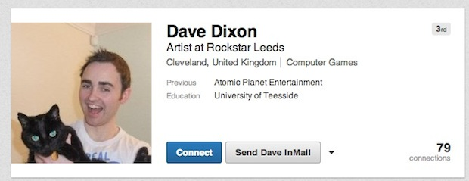
Photo & Headline
Good
Bad

Slide 6
Summary & Introduction
Good
Bad
Paul H. Simon
“No one is good at everything. As much as you may be in command of your core offering, chances are your messaging doesn’t quite make the grade.
I help business get their messages out clearly, concisely and accurately. My writing, editing and webinar management services help clients who struggle with….”
Stereotypical Buzzwords
“A dynamic leader with the ability to drive change and proven track record of high accomplishments in various areas.
Highly organized individual, believes in empowerment and team work, highly adaptable, strong business sense, effective communicator, results-oriented, and can-do attitude.”

Slide 7
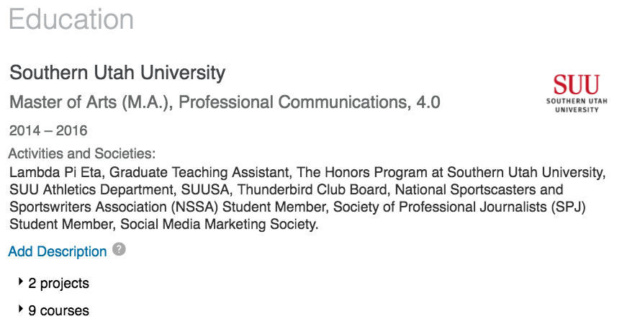
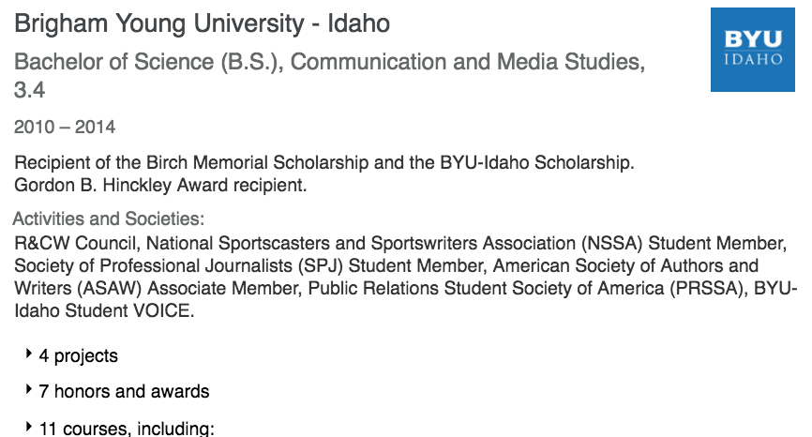
Education History
If you’re a good student, show off your academic accomplishments.
Placement of educational history in your LinkedIn profile depends on industry you’re looking to enter.

Slide 8
Displaying Work History
Do
Don’t
Display first-person experience summaries.
Use bulleted information.
Outline publications and project work.
List of activities including:
  volunteer initiatives,
  certifications,
  and third party interests.
Use buzzwords.
Lie about employment and/or responsibilities and duties.
Write too much.

Slide 9
Recommendations
A recommendation is a comment written by a LinkedIn member to recognize or commend a colleague, business partner, or student. Viewers of your profile often view the recommendations you've received on your profile to see what others have to say about your work.
The best recommendations come from people who value your work, services or products, such as managers, colleagues, co-workers, customers, and clients. Hiring managers and people searching for new customers and business partners prefer to work with people who come recommended by someone they know and trust. There's no limit to the number of recommendations you can request or give.

Slide 10
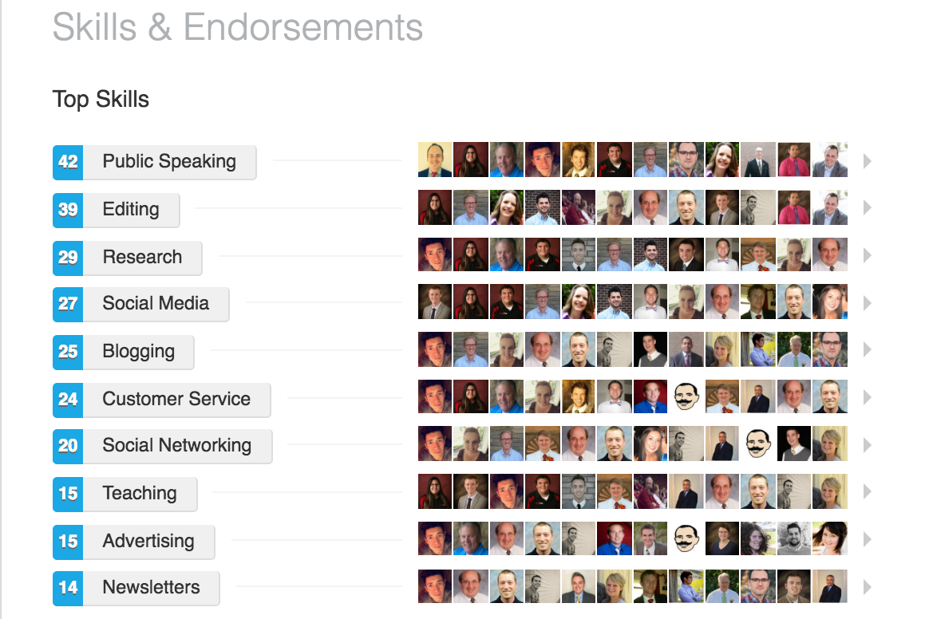
Skills & Endorsements
Skill endorsements allow your connections to validate the strengths found on your own profile.

Slide 11
Contact Information
You can send and receive messages from anyone on LinkedIn.
Your profile can also feature links to your:
  Personal email,
  Twitter or Facebook accounts,
  Blog,
  Website,
  Phone and/or Skype.

Slide 12
Connect with the World
Once you’re satisfied with your profile, start finding connections.
Connections include:
  Former employers and co-workers,
  Former professors and classmates,
  Friends and family,
  Anyone else who you’ve worked with.
You can also connect with those you’d like to work with.

Slide 13
Why I Use LinkedIn?
It has been a valuable networking tool for me.
  Stay in touch with former co-workers and supervisors.
  Introduce myself before an interview.
  Stay up to date on industry trends.
I have received job offers over LinkedIn.
Many companies are asking for a link to your LinkedIn account instead of a traditional résumé.

