Slide 1

Podcasting 101
Produce, Post, Promote

Slide 2
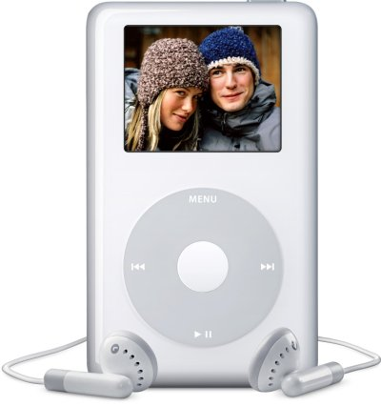
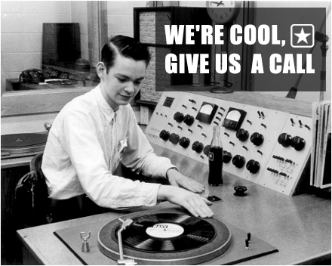
What is a Podcast?
+
iPod
broadcast

Slide 3
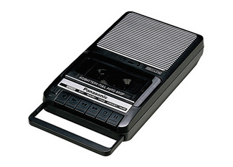
What is a Podcast?
So, what’s new?

Slide 4

What is a Podcast?
Enormous distribution

Slide 5
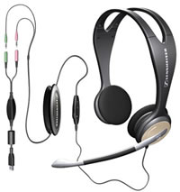
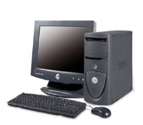
What is a Podcast?
Cheap to produce so many more available

Slide 6
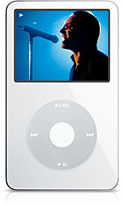
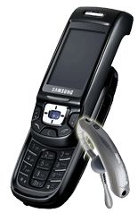

What is a Podcast?
Any MP3 player

Slide 7
What is a Podcast?
An audio program created for distribution via the internet
  Audio files are most often played on portable MP3 players (i.e. iPods, smart phones, etc.)
  Also played on a computer, either embedded onto a web page or downloaded to a media player (iTunes, Windows Media Player, etc.)
  Audiences can download (iTunes) or stream (apps like Stitcher or DoggCatcher)
  Podcast can be affiliated with radio stations, print or online publications, and companies/non-profits, or can stand on their own

Slide 8
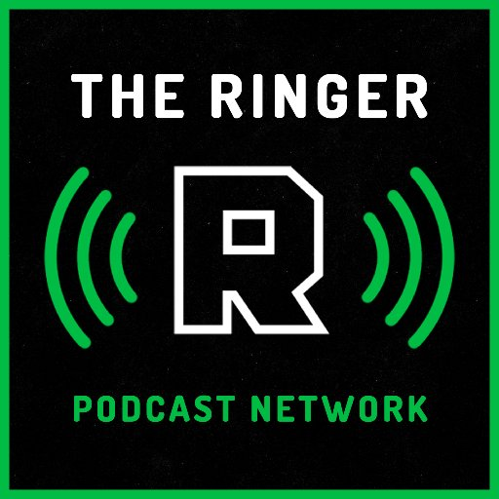




Examples of Podcasts

Slide 9
Podcasting Stats of Note
The popularity of smartphones means podcasts are more accessible than ever. More than 60% of the American public has a smartphone. (This increases to 80% of the 18- to 34-year-old demographic.)*
In 2013, the iTunes Store eclipsed 1 billion podcast subscriptions.
*Inﬁnite Dial 2014 study, the latest from Edison Research on consumer adoption of digital media

Slide 10
What Makes a Good Podcast?
  A combination of many elements, including:
    Preparation
    Personality
    Clear target audience
    Knowledge / expertise
    Storytelling and Editing
    Production quality
    Consistency

Slide 11
Getting Started: Equipment
Most basic setup:
Microphone → Cable → Computer → Headphones/Speakers
If your podcast will only have one person speaking, your simplest option is to connect a USB microphone directly into your computer.

Slide 12
Making Them
Dead simple More involved
Windows
Sound Recorder
or
Freecorder
+
Podomatic
Audacity
+
Podomatic
Audacity
+
Blog/Website
+
Feedburner

Slide 13
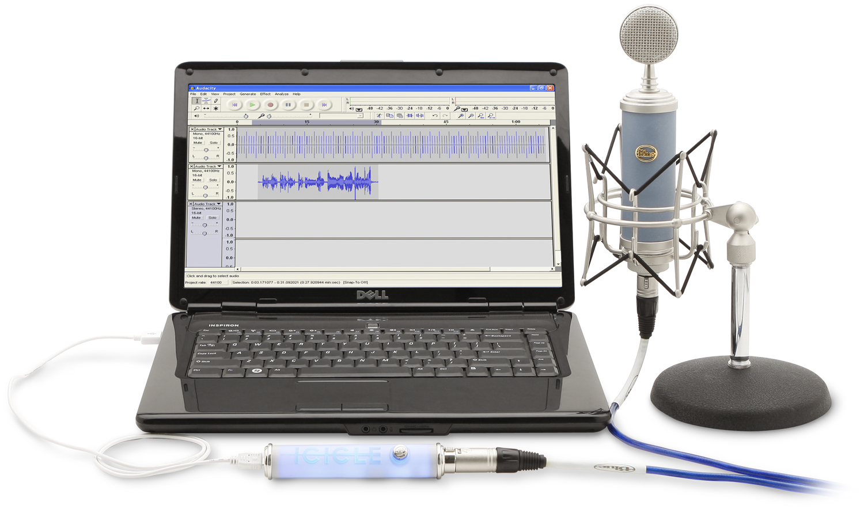
Basic Setup:

Slide 14
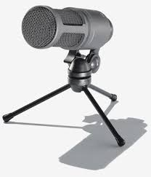
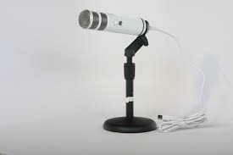
USB Microphones:
Audio Technica 2020
$150
Röde Podcaster
$229

Slide 15
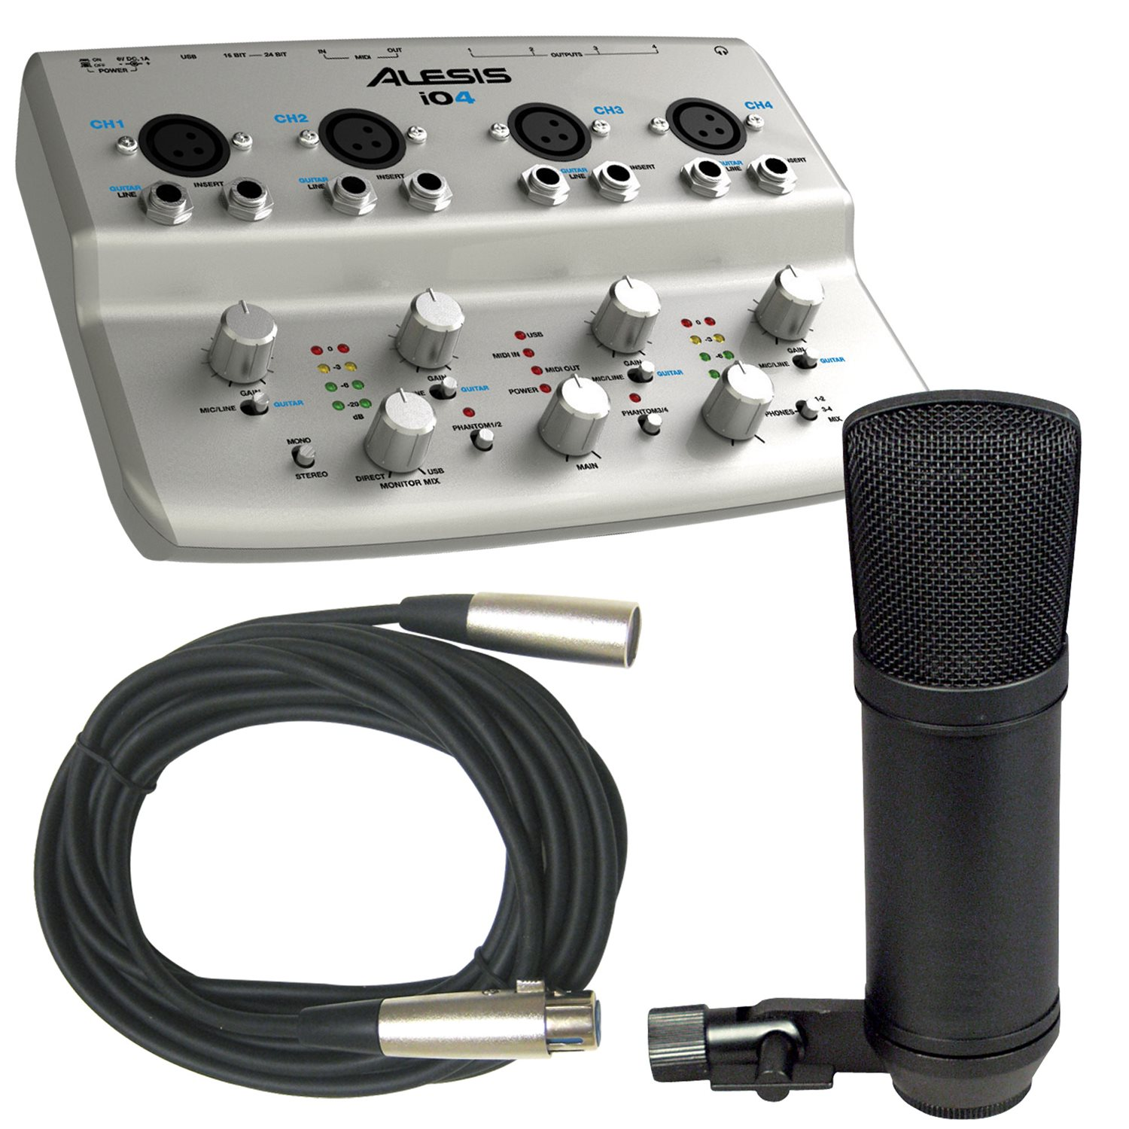
More Advanced Setup:
Microphone → cable → audio interface → computer → headphones/speakers

Slide 16

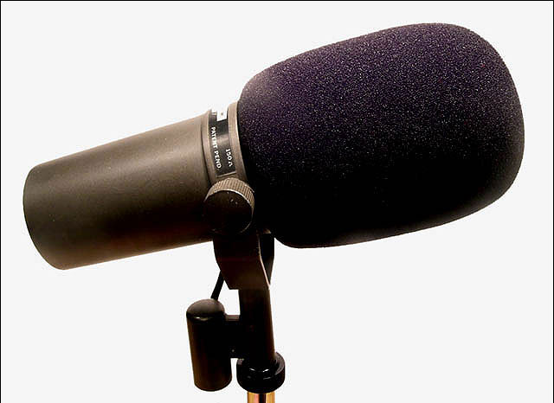
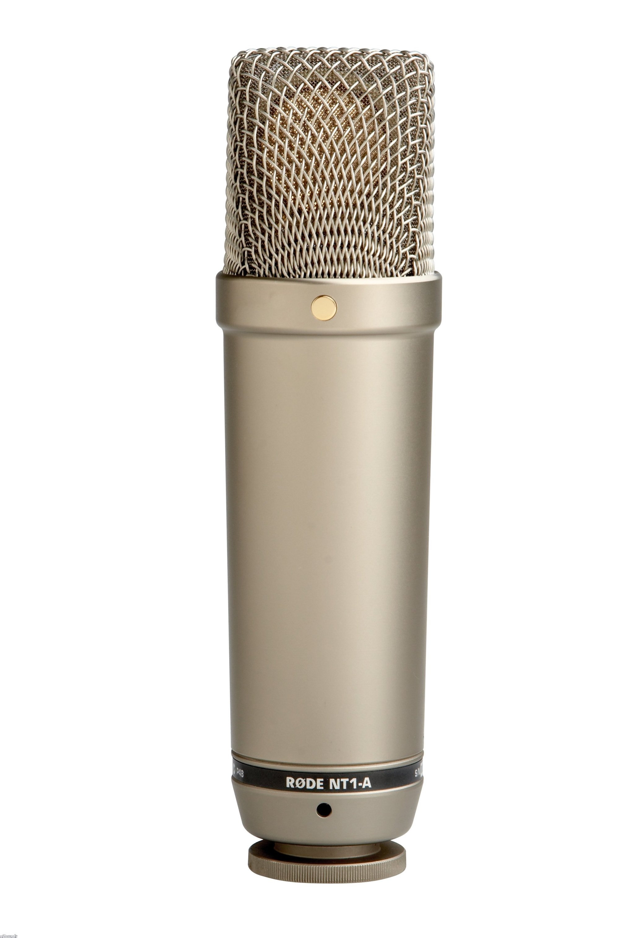

Microphones:
Electrovoice RE-20
$449
Shure SM-7B
$349
Rode NT1-A $229
Shure SM-58 $100

Slide 17
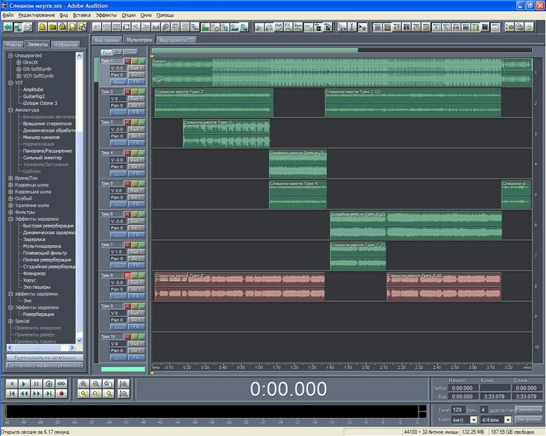
Hit Record
GarageBand
Audition
ProTools
Hindenburg
Audacity

Slide 18
Recording Considerations
The ‘deader’ the better. Avoid reflective or hard surfaces, such as windows or concrete walls. If your space includes these surfaces, you will want to ‘deaden’ them with acoustic foam, carpet, blankets, or heavy drapes.
Listen for noise. Avoid fans, air conditioning units, furnaces or other appliances that generate mechanical or electrical noise.

Slide 19
Publishing
Podcast service providers (beginner)
  Include MP3 file hosting, basic website, web MP3 player, RSS feed, reporting, smartphone apps
    Podbean (free / paid)
    Libsyn (paid)
    Hipcast
    SoundCloud
Blog service providers (intermediate)
  Plugins allow you to incorporate podcast into your existing WordPress/Blogger blogs
DIY (advanced)
  Purchase web hosting
  Create RSS feed via Feedburner, Feed Shark, Feedblitz or other alternative

Slide 20
Promotion
iTunes (get ratings)
Stitcher
Podcast Networks
Aligning with radio stations (99% Invisible, Destination DIY)

Slide 21
Promotion continued…
Social Media
  Facebook, Twitter, Google+
  Where is your audience online?
  Where are similar podcasts and blogs?
    Blogroll – link to other podcasts you like and your audience will like
Self-promotion
  Word of mouth/web
  Who’s writing about what you’re talking about?

Slide 22
Music for your podcast
Where to find royalty-free music:
www.freemusicarchive.org
www.ccmixter.com
Enlist local musicians/composers via Craigslist or college bulletin boards (and negotiate a rate).

Slide 23
Run Down (script) Example
SUU Football’s last game this weekend
  Rough season, finish strong
  Looking ahead to next season
SUU Volleyball last game
  Senior night
  Last game of Coach Hoyer’s first season
  Grade?
SUU MBB
  2-0 for first time since 2006
  Beat MWC first time since 2006
  Playing Seattle and old coach next
  Hopes/expectations for season

Slide 24
Podcasting Assignment
Work with a partner.
Create a rundown of at least three topics.
Podcast for at least 10 minutes.
Turn in the audio file and rundown together.
  Only one person in group needs to submit.
  In comments section, indicate who was in your group.
You will be given time in class on Friday to complete the assignment.

